Slide 1
Practical points
Please keep mics on mute unless you'd like to ask a question
Do please use the chat box
Trouble with sound? Trying leaving and coming back, try a different browser
The session will be recorded and put on Moodle

Slide 2
Getting into Management Consultancy
October 2026

Slide 3

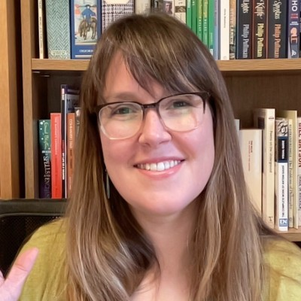
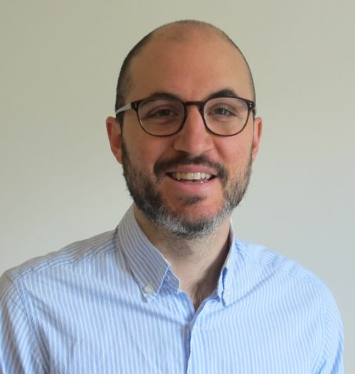
Meet the Careers Team
Fiona Telford | Lucy Hawkins | Josh Phillips
Mondays and Tuesdays | Mondays, Tuesdays and Wednesdays | Wednesdays, Thursdays & Fridays
Careers@lshtm.ac.uk

Slide 4

What we will cover
What? (is Management Consultancy)
Why? (might you consider Management Consultancy)
Who? (are the Management Consultants)
How? (do you get in)
Notes:
What - Term can be confusing. Several different perceptions of what consultancy is.
Why – something on how to connect up what it is to the skills you will be developing at LSHTM

Slide 5
What is Management Consultancy?
A definition of management consultancy from the Institute of Consulting
'The provision to management of objective advice and assistance relating to the strategy, structure, management and operations of an organisation in pursuit of its long-term purposes and objectives. Such assistance may include the identification of options with recommendations; the provision of an additional resource; and/or the implementation of solutions.'

Slide 6
What is Management Consultancy?
A definition of management consultancy from the Institute of Consulting
'The provision to management of objective advice and assistance relating to the strategy, structure, management and operations of an organisation in pursuit of its long-term purposes and objectives. Such assistance may include the identification of options with recommendations; the provision of an additional resource; and/or the implementation of solutions.'
Assessing and evaluating
Researching (qual and quant)
Analyzing and presenting evidence
Change management
Improving efficiency, productivity, profit, market share
Forward planning
Horizon scanning
Synthesizing data
Advising/coaching
Delivering a project

Slide 7

Why consider management consultancy?
Quality of training and development provided
Generous salary
Variety and travel
Highly selective recruitment: badge of quality
Transferable business skills, e.g.
“We use a business-minded approach to shape healthcare markets to reduce the costs of lifesaving medications, diagnostics, and other health products in low- and middle-income countries. We work with governments to reform their health systems, targeting areas where current approaches are failing, moving too slowly, or at a scale that leaves too many dying or suffering needlessly.”
Notes:
Consultancy firms often provide good training and career development. Many other organisations value those skills. CHAI is an example of an organization built on a similar model to consultancy. (They often advertise jobs on our job feed). Use business minded approach to improve access to health (antiretrovirals in HIV was where they started). Got health ministries to agree to minimum purchase so they negotiated price with pharma. Example of how to get benefit of training and add business mind to your skills perhaps move on to something that needs both.

Slide 8
Who?
Big Four and generalist firms:
Deloitte, EY, KPMG, PwC, Accenture, Capgemini Invent, FTI Consulting, Mercer
Strategy firms:
McKinsey, BCG, Bain, Kearney, Oliver Wyman, Roland Berger
EY-Parthenon, Monitor Deloitte, Strategy&
Eden McCallum, Mars Co, Elixirr, Ipsos Strategy3, L.E.K. Consulting
Life sciences and health specialist: IQVIA, ZS Associates, Putnam (Inizio), Clarivate, Frost & Sullivan, Simon-Kucher, Trinity Life Sciences, Health Advances, Blue Matter, Syneos Health
Generalist firms with particular health expertise: e.g. Kantar Health, Newton Impact
Health economics and HEOR: Office of Health Economics (OHE), York Health Economics Consortium, Costello Medical, Lumanity, Adelphi Values, Avalere Health, Evidera (Thermo Fisher), RTI Health Solutions, Cytel, Frontier Economics, Oxford Economics
Health systems and public sector: Carnall Farrar, PA Consulting, LCP Health Analytics, Mott MacDonald, Guidehouse, Booz Allen, Mathematica, Abt Global
International development and global health: Oxford Policy Management, Palladium, DAI Global Health, Tetra Tech, Chemonics, Genesis Analytics, Itad, Crown Agents, Dalberg, FSG, Pharos Global Health Advisors
Sustainability, environment and health: ERM, Arup, WSP, Ramboll, Jacobs, Ricardo, Anthesis, Carbon Trust, South Pole
Research, insight and policy analysis: Economist Impact, Ipsos, Kantar Public (Verian), RAND Europe, Nuffield Trust, The King's Fund
Health policy communications and public affairs: Edelman, APCO Worldwide, FleishmanHillard, Weber Shandwick, Hanover Communications, Incisive Health, Portland Communications
Asia-based health consultancies: Asia Care Group, Solidiance, Vriens & Partners, Frost & Sullivan Asia
Notes:
Life sciences and health specialist: IQVIA, ZS Associates, Putnam (Inizio), Clarivate, Frost & Sullivan, Simon-Kucher, Trinity Life Sciences, Health Advances, Blue Matter, Syneos Health
Health economics and HEOR: Office of Health Economics (OHE), York Health Economics Consortium, Costello Medical, Lumanity, Adelphi Values, Avalere Health, Evidera (Thermo Fisher), RTI Health Solutions, Cytel, Frontier Economics, Oxford Economics
Health systems and public sector: Carnall Farrar, PA Consulting, LCP Health Analytics, Mott MacDonald, Guidehouse, Booz Allen Hamilton, Mathematica, Abt Global
International development and global health: Oxford Policy Management, Palladium, DAI Global Health, Tetra Tech, Chemonics, Genesis Analytics, Itad, Crown Agents, Dalberg, FSG, Pharos Global Health Advisors
Sustainability, environment and health: ERM, Arup, WSP, Ramboll, Jacobs, Ricardo, Anthesis, Carbon Trust, South Pole
Big consultancies – can't guarantee to be working only on health.
MCA – uk professional body, directory of members available

Slide 9
How: common recruitment pathways
Graduate schemes - deadlines imminent for next September entry, typically big firms hiring a whole cohort of new starters. Highly competitive.
Direct hire - recruitment when needed. May use agencies to help fill specific senior or highly technical roles. Year-round.
Fixed term contracts – short term projects, bringing in specific knowledge or experience for a particular goal. Year-round, may be word of mouth
Notes:
How to get in. Grad schemes if you have little or no relevant experience – early deadline is reason for timing of these sessions. See last week's workshop for list of relevant schemes.
Smaller like Costello welcome direct approach and page on web which sets this out. Might be invited to work on a specifc project if needs more people than already work for them

Slide 10
How: typical application process
Stage | May look like | Strategy
Applications | CV and cover letter and/or application form | Use the language of the sector – match keywords, show results and tailor to selection criteria Check firm AI policy for applications
Online tests | Online or in person - numerical, verbal reasoning, personality are common | GF: practice tests
Interviews | Online or in person Strengths, competency, background, fit assessment First round may be asynchronous | Practice interview in a careers appointment eCareersGrad: Interview Success
Case study interviews | Likely more than one, could be merge into assessment centres | eCareers Grad: Master the Commercial & Consulting Case
Assessment Centre | Final assessment, group exercises, written tests, work simulation, presentations, more case study interviews | GF: Assessment Exercises

Slide 11
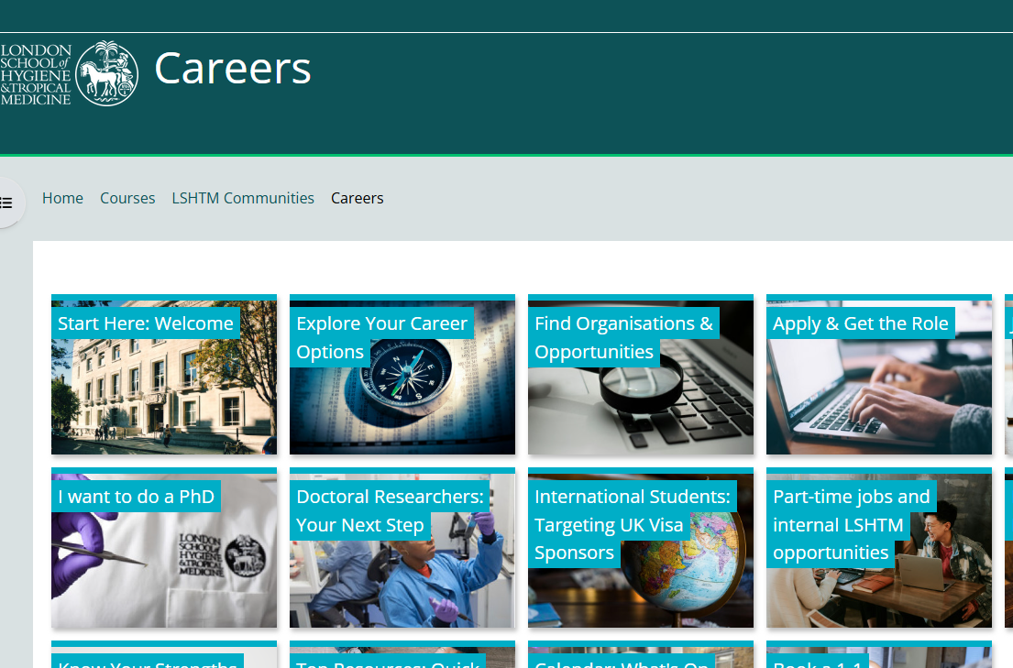

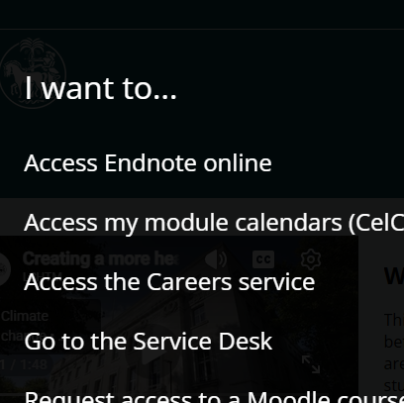
Support resources
https://ble.lshtm.ac.uk/
1
3
2

Slide 12
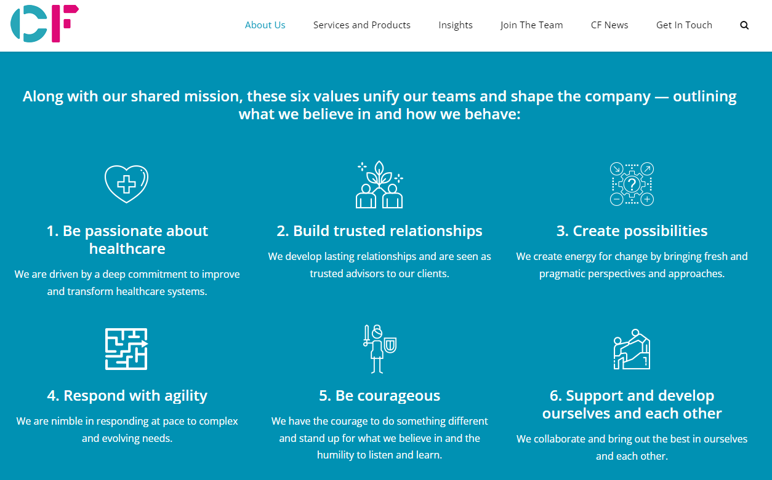
How to tailor applications: values
Notes:
CF (Carnall Farrar) does a lot of work in health care sector. Values are key to showing your 'fit' and helpful if they don't offer a list of requirements
Plus communication, problem-solving and team-working techniques

Slide 13
How to tailor applications: selection criteria
Experience in the sector or for client organisations
Communication skills
People skills
Problem solving
Analysis
Confidence
Impact
Initiative and motivation
Entrepreneurial thinking
AI Literacy
Commercial awareness
Client relationships are very important!

Slide 14
How to research for interview: commercial awareness
Try:
PESTLE analysis
SWOT analysis
FT articles
Economist articles
Business case studies:
See eCareers Grad (Apply section on Moodle)
Understanding the business world and how it's affected by political and economic issues
A firm grasp of what's currently going on in the consulting industry
Knowing how to approach situations in a commercially practical way
Internal factors – what the business does, what matters to its customers/clients, what makes it successful
External factors – understanding the industry in which it operates (trends, what competitors are doing), economic climate, developments in technology, environmental issues, government policy and initiatives
Notes:
PESTLE
If you've come from very different backgrounds, it might be tricky to talk about your experience in these terms. This breaks down what it really means to help you review your exp in these terms. Have you applied for grants? Negotiated deals?

Slide 15
How: Case Interviews
“The case study will feature a business problem that you will seek to solve during the interview. It will not require extensive knowledge of specific industries or processes and some cases have no right or wrong answers. Your questions and thought processes are more important than coming up with an actual solution.” (BCG)
Notes:
Business problem that you don’t know about – not testing your knowledge – your thinking and problem solving skills – explain your thinking as you go through. You don’t get marks for getting it right – you get it for explaining your working out.
Useful advice but really about communicating your thinking. _ lots on line and check the big accountant firms – can give you an idea of whether it is for you as gives you an idea – Boston Consulting and Bain . Try them out and practise them. Practise talking it through rather than screen and thinking.

Slide 16
How: Case Study Advice
‘When answering case study style questions, make sure you communicate your thought process clearly so your interviewer can understand how you got to your answer.’ - L.E.K. Associate, Durham Alumni.
‘Find a case study partner to practise with. Real-life interviews are a rather different experience to what you read in interview guides!’ – L.E.K. Associate, LSE Alumni.
‘Practice, practice, practice. Get comfortable doing cases and with multiplying and dividing.’ – L.E.K. Associate, Imperial Alumni.
‘Be ready to be confronted with questions about industries you have probably never heard about. It is all about asking relevant questions, showing good reasoning and being confident.’ - L.E.K. Associate, Stockholm School of Economics Alumni.
Notes:
If you need this, we have an alumna who is willing to help and we can put you in touch.

Slide 17

Have we covered?
What? (is Management Consultancy)
Who? (are the Management Consultants)
Why? (might you consider Management Consultancy)
How? (do you get in)

Slide 18
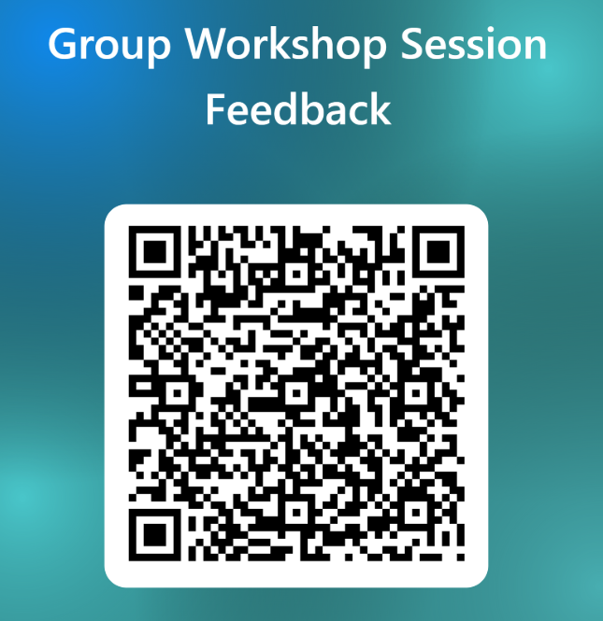
Thank you
Questions & feedback?

