Slide 1
How to make the most of the Careers Service as a distance learner
The Careers Service

Slide 2
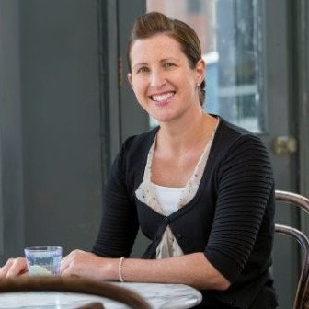

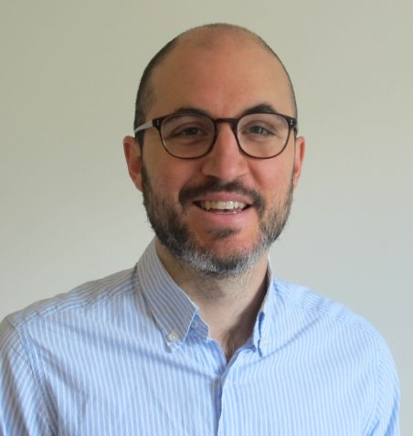
Meet the Careers Team
Fiona Telford | Lucy Hawkins | Josh Phillips
Mondays and Tuesdays | Mondays, Tuesdays and Wednesdays | Wednesdays, Thursdays & Fridays
Notes:
Who

Slide 3





What do we offer?
Online & Digital resources via Moodle
One-to-one career guidance on strategy, CV, cover letter, LinkedIn and more (access up to 2 years after graduation)
Practice interviews
Employability workshops
Careers events including Discover PH & GH career pathways, alumni networking events, international jobs fair, employer talk, alumni panels and more...
LSHTM Connect
Vacancy listings
Careers Newsletter fortnightly email
Notes:
What

Slide 4
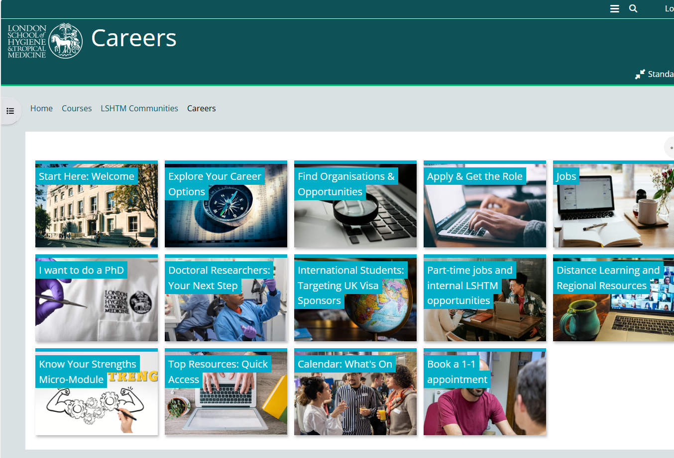

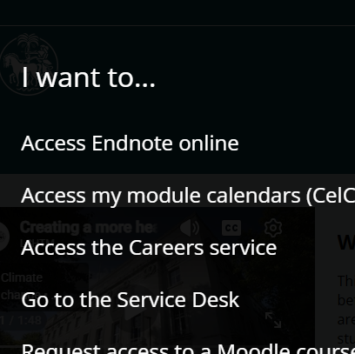
Careers Moodle
https://ble.lshtm.ac.uk/

Slide 5
Career Starters / Changers / Developers
Starters
<2 years work experience
LSHTM course is a continuation of your studies
Changers
2+ years work experience in a different area
LSHTM course is a springboard to something different
Developers
2+ years work experience in a related area
LSHTM course is fuel for further professional growth

Slide 6
Graduate training
Starters
Book an appointment this term
If you are a career starter and are considering applying for Graduate Training Programmes / Schemes (most large, sector related organisations hold recruitment campaigns Oct-Dec)
If you are considering applying to graduate healthcare management consulting firms (most consultancies hold recruitment campaigns Sep-Nov
To connect with the service at the start of your studies and begin exploring your options

Slide 7
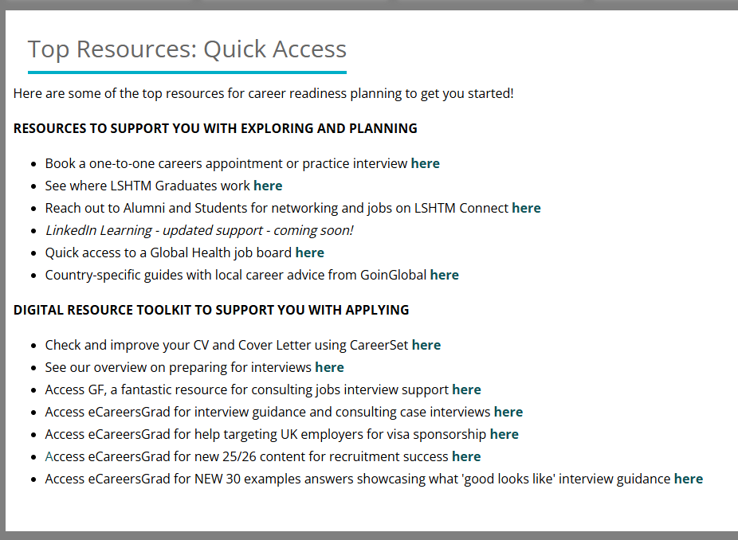
Top Resources on Moodle
All
CareerSet & LSHTM Connect
Starters
eCareersGrad and GF

Slide 8
Explore your career options
Changers
AI tool + research + 1:1
Alumni destinations 2019-2025
Alumni insights – LinkedIn, LSHTM Connect
AI recommended prompt for information synthesis (check conclusions)
Know your Strengths Micro Module
Identify your transferable skills and strengths from your previous career

Slide 9
Workshops this term: all
All
Diarise
Regional focus Career Q&A sessions (North America, EU, Asia, Africa)
Careers with UN organisations
Networking remotely
Finding and funding a PhD
How to use AI for career development
Dealing with rejection and uncertainty
Group coaching: LinkedIn

Slide 10
Workshops this term:
Developers
Diarise
Motivation and strategic planning for mid-career
Developing your emotional intelligence as a mid-career professional
Pitching for promotion
Starters/
changers
Diarise
Planning your next step: how to get started
Psychometrics testing workshop
Discover Public and Global Health Organisations
Discover Public and Global Health: Alumni panel
CHAI

Slide 11
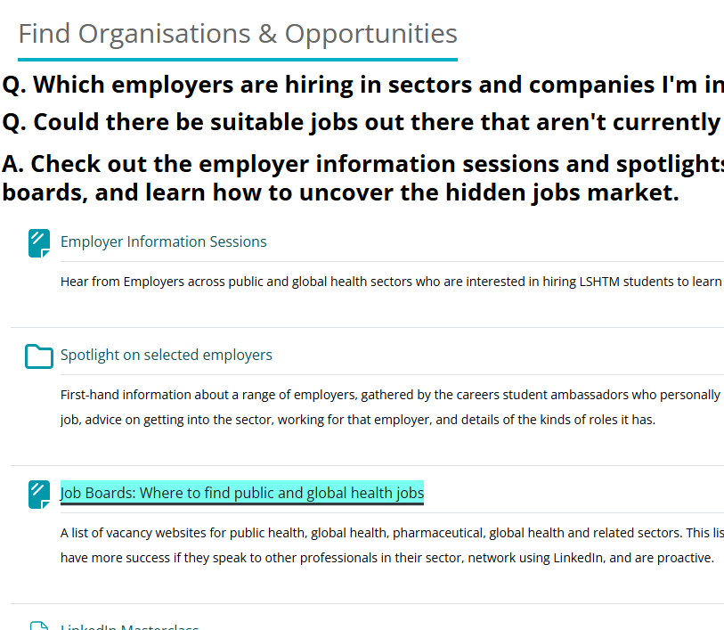
Job hunting
When are start dates for roles available now?
When do you need to start your end-of-course job hunt, based on your findings?
All
Advance job hunting

Slide 12

Working in the UK after your studies
We don’t give visa advice, but have curated:
Talk + slides on working after your studies from a visa adviser
eCareersGrad online course on targeting UK employer sponsors
111 UK employers who have hired LSHTM graduates and hold a current Skilled Worker visa sponsorship licence

Slide 13
Extra tips
In person 1:1 appointments can be converted to online on request.
DL General Zone has a careers forum for Q&A
Email careers@lshtm.ac.uk if you need further support
Our regional resources are growing on Moodle
Let us know what you need!
Notes:
https://ble.lshtm.ac.uk/mod/forum/view.php?id=461064

Slide 14

So: what’s your next step?
?
Questions and
feedback welcome!

