Slide 1

Local Authorities: Their role in Health, and potential careers
Max Edgington, Islington Council

Slide 2

Introduction
Overview of local government and local authorities
Potential local authority careers General work advice
Challenges and opportunities in the sector
General career advice

Slide 3
What is a Local Authority?

Slide 4
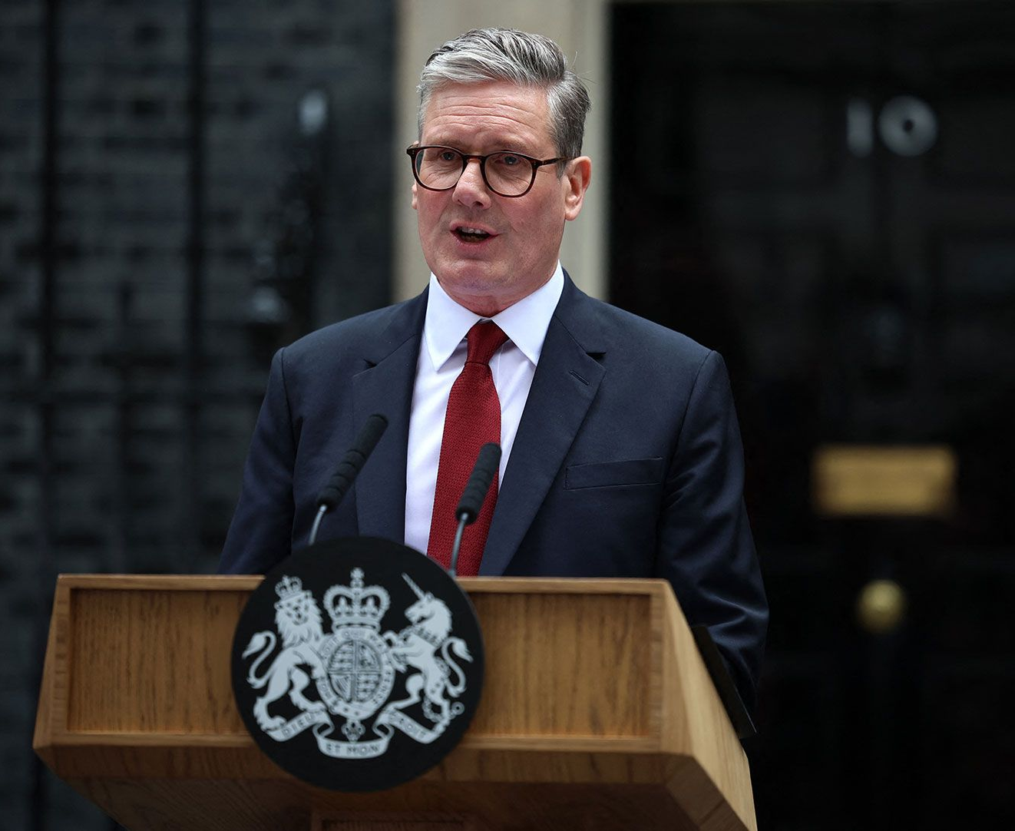
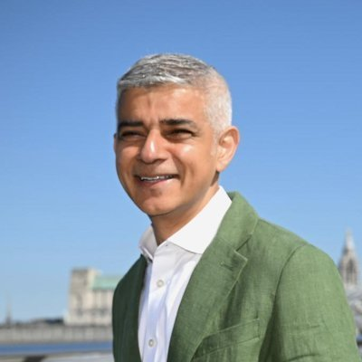
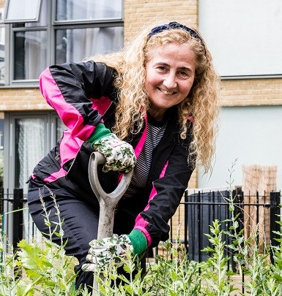
Overview of their structure?
Central Government (MPs, Ministers, and Civil Servants)
Strategic Authorities (Mayor, and Greater London Authority workers)
Local authority (Councillors, Local Authority Officers)
Also known as: The Government
Also known as:
City government, municipal governments, regional government (previously known as combined authorities)
Also known as:
Local councils, borough council
Notes:
Some much more complex
Two tiers
London is a nice “neat example”
Might be known as local councils, local government, city government, municipal governments

Slide 5
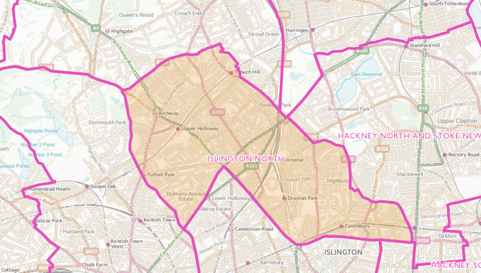
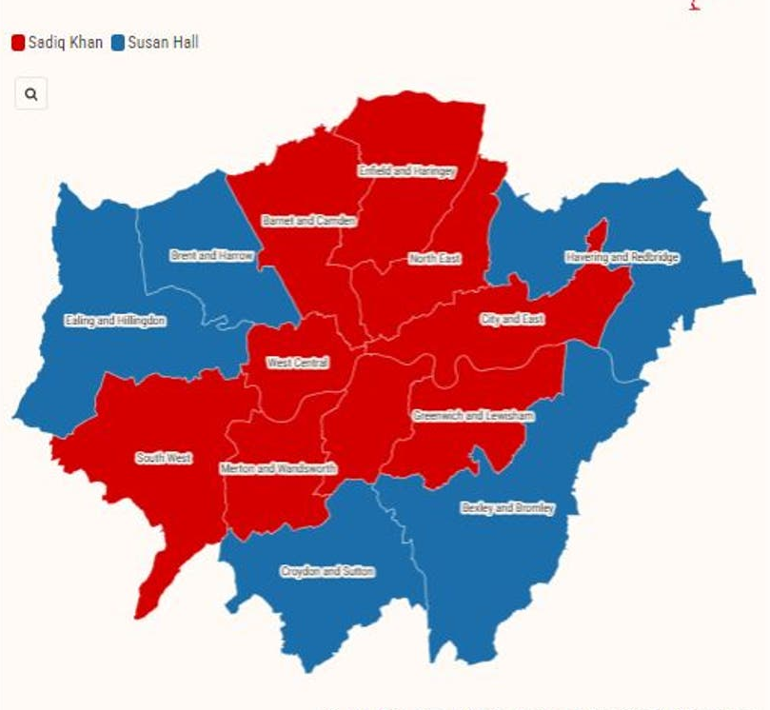
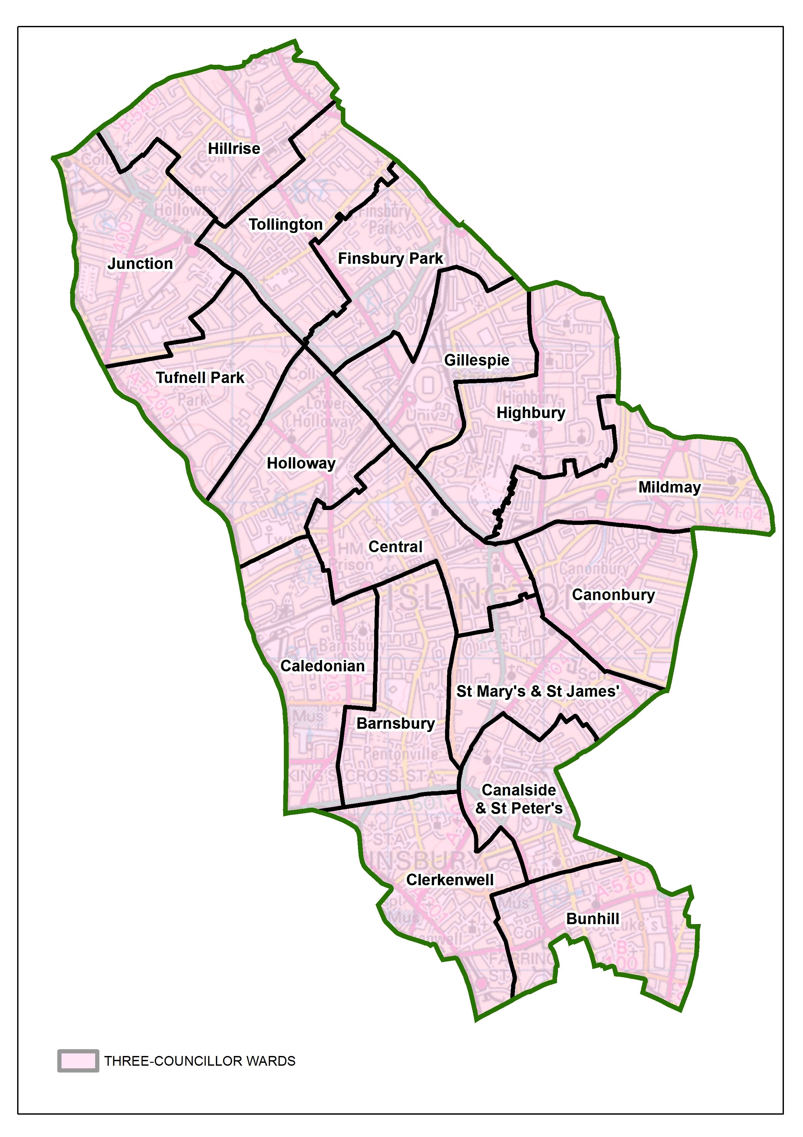
Central Government (MPs represent constituency’s, an area of around 100,000 people )
Combined Authorities (Mayor governs the city)
Local authority (Councillors represent a ward, of around, 15,000 people)
This is the area of focus for today
Notes:
Some much more complex
Two tiers
London is a nice “neat example”

Slide 6
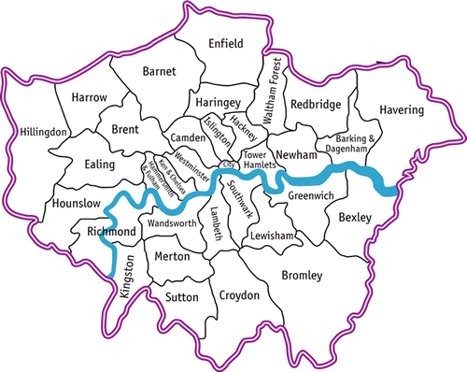
What is a local authority?
A public sector organisation that carries out services in a local area
E.g. in London these are divided into boroughs, they can be cities e.g. Manchester City Council or represent a more rural area e.g. Kent County Council
Work is divided into legally must do (statutory) and discretionary (non-statutory)
Staff work for the authority to carry out wishes of politicians but are apolitical, almost like local civil servants
They deliver over 700 services
800 different roles from accountants, lawyers, tree specialists, to social workers, public health consultants and transport planners

Slide 7

History and formation
Establishment of Parks
Director of Public Health (formerly Inspector of Nuisances)
Slum Clearances
Municipal Swimming pools and Schools
Water departments
Birth and Death registration
“We have not the slightest intention of making profit…We shall get our profit indirectly in the comfort of the town and in the health of the inhabitants” Joseph Chamberlain, former Mayor of Birmingham, 1880
Notes:
Lots of large differences in peoples lives, and health. traced back to local gov.
• Things we take for granted weren’t always so.
o Establishment of Parks
o Director of Public Health (Inspector of Nuisances). 175 anniversey. Helped to usher in significant increased in life expectancy increase. Life expectancy around 40. life expextency has been on a study upward trajectory since, disragrding the last decade or so.
o Slum Clearance
o Municipal Swimming pools and Schools
o Water departments
o School Nurse
Birth and Death registration. May not seem important, but it’s a cornerstone of research to have this information, to be able to see what people are dying from. “what gets measures gets done”
o
Some of the largest improvements of health is down to local authorities
Lots of the things we take for granted.
Current structure of local authorities is complex but still important.

Slide 8
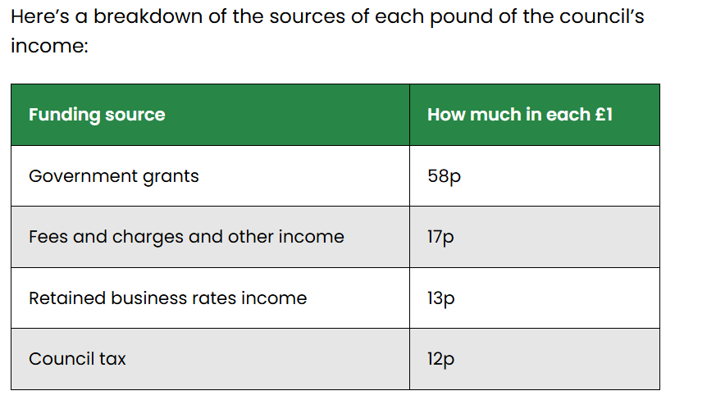
Modern day local government
Funded in three ways
Council tax (local tax on properties, income from central government and fees and charges e.g. parking and business rates)
Carry out hundreds of services
Often less glamorous and less appreciated
Most localised tier of democracy
Help to deliver central government goals
E.g. growth. more house building,
As well as their own goals
E.g. Islington is “for a more equal Islington” and our five missions

Slide 9
Potential roles related to public health

Slide 10
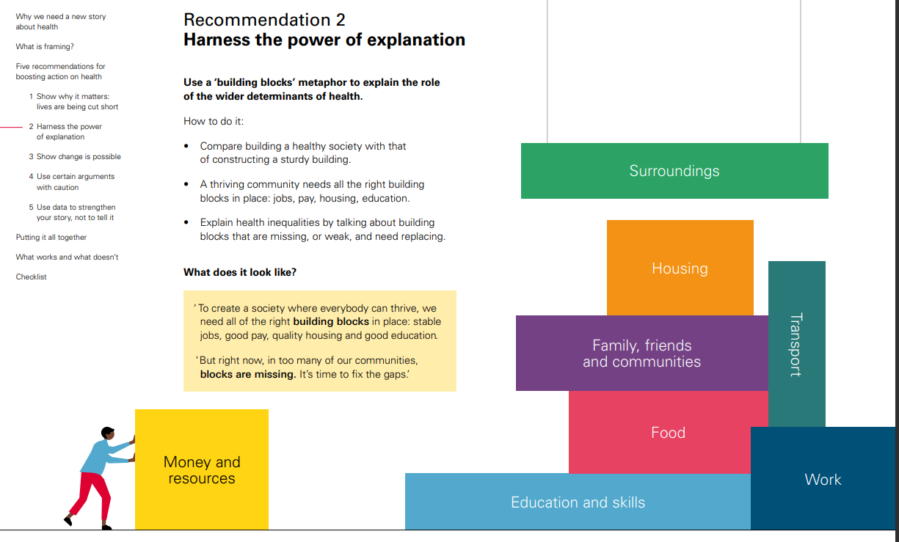
Building Blocks of Health
Our surroundings influence health
Therefore, multiple roles can therefore influence health, not just public health roles
Lots of roles in local government which have an influence of public health, may not have heard of or thought of
Notes:
Some of the roles that you make have to implement these strategies in are
Difference between Cllrs and Officer.
Type of roles you may have
• Public Health consultant
5 years training scheme.
o 5 rotations
o Master’s in public health
• Director of Public Health
• Data analysis
• Policy officer – advising and creating on policy across the council with a public health focus
• Children’s services, housing, planning etc. All areas that can make a big difference to public health. Individual roles within this
public health roles are secure, growing appetite, especially from those with non medical backgrounds. Transferrable internationally. Well paid public sector role.

Slide 11
Likely roles and work
Public Health Consultant
Director of Public Health
Policy and Strategy
Data Analysis
Integrated Care Board roles

Slide 12

Policy and Research roles
Strategy and Policy Teams
Strategy and Policy roles within directorates
Partnering with academia
Social service’s roles: Adult’s and Children’s services
Practical example: 50 Steps to a Healthier Newham Newham Health and Wellbeing Strategy 2024-2027
Notes:
Some of the roles that you make have to implement these strategies in are
Difference between Cllrs and Officer.
Type of roles you may have
• Public Health consultant
5 years training scheme.
o 5 rotations
o Master’s in public health
• Director of Public Health
• Data analysis
• Policy officer – advising and creating on policy across the council with a public health focus
• Children’s services, housing, planning etc. All areas that can make a big difference to public health. Individual roles within this
public health roles are secure, growing appetite, especially from those with non medical backgrounds. Transferrable internationally. Well paid public sector role.

Slide 13

Data roles
Data teams
Data roles within teams
External organisations e.g. think tanks, research institution etc
Practical example: Data highlighting low take up of vaccines, then designing specific measures to improve take-up e.g. Leicester City Council during Covid-19
Notes:
Some of the roles that you make have to implement these strategies in are
Difference between Cllrs and Officer.
Type of roles you may have
• Public Health consultant
5 years training scheme.
o 5 rotations
o Master’s in public health
• Director of Public Health
• Data analysis
• Policy officer – advising and creating on policy across the council with a public health focus
• Children’s services, housing, planning etc. All areas that can make a big difference to public health. Individual roles within this
public health roles are secure, growing appetite, especially from those with non medical backgrounds. Transferrable internationally. Well paid public sector role.

Slide 14

Public Health roles
Strategy and researcher roles
Commissioning roles
Consultants
Director of Public Health, and Deputy Director
Project Officers
Hybrid roles with other teams e.g. planning
Distributing funding from the public health grant, working with teams across the council, working with academic partners. Islington annual Public Health Report 2024/25

Slide 15
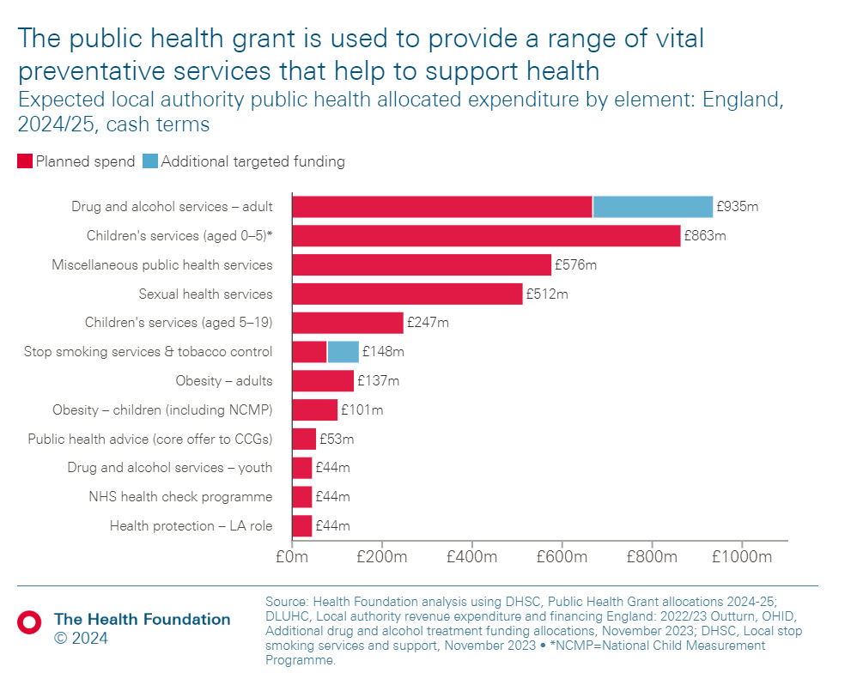
Public Health work
Statutory responsibilities
Influencing and working with others
Working beyond “health”
Practical example: Public health teams working with transport teams to improve active travel, lower pollution and improved road safety.
Notes:
• Health inequalities between LAs and within them. Luke Munford data.
In Westminster, Life expectancy is 81 in Westbourne ward, Knightsbridge, Belgravia and Hyde park ward is 91.3. short 10-minute walk.
• What interesting to yourselves as people studying public health is it represents many of the challenges you will face. LAs represent key challenges of PH.
• Sure that you’ll all have fantastic idea, energy, solutions to bring.
• These have to be balanced out.
o Political choices
o Non-public health prioritises, like spending on health or transport project.
o PH people in local authorities, because of the political dimension that they work in must develop skills in framing issues, persuading, compression,

Slide 16

Integrated care board
Policy and Strategy roles
Commissioning
Data analysis
Engagement roles
Transformation roles
Practical example: Develop a strategy to improve mental health services through partnering with local authoirties.
Notes:
• Health inequalities between LAs and within them. Luke Munford data.
In Westminster, Life expectancy is 81 in Westbourne ward, Knightsbridge, Belgravia and Hyde park ward is 91.3. short 10-minute walk.
• What interesting to yourselves as people studying public health is it represents many of the challenges you will face. LAs represent key challenges of PH.
• Sure that you’ll all have fantastic idea, energy, solutions to bring.
• These have to be balanced out.
o Political choices
o Non-public health prioritises, like spending on health or transport project.
o PH people in local authorities, because of the political dimension that they work in must develop skills in framing issues, persuading, compression,

Slide 17

Miscellaneous
Economic development
Benefits and income maximisation teams
Transport teams
Green space
Voluntary and Community roles (VCS sector). Range from, helping refugee and asylum seekers, helping those experiencing homelessness etc.
Community Safety
Notes:
• Health inequalities between LAs and within them. Luke Munford data.
In Westminster, Life expectancy is 81 in Westbourne ward, Knightsbridge, Belgravia and Hyde park ward is 91.3. short 10-minute walk.
• What interesting to yourselves as people studying public health is it represents many of the challenges you will face. LAs represent key challenges of PH.
• Sure that you’ll all have fantastic idea, energy, solutions to bring.
• These have to be balanced out.
o Political choices
o Non-public health prioritises, like spending on health or transport project.
o PH people in local authorities, because of the political dimension that they work in must develop skills in framing issues, persuading, compression,

Slide 18

Some of the main challenges
Politics
Finances
Central-local relationships
Lack of trust
Low democratic engagement

Slide 19

Opportunities
Devolution
Creativity
“Necessity in the mother of invention”
Reform of services (small r)
Supportive policy
Renters reform, planning etc
AI
What to do with time savings?

Slide 20
Key skills required

Slide 21
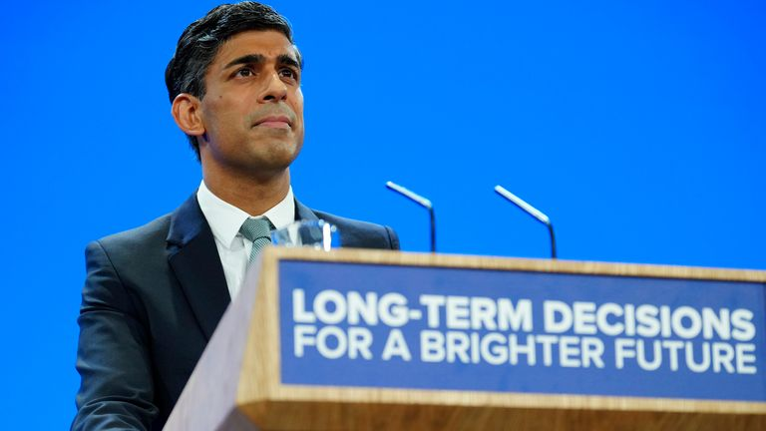
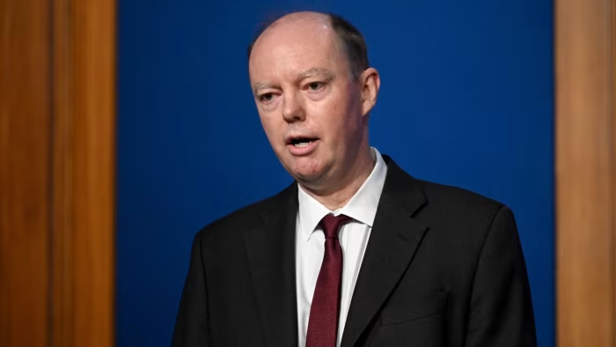
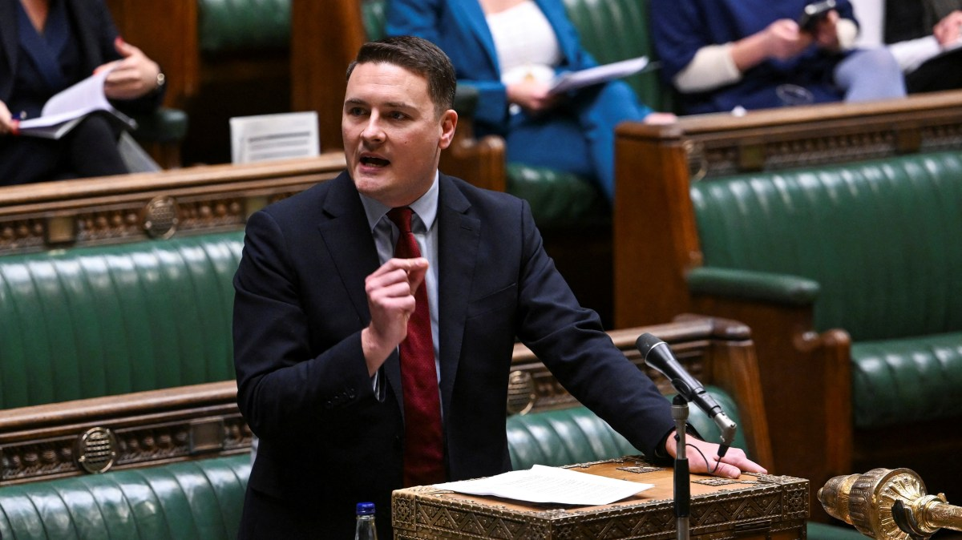
Framing: Same problem, different frames
Then PM Rishi Sunak:
“Smoking places huge pressures on the NHS and costs our country £17 billion a year. We have a chance to cut cancer deaths by a quarter, significantly ease those pressures and protect our children, and we should take it.”
Chief Medical Officer for England, Professor Chris Whitty, said:
“A smoke-free country would prevent disease, disability and premature deaths for children born today and for people long into the future.”
Wes Streeting, Health and Social Care Secretary
“these measures add up to the most significant public health intervention in a generation. They are a giant leap in this Government’s mission to build a healthy society and, in doing so, they will help to build a more healthy economy too”

Slide 22

Data Translation
Translating data into a narrative
Data shows problem is x, which means y, and thus we should do z.
Making that persuasive and clear
Boiling data down into digestible understand
1 child in every classroom lives in temporary accommodation versus a figure that is hard to quantify
Ground it in the experience of residents
Growing problem of x, is leading y resident to cut back on their hours.

Slide 23

Thinking creatively
What other teams and budgets can you influence?
What moment or event can you use to gain traction on an issue?
What’s the balance of technology versus in person services?
What solutions can be adapted from other countries, or local authorities?
How can you work effectively with Strategic Authorities? (Mayors and the Greater London Authority for London)

Slide 24
Reflections and advice

Slide 25

Reasons I like working in local government
Local innovation
Engagement
Work grounded in place
Breath of work
Devolution of further powers
Whole life course of work
They help the most vulnerable in society
More preventative
Councillors (local politicians) are more trusted

Slide 26

General advice
Time of applications vs developing skill
Dissertation as a signal
Topic and organisation
Value of student societies
Can always start one
Events, webinars, conferences (student discounts)
Okay not to know, and to ask people to explore careers
Peer research opportunities

Slide 27

Routes into local government
Grad Schemes
LGA Impact grad scheme
Local specific grad schemes
Specialist role grad scheme e.g. Pathways to Planning
Placements
Secondement from other organisations e.g. civil servants
Entry level roles
Research organisations e.g. NIHR
Academic partnerships
Notes:
Some of the roles that you make have to implement these strategies in are
Difference between Cllrs and Officer.
Type of roles you may have
• Public Health consultant
5 years training scheme.
o 5 rotations
o Master’s in public health
• Director of Public Health
• Data analysis
• Policy officer – advising and creating on policy across the council with a public health focus
• Children’s services, housing, planning etc. All areas that can make a big difference to public health. Individual roles within this
public health roles are secure, growing appetite, especially from those with non medical backgrounds. Transferrable internationally. Well paid public sector role.

Slide 28
Any questions?
max.edgington@islington.gov.uk, https://www.linkedin.com/in/max-edgington/

Slide 29

Useful organisations to follow
Society of Local Authority Chief Executives (SOLACE)
Local Government Association (LGA)
ADPH (Association of Directors of Public Health)
Municipal Journal (The MJ)
Local Government Chronicle (LGC)
Greater London Authority
London Councils
District Councils Network (DCN)
County Councils Network (CCN)
SIGOMA
Chartered Institute of Public Finance and Accountancy (CIPFA)
Centre for Cities

Slide 30
References
https://jech.bmj.com/content/71/8/827
https://pubmed.ncbi.nlm.nih.gov/28977629/
https://www.york.ac.uk/media/che/documents/newsletters/March%202020.pdf
https://www.health.org.uk/news-and-comment/charts-and-infographics/public-health-grant-what-it-is-and-why-greater-investment-is-needed
https://www.lgcplus.com/finance/councils-face-6-9bn-funding-gap-by-2026-27-09-09-2024/
https://www.health.org.uk/evidence-hub/local-authority-dashboard
https://www.health.org.uk/publications/how-to-talk-about-the-building-blocks-of-health
https://www.newstatesman.com/spotlight/economic-growth/regional-development/2024/01/council-bankruptcy-tracker-local-government-authorities-finances

