Slide 1
Motivation and strategic planning for mid career
Lucy Hawkins, Careers Consultant

Slide 2

Learning Objectives
Identify what my career needs to provide at this stage
Assess different strategic approaches and decide on 1 thing you could do to test an approach
No pressure to share
Interactive anonymous input
This Photo by Unknown Author is licensed under CC BY

Slide 3
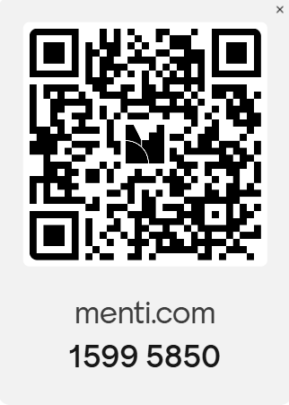
What do you want from your career?
more / less / different

Slide 4
Prioritising action
Control
Look for low effort small wins
Biggest
achievable impacts - prioritise
Deprioritise
Look for big wins achievable with help
Impact

Slide 5
Coming back to our values
Notes:
Edgar Schein’s Career Anchors

Slide 6
Framework for thinking
Knowing yourself
Knowing your options
Preferred skills
Core interests
Values
My practical needs
The needs of my ecosystem
Decision- making
Taking action
DOTS, even further adapted from Law & Watts, 1977, 1996

Slide 7
Defining what you want and need
A good career strategy isn't the career you'd choose in the absence of constraints. It's one that works with the life you actually have.
Wants
Preferred skills
Topics of interest
Values
Needs
What I need: £, time, location
What my ecosystem needs: my family, community, environment
Preferred skills
Core interests
Values
My practical needs
The needs of my ecosystem

Slide 8
Strategic planning
Notes:
Edgar Schein’s Career Anchors

Slide 9
Strategic approaches
Not sure
Enhancing the aspects of your current role that relate to your guiding principles
Staying within the same role and field but looking for an opportunity which matches your principles more closely
Career change
A pivot away from what you've been doing to a whole new area, possible retraining
Unclear what your guiding principles are, or how to overcome the challenges you face
Job shift
Portfolio career
Combination of different part-time roles, which in totality meet your guiding principles
Promotion
Moving to manage/regulate/
teach/assess/advise those who do your current role
Recovery
Job crafting
A holiday, less challenging role, reduction in hours or a career break which allows you to reset and recover before moving forward

Slide 10
Example
Not sure
Take on strategy at the practice for staff safety and wellbeing
Move from partner to salaried GP
Career change
Creating a Social and Therapeutic Horticulture non-profit
Book a 1:1 appointment
Job shift
Portfolio career
GP 3 days + Medical Examiner 1 day + 1 day volunteering with a gardening therapy scheme
Promotion
Move to a senior role in a regional GP Federation improving practice
Recovery
Job crafting
Negotiate sabbatical for next 6 months for gardening, rest + parenting
GP, mid-career, partner in practice
Wants
To feel safer at work - stressed patients being confrontational
To refocus on making things better for people rather than surgery business strategy
More time in nature
Needs
Less stress – burnout risk
Context
Twins in last 6 months of high school, stressed about exams. Partner made redundant with 1 year redundancy pay.

Slide 11
Strategy into action
Not sure
Talk to your manager about where there might be opportunities to do more x?
Identify someone who has made that shift and ask to chat
Career change
Identify someone who has made that shift and ask to chat. Look at vacancies and requirements
Book a 1:1 appointment
Job shift
Portfolio career
Talk to your manager about whether there is the potential to reduce your hours in your current role?
Promotion
Look at vacancies and requirements for more senior roles
Recovery
Job crafting
Look at finances and assess what’s possible.
Which approach has the highest potential for you?
What is one action you are going to do to test this approach?

Slide 12


Feedback and Q&A
https://forms.cloud.microsoft/e/4p7U5N14cT

Slide 13
Thank you!
Notes:
Intro Julia Shen and make her a panelist. Set record!

