Slide 1



HEALTH
Better analysis
Better decisions
Value unlocked for our clients

Slide 2
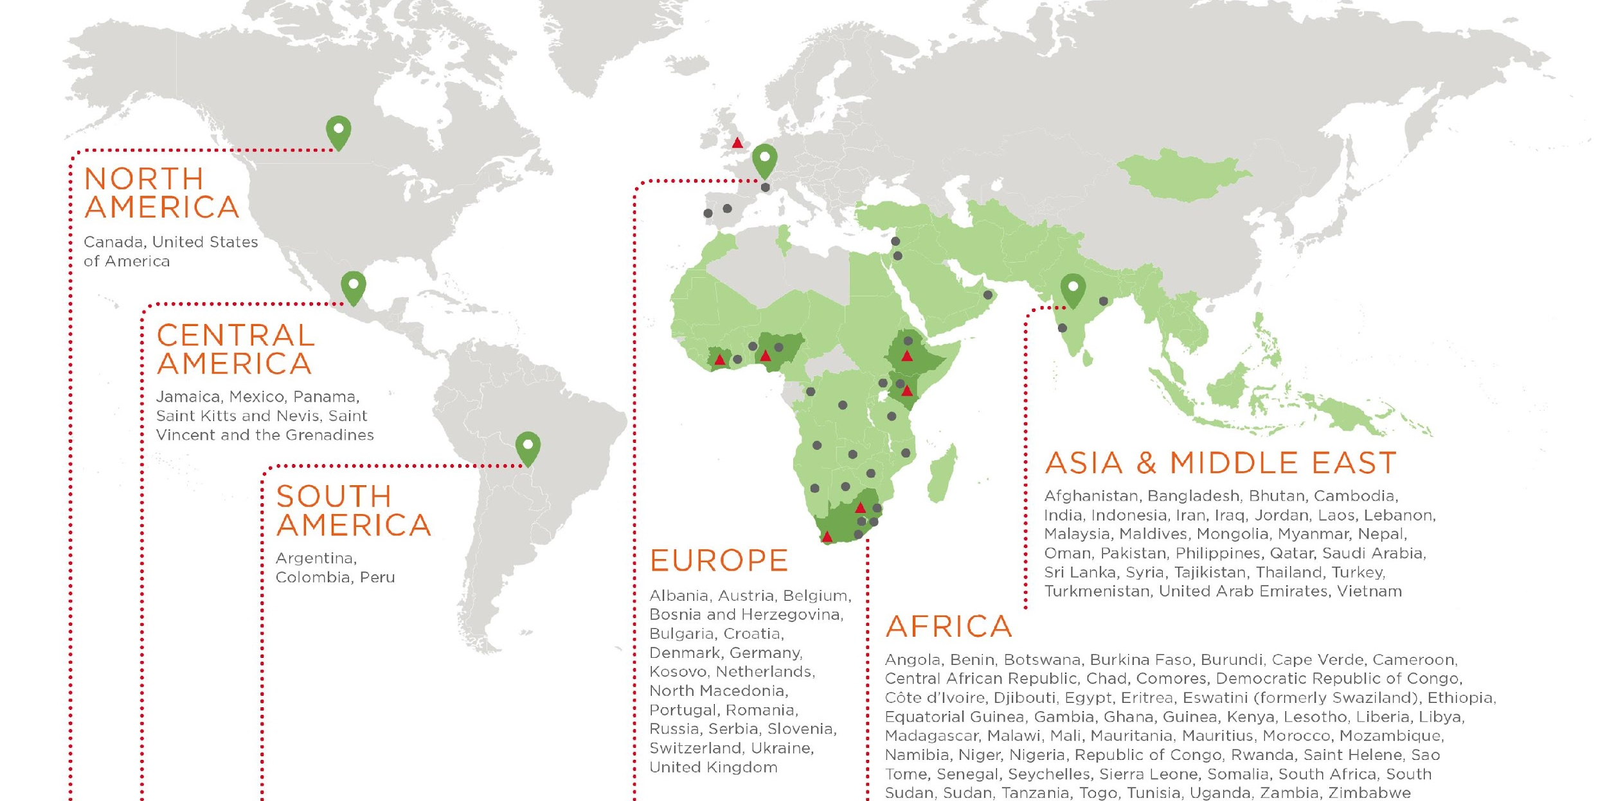
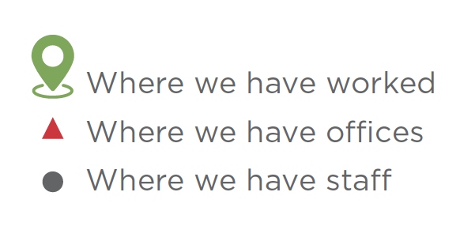
WHO WE ARE
Genesis is a leading impact and strategy consultancy and has worked in more than 100 countries.
We focus on the 4 billion people in countries with young populations across Africa, the Middle East and Asia.
That is the Young World.
Our roots are in Africa.
We partner with the world’s leading foundations and multilaterals, governments, and corporations with rapidly scalable technologies.
We have ~250 staff in more than 25 countries, and seven main hubs.

Slide 3

OUR VALUES
At a time when many consulting firms have been shaken by failures of integrity,
we take immense pride in our reputation for ethics, balance and fairness.
Our values are an essential part of the way we work. We produce strong, independent analysis that seeks to balance economic with social concerns; markets with society; public with private interests. Our ability to see the position of all sides is a stand-out strength.
Our purpose is to unlock value by working closely with our clients to find real, scalable solutions. The foundation of our distinctive delivery is technical skill and deep sector knowledge we have developed through our work across the public and the private sectors.
All our work is guided by our core values:

Slide 4
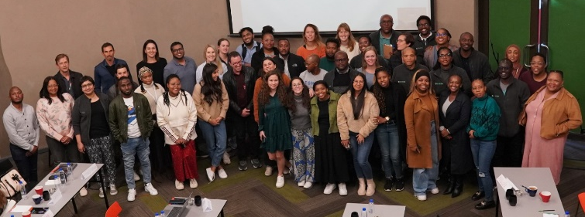
ABOUT
OUR HEALTH PRACTICE
We work with our clients to develop solutions aimed at improving health of populations throughout Africa.
Celebrating 7 years of Health
Our region faces the challenges of the quadruple burden of disease, which includes both communicable and non-communicable diseases, as well as poverty, violence and injury.
Coupled with this are relatively weak health systems, heavy reliance on donor funding and inequitable public and private sectors. Within this context, we provide experts who have decades of experience in the design, implementation, costing and evaluation of health programmes, the strengthening of sustainable health systems and the use of digital technologies to improve the quality of life.
Our health work is bolstered by in-house specialists in
Applied Behavioural Economics, Digital Excellence, Human Development and Monitoring, Evaluation & Learning. Donor organisations, foundations and governments across Africa routinely rely on Genesis for expert advice and support. We have worked extensively with public and private healthcare sectors.
This gives us a position of trust based on a strong reputation for providing robust and independent expert advice.
4

Slide 5
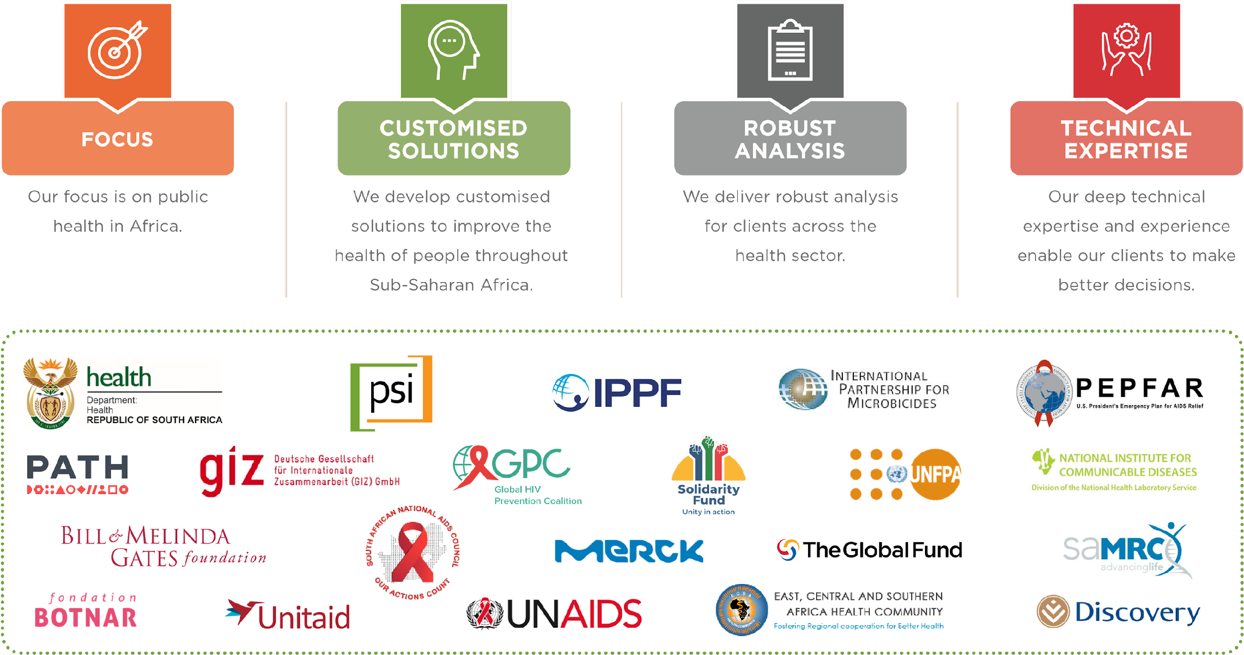





WHY CLIENTS
CHOOSE GENESIS
Our focus is on public health in Africa
We develop customised solutions to improve the health of people throughout the continent
We deliver robust analysis for clients across the health sector.
Our deep technical expertise and experience enable our clients to make better decisions.
5

Slide 6
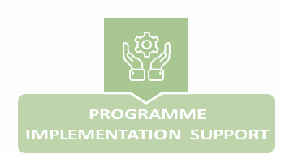
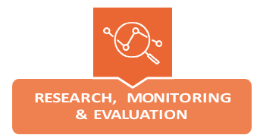
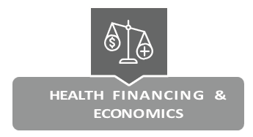
OUR HEALTH
EXPERTISE
We design and implement a variety of research projects - from national household surveys to discrete and focused programme reviews, formative research, process and end-of-programme evaluations.
Our team draws on multidisciplinary skills in public financial management, health finance, costing, efficiency studies and other economics analyses to inform policy, build resilient health systems and facilitate efficient implementation of health programmes to improve healthcare in the region.
We help unlock value and maximise impact in health delivery across Africa through addressing technical health systems challenges in programme implementation. We do this by providing technical assistance, capacity development and harness knowledge management & learning.
6

Slide 7
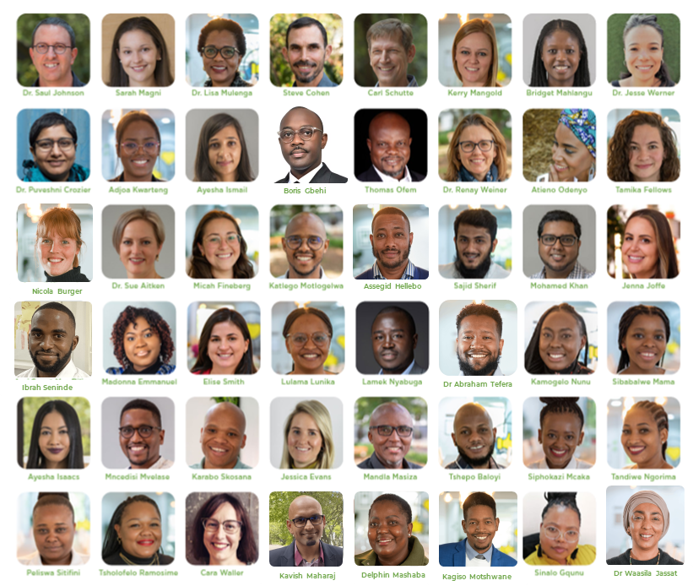
OUR
TEAM
Some of our qualifications include
post-graduate degrees in
MBBCH | Epidemiology and Biostatistics | Applied Economics | Health Information Systems | Public Health (Economics) | Management of Health Systems | Mass Communication | Community Health and Tropical Medicine | Public Health (Social and Behaviour Change Communication) | Neuropsychology | Demography and Population Studies | Epidemiology (Implementation Sciences) | Sociology | Business Administration | Environment and Development Studies | Public Health (Health Policy and Management) | Anthropology | Human Genetics | Public Health for Development | Chartered Accountant (SA) | Chartered Global Management Accountant | Population Studies | Molecular Physiology | Public Health (Disease Control) | Philosophy in Medicine | Development Theory and Policy | Public Health (Epidemiology) | Clinical Health and Child Psychology | Business Communications | International Development and Political Science | Health Services Management
Our team is well qualified with more than 150 years of public health experience between us
7
Notes:
Speak to how the team consists of individuals with various backgrounds.

Slide 8


WHAT MAKES GENESIS DIFFERENT
We work on diverse projects, roles and locations across Africa, the Middle East and Asia.
Remote/Hybrid working model
We proactively seek out opportunities with very large potential to create social value.
Our work covers expert diagnostics, robust solution design, building coalitions for change, and implementation.
Our way of working combines technology, human engagement, expert analysis, creativity and systemic approaches.

Slide 9
OUR OFFER
The Health practice is divided into different service lines offering its own specialisations and expertise.
This allows you to work in your broad area of interest and provide an opportunity to specialise and further develop your career. Genesis practices also work together, and cross-practice work can expose you to every corner of the firm that you would wish to explore.
What our work offers:
Doing work that matters, from day 1, often in countries other than your own.
A fertile ground for learning enabled by our internal flat structure. You’ll work in high performance teams within a collaborative and supportive culture.
Building your skills and confidence to enable you to make an impact and develop as an expert in your field.
Exposure to projects, solving real and high-impact problems alongside clients in the public-, private-, and donor sectors.
Becoming part of the solution – helping rewrite the script of how impact firms can bring about change at scale in complex situations.
At the same time you will be exposed to projects that address global challenges such as poverty and inequality, job creation, youth economic opportunity, and environmental sustainability.

Slide 10







ARE YOU INTERESTED
IN JOINING OUR TEAM?
Website Join our team
Email recruitment@genesis-analytics.com
Please visit the Young Professionals page of our website to learn about current opportunities and to apply online.
Please familiarise yourself with our areas of work and document the three areas that appeal to you most in your motivational letter. This helps us get a sense of your interests and also to identify the best representatives to consider your profile.
Click on the links below to learn more about our different areas of expertise:
Centre of Digital Excellence
Evaluation for Development
Human Development
For more information
Climate Finance and Economics
Financial Services Strategy
Shared Value and Corporate Impact
about our firm and our work
Competition and Regulatory Economics
Health

