Slide 1

Careers with
UN Organisations
November 2023
Notes:
Juliette McHardy <js@mchardy.nz> has volunteered – see email 28/9/22 i9n careers@ inbox
See email in careers@>contacts from 27/10/21 from Jennifer Kealy for more advice

Slide 2
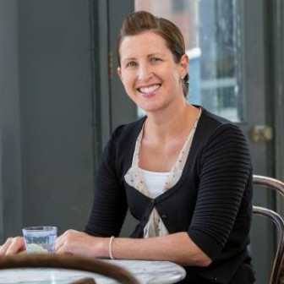
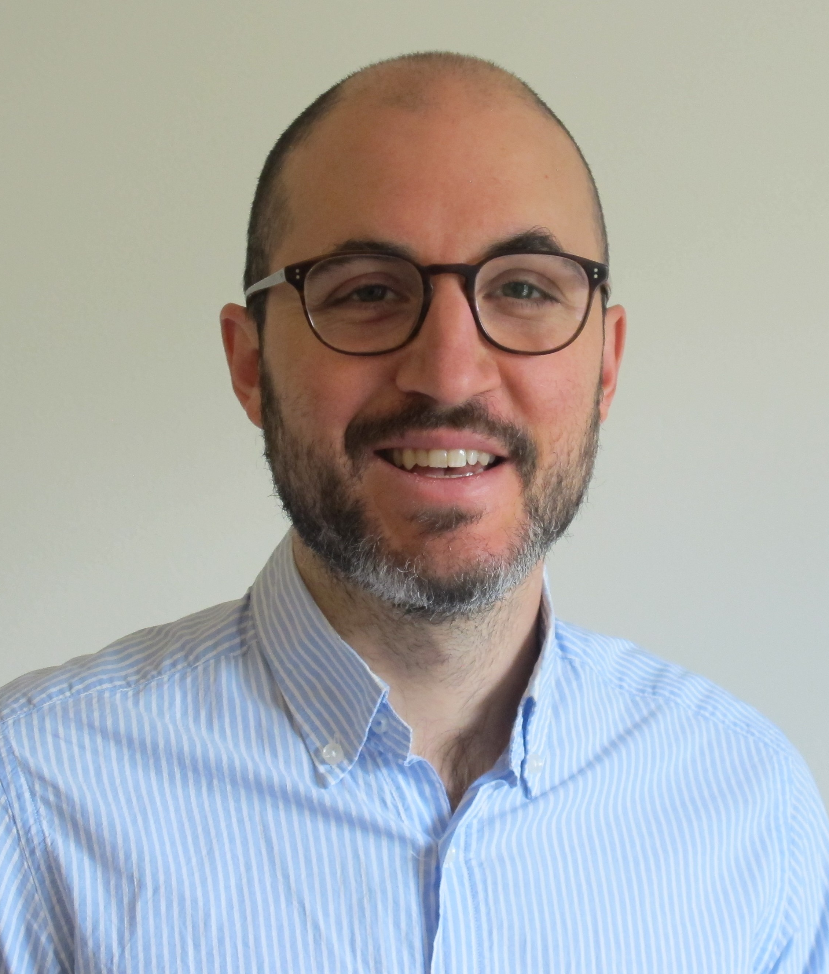
We are here to help
Fiona Telford –Careers Consultant Mondays & Tuesdays
Josh Phillips – Careers Consultant
Wednesdays, Thursdays & Fridays
Contact us on careers@lshtm.ac.uk
Notes:
Intro to us.
This session is all about introducing you to the breadth of options available and to resources for exploring ideas

Slide 3
Practical points
Please keep mics on mute unless you'd like to ask a question;
Use the chat box lots;
Trouble with sound? Trying leaving and coming back, try a different browser;
The session will be recorded and put on Moodle under 'Exploring Career Options (Recordings)' - there is a folder specifically about UN organisations.

Slide 4

What we will cover today
The UN funds, programmes and specialised agencies.
Some UN terminology.
Some routes in.
Example UN organisations: WHO, UNFPA, WFP, UNV.
Tips, courtesy of Michael Emery (when at UNFPA).
Next steps?
Insider insight. Q&A with Katy Mackey
Notes:
Guests today are Indira and Sarah who have experience within Food programmes so will pause later for them to add more about their experience and offer insights.
We will also offer some insights and advice from Michael Emery who is established within HR, was at UNFPA, now IOM

Slide 5

Funds, Programmes and Specialised Agencies
Programmes and Funds include UNHCR, UNFPA, WFP, UNDP, UNICEF
“The programmes and funds are financed through voluntary rather than assessed contributions. The Specialized Agencies are independent international organizations funded by both voluntary and assessed contributions.”
This means politics and diplomacy can be very important.
WHO is one of the Specialised Agencies, along with FAO (Food and Agriculture Organisation) and numerous others.
Systems vary across different agencies/programmes.
Notes:
https://www.un.org/en/about-us/un-system
Key thing is that some are financed by voluntary contributions (countries can decide not to fund) and others by assessed contributions (amounts per country are worked out). This makes a difference – eg US withdrawing funding in Trump era from UNFPA and then during Covid from WHO. Politics and diplomacy can affect what is supported. E.g. Trump decided not to fund UNFPA and therefore affects availability of jobs. So und of politics and certain amount of diplomacy is needed.

Slide 6
Some UN Terminology and its implications
Positions graded as ‘P3’, ‘P4’ etc
(P3 usually need 5 years’ experience, P4 8 years’ experience, PhD ‘counts’ for half the number of years’ experience)
If you have less experience, look for ‘P1’, ‘P2’ jobs (see also YPP – next slide)
Duty stations (categories A-E – there is also H for Headquarters or similar)
A – most secure/comfortable locations (around 10% successful applications will be external)
E – more remote/risky locations in lower resource settings (eg Yemen, Sudan)
Categories A-C you can be accompanied by family members, not categories D-E.
R&R (rest and recuperation) periods – vary according to nature of posting. In the most difficult settings you get 5 days out of country every 4 weeks.
Notes:
Quick slide for reference really. 4 year PhD counts for 2 years off the years needed. Masters might not count in the same way (max one year but only some orgs). The gain is in the skills and knowledge of a Masters.
In some roles at country level, they are likely to rotate people to other roles every 5-8 years to other countries. Real plus to have previous UN exp.

Slide 7
Some routes into UN: YPP and JPO
YPP (Young Professionals Programme) https://careers.un.org/lbw/home.aspx?viewtype=NCEWN&lang=en-US
Entry by examination, application (indicating Nov opening date for 2022, open for 2 months)
Must be under 32 years before taking exam
Must be from a participating country (UK is not one) – it is for countries that are under- or unrepresented in the United Nations
Experience not required (but may be selection criterion)
JPO (Junior Professional Officer Programme)
https://careers.un.org/lbw/home.aspx?viewtype=AEP
Must usually be under 32 years (but donor country rules vary)
Must have at least 2 years’ experience
Must be from participating donor country
Notes:
Key point – must be participating country – list here for YPP (and at that weblink).
Afghanistan, Andorra, Angola, Antigua & Barbuda, Bahrain, Belize, Brazil, Brunei Darussalam, Cabo Verde, Cambodia, China, Comoros, Democratic People's Republic of Korea, Djibouti, Dominica, Equatorial Guinea, Gabon, Grenada, Guinea-Bissau, Haiti, Israel, Japan, Kiribati, Kuwait, Lao People's Democratic Republic, Lesotho, Liberia, Libya, Liechtenstein, Luxembourg, Marshall Islands, Micronesia (Federated States of), Monaco, Mozambique, Namibia, Nauru, Norway, Oman, Palau, Papua New Guinea, Qatar, Republic of Korea, Saint Lucia, Saint Vincent and the Grenadines, Samoa, San Marino, Sao Tome and Principe, Saudi Arabia, Solomon Islands, South Sudan,Federal Republic of Somalia, Suriname, Timor-Leste, Republic of Turkey, Turkmenistan, Tuvalu, United Arab Emirates, United States of America, Vanuatu, Venezuela (Bolivarian Republic of)
Information about application process here: https://careers.un.org/lbw/home.aspx?viewtype=NCEA&lang=en-US
Participating countries for JPO – does include UK
AustraliaAustriaBelgiumChinaDenmarkEgypt
FinlandFranceGermanyHungaryIsraelItaly
JapanKuwaitLuxembourgMongoliaMoroccoNetherlands
NorwayRepublic of KoreaSaudi ArabiaSpainSwedenSwitzerland
United Arab EmiratesUnited KingdomUnited States
Disciplines considered
Political scienceSocial scienceLaw
Human RightsProgramme ManagementPublic Administration
Economic AffairsEnvironmental AffairsGender Affairs

Slide 8
Other routes in
Internships (seem to be more available now):
WHO – Global Internship Programme, info here;
UN – info here (but some separate links to funds / programmes broken);
UNHCR – unpaid (info here)
UNOPS (info here)
Short term contracts.
Consultants roster (UN wide roster).
Salaried posts, maybe via country office first.
Notes:
If you can get an internship, you can get involved in a lot of events and other local agencies and can see more ops. Be sure to focus on competencies. Key is about you getting on with delivery as soon as you start. Be prepared to talk about your interests and what you want to work on. e.g. children's health. Importance of proactive networking. Think about summer project topic or sending your dissertation to relevant agency. Follow on LI. Persistent and focussed.
More options at regional level for entry level roles.
Can be good to get on the roster so you become known for your area of expertise. Need to network or to have a clear area of specialism. In this context, means short contracts. Good areas include SPSS/R/STATA. Check ads to see what they are interested in
Also UN fellowships https://www.un.org/en/observances/decade-people-african-descent/fellowship-programme
See Fabrizzio's list. Some countries are less popular so look at those BUT if they are riskier to work in, you will need to demo more experience

Slide 9
Example UN organisation: WHO
Leadership on global health matters and shapes research on the health agenda.
Bridge between research, ministries of health and those delivering – for example producing guidelines such as on AMR (something UK asked the WHO to work on).
Combines 6 health organisations with regional officers who are legally independent of HQ – they hire and fire independently of HQ.
Can approach the regional offices directly - higher chance of success if you are a national from that region.
151 country offices, high turnover of opportunities there.
Notes:
Going to give a bit more detail about four of the UN agencies: WHO, UNFPA, WFP, UNV as examples and also to demonstrate that they really do vary.
AMR=antimicrobial resistance
From Jem (2 years ago) – country office more on the ground, regional office working between HQ and on the ground, HQ more remote from delivery. Country office is a good way in for people from countries where WHO operates. More chance if national of that country. BUT might not be easy to transition from her to international role (Indira Bose, Nov 22)
Note from Fabrizzio: – WHO is the place everyone looks at, but it’s not the only one working in health.
MD – probably an advantage for WHO because historically was a medical doctor organization (but not now headed by a medical doctor). Gives a bit of status but probably not that important for getting work.
Other UN oganisations less doctor focused and less emphasis on status.

Slide 10
What do WHO look for?
Breadth and variety of experience and discipline (more than 50% of people come from non-health related backgrounds).
A second language (after English) – French, Spanish, Russian, Chinese or Arabic especially useful (minority languages can be useful too).
Soft skills “you have to work under conditions of mission impossible and accomplish things in spite of those conditions”. Challenge is “global health diplomacy”.
Teamwork
Respecting and promoting individual and cultural differences
Communication
Knowing and managing yourself
Producing results
Moving forward in a challenging environment
Selection process is competency based and starts with the post rather than the person (ie identifying what is needed for that post).
Notes:
The 'global health diplomacy' is just a quote from a talk I went to at the LSE event a few years ago and is simply referring to the challenges the WHO faces (made obvious during Covid) in tackling things globally - with America thinking WHO was favouring China etc.

Slide 11
Experience required, and tips for applying
For technical positions: several years of experience in that specialised area. International and developing country experience often required.
For management support: several years of experience in the same area (international experience an advantage).
Average age for joining WHO? 42
Tips for applying:
Apply persistently and repeatedly
Write one page letter highlighting just three points: your experience (other UN experience counts for a lot), your area of expertise (summed up in a sentence), why you would be an asset to WHO.
They use electronic pre-screening so make sure your application covers everything they require.
Notes:
Average age quoted a couple of years ago was 42. Not sure if it includes interns... Focused and persistent. Lots of senior people at HQ so you will have exp so can have more impact.
Can skip over these tips depending on what has been covered by those contributing to session (and Fabrizzio from notes)

Slide 12
Example: UNFPA
UNFPA advocates for a world where every girl and woman is treated with dignity and respect. They promote the use of population data to reduce poverty and they provide life-saving support in humanitarian contexts. There is quite a lot of work with data, so they like statisticians and demographers. However, there is a lot of negotiating and diplomacy needed in this organisation as its work is highly controversial.
Controversial
Women’s rights (compared to traditions of some cultures) often controversial
Especially access to family planning, access to abortion.
Employees say key quality needed is courage.
Politics can mean funding is volatile.
Notes:
Look beyond WHO. Going to give a couple of other examples to illustrate how different some of the different organisations are.
In countries where abortion is not legal the UNFPA promotes compassionate after-abortion care (because abortions still happen). Where abortion is legal they promote safe abortions. Diplomacy needed, sensitivity to cultural differences e.g. communicating across cultural barriers or when you made a mistake (humility is important)
During Trump regime cut funding to UNFPA (I think that’s now been reversed) – very vulnerable to changes in finance according to political winds of change. Lots of work with data.

Slide 13
Example: WFP
Aim: to eliminate hunger by 2030
Relatively large proportion (for a UN organisation) of employees work in direct delivery, work is relatively ‘operational’ and ‘quick’. https://www.wfp.org/careers
Types of contract:
International professionals – highly skilled, mid-career, fixed-term, highly competitive
National officers – usually in your country of origin “the backbone of the organisation”
Consultants/short term professionals (3-11 month contracts) – usually highly skilled with specialist skills (didn’t quite get in as International Professionals)
JPOs – highly skilled, usually at least 3 years’ experience in field, sponsored by donor countries. More than 80% have 3-8 years’ experience, 90% have a master’s degree, 2% have a PhD
WFP volunteers (mostly in Rome, but some in country offices) – apply through website
Future International Talent (FIT) pool (check currently open pools)
Notes:
Key thing with WFP is how much more operational and involved in implementation it is very different to HQ WHO.
Future International Talent (FIT) pool – all currently closed. Once in pool have to go where offered. Usually in pool for two years (we think)

Slide 14
Example: UN Volunteers
https://www.unv.org/become-volunteer
International: register for Global Talent Pool (requirements: 25 or over, at least 2 years’ professional experience, commitment to values and principles, ability to live and work in challenging settings – how do you demonstrate that?) - details include profiles in demand
National: minimum age 22, citizen (or refugee/stateless residing there legally) of country where UN is working
Youth (NEW): maximum age 29 (normally not expected to have over 2 years’ experience).
International, national and youth volunteers receive a living allowance.
Also online volunteers:
Many part-time opportunities, including research, writing/editing, advocacy, project development and management
Notes:
UNV is a great way in – not actually completely voluntary, do still need some experience including living in challenging settings. Paid a stipend.
Also expert vols, 35+
In the meantime, online volunteering is ideal way to start getting involved.

Slide 15
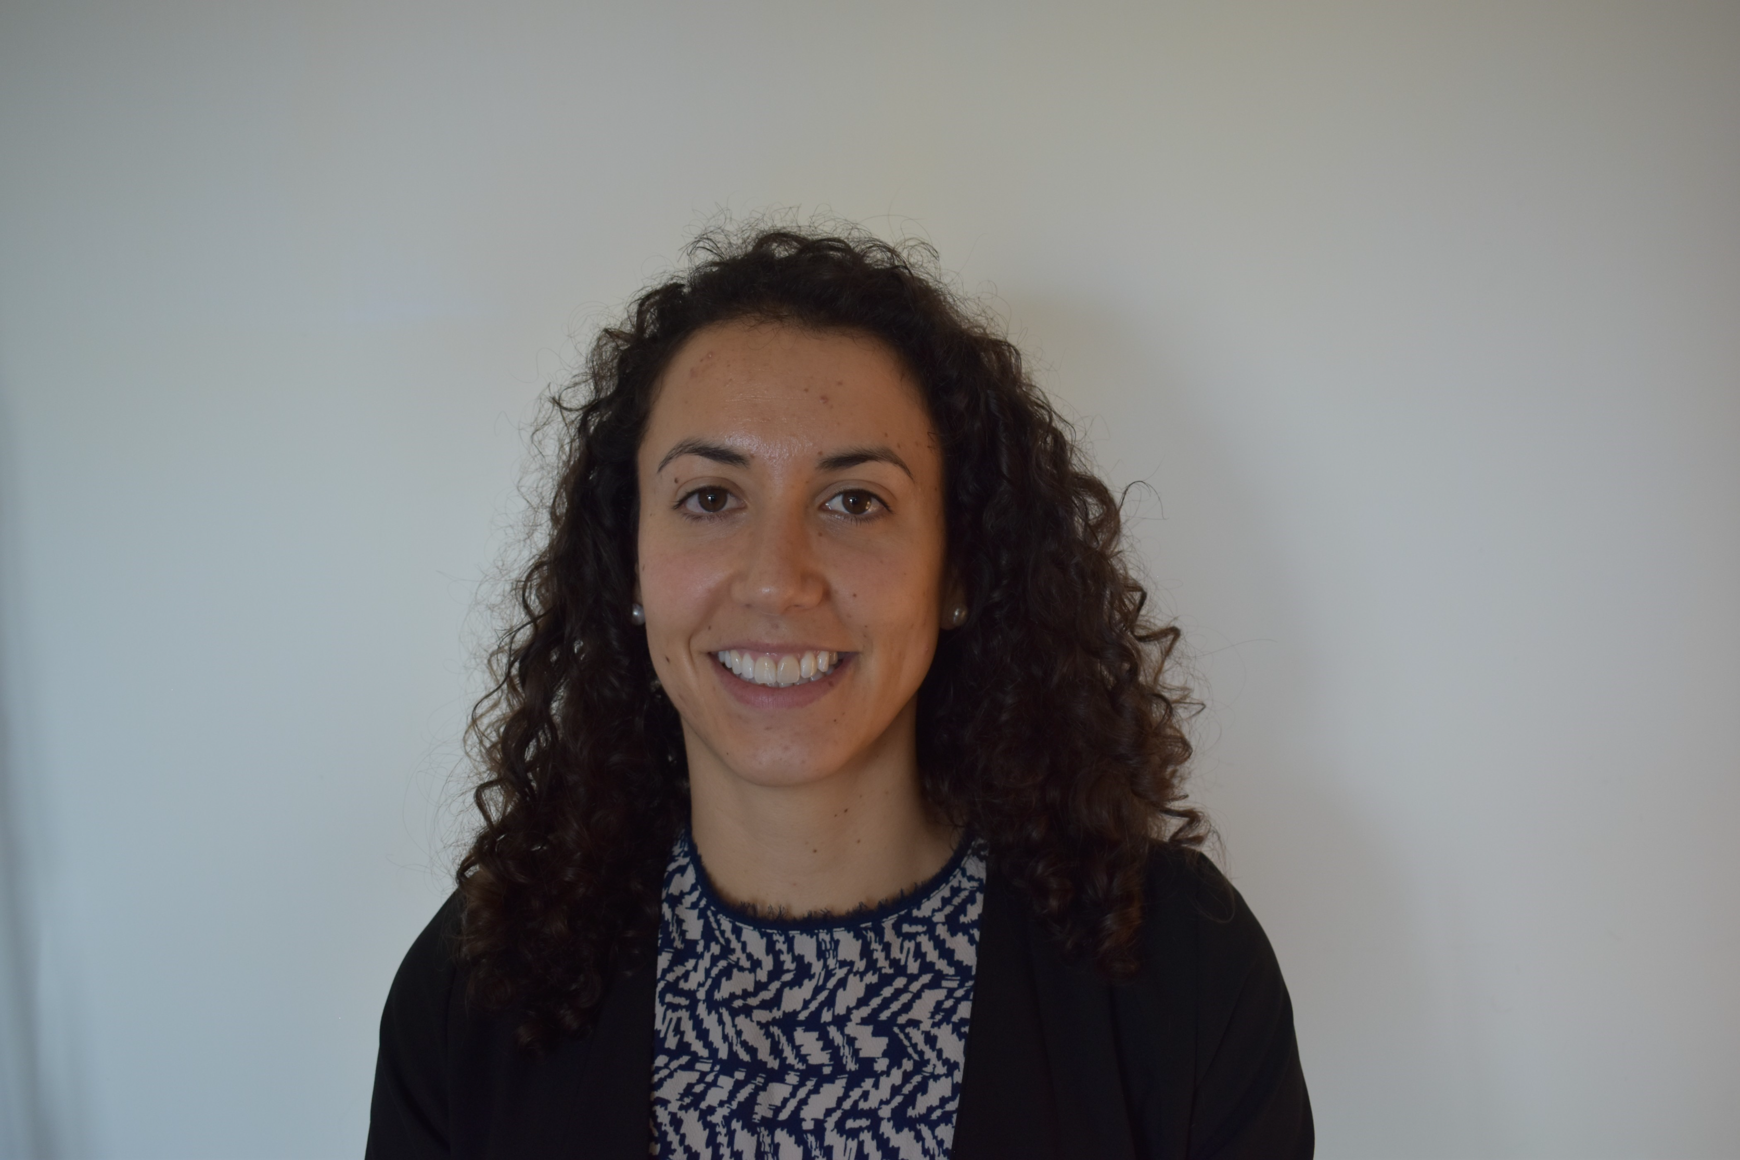
Insider insight (1st Nov session)
Sarah Najera Espinosa:
Food and Agriculture Organization of the United Nations for ~5 years. (various roles e.g. Nutrition and Food Systems, Food Safety).
As a consultant with FAO, worked on food composition, pesticides maximum residue limits, the role of pesticides and microplastics in the human gut microbiome, and the effects of climate change on nutrition and biodiversity.
Conducted in-depth literature reviews, extrapolate and analyzed data, communicate technical results in internal and external reports, and organize two side events at pre-COP26.

Slide 16
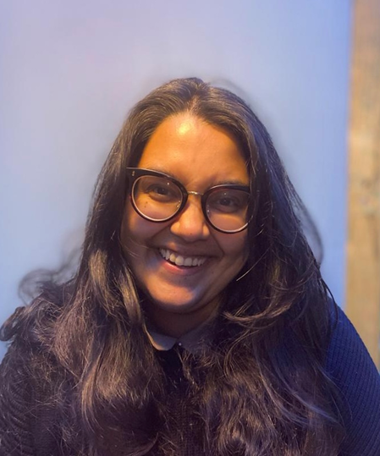
Insider insight (1st Nov session)
Indira Bose
(BSc LSE, MPA Columbia University):
•Currently, PhD candidate at LSHTM researching rainfall variability and the impact on infectious diseases and undernutrition in West Africa
•7 years working at the World Food Programme at HQ and various country offices
•Head of the Policy and Advocacy team in Cambodia for 3 years (leading the vulnerability analytics, nutrition and social protection team).
•3 years at HQ developing and rolling out a model to estimate unaffordability of nutritious diets and advice governments on how to improve their food and nutrition policy and programmes- called ‘Fill the Nutrient Gap’ (Bose et al., 2019).
•Technical Advisor for nutrition analysis and policy for the Zimbabwe CO
•Previously worked with the World Bank, Innovations for Poverty Action, Ministry of Agriculture in Myanmar/World Fish

Slide 17
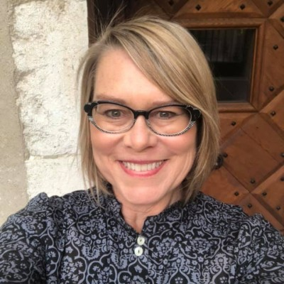
Insider insight (2nd Nov session)
Jennifer Kealy:
Current DrPH candidate, research in Uganda January 2023
Consultant with WHO, Access to Medicine and Health Products Division
Previous experience with WHO in Liberia (2009-2013) and with TB surveys group
Prior experience in pharma, biotech, an academic institute and an NGO
Clinical research (drugs/vaccines/diagnostics for NCDs and IDs)

Slide 18
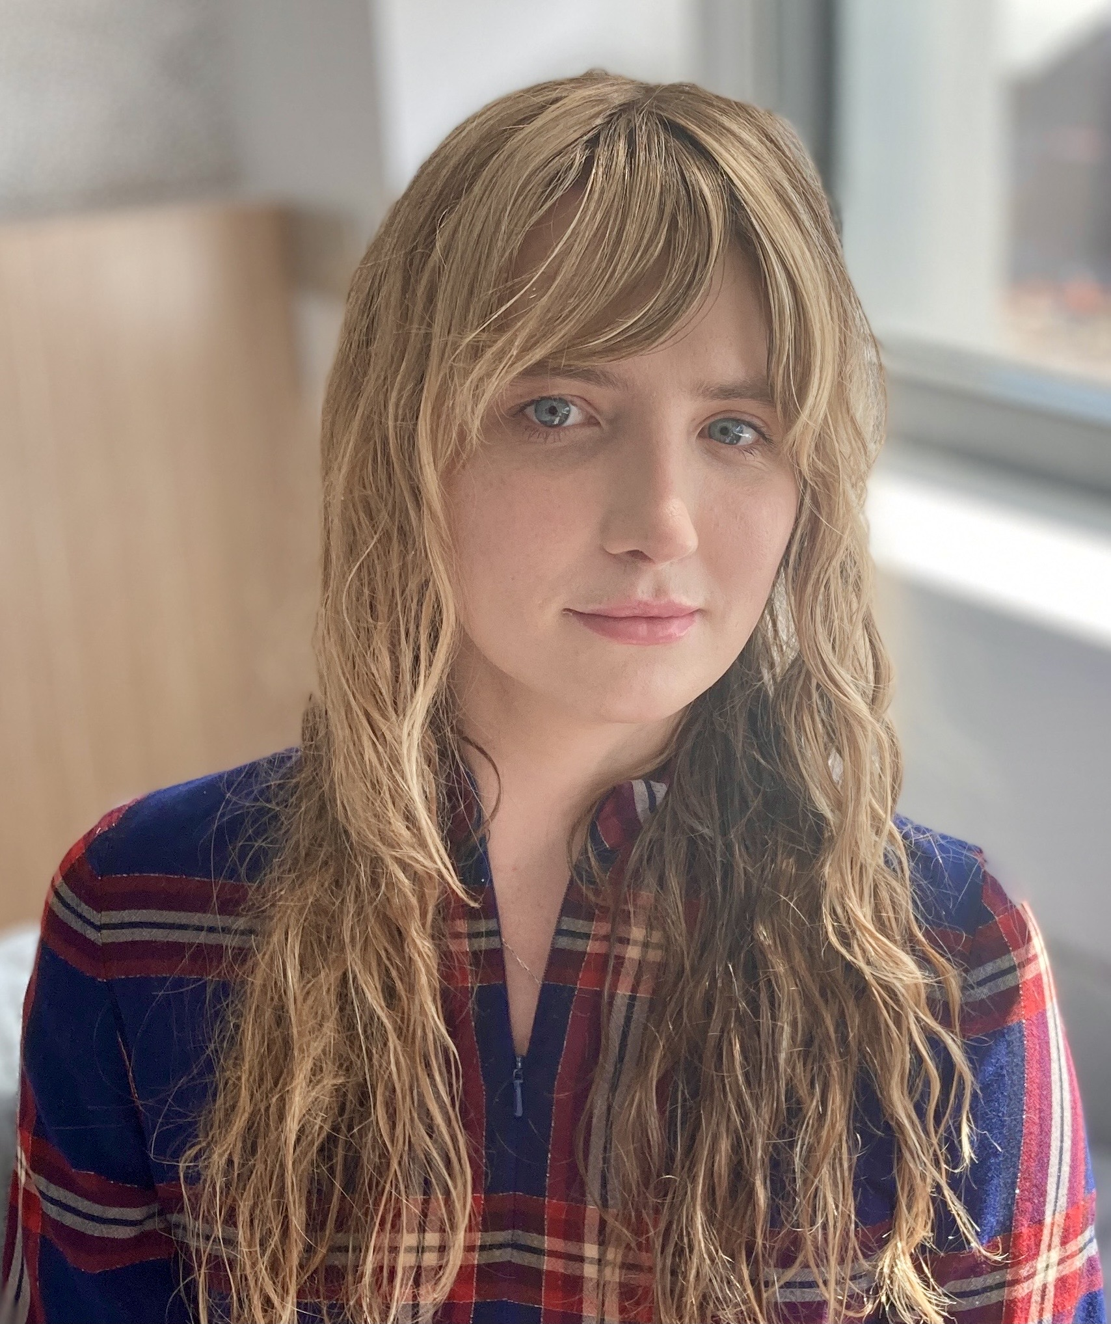
Insider insight (2nd Nov session)
Juliette McHardy:
Consultant with the Department of Social Determinants at WHO HQ, working with Commercial and Economic Determinants Unit.
Consultant with the O’Neill Institute for National and Global Health Law.
Qualified lawyer and admitted solicitor and barrister of the High Court of New Zealand, background in national and global public health law, human rights law.
Internship at WHO’s Fiscal Policies for Health Unit focused on advancing national legal capacity for health-promoting taxation.
Continued with WHO as a full-time consultant before starting a Fellowship at O’Neill
Current MSc in Health Policy Planning and Financing at LSHTM and LSE.

Slide 19
11 general tips for building a career in an international organisation
(courtesy of Michael Emery, HR Director, IOM)
Qualifications (agencies vary a little, but many prefer a master’s)
Documents (get the paperwork right). Be aware that funders such as DFiD are increasingly ‘results orientated’.
Networking is vital
Tier 3 ‘passive networkers’
Tier 2 ‘active networkers’
Tier 1 ‘creative networkers’ – be one of those
Reputation management (not just your online presence but the way you behave towards colleagues – 360)
Competencies (used for recruitment and performance management)
Job satisfiers (think about what satisfies you in a job)
Values (e.g. could you answer, “What are the three values that are most important to you and how do these values translate into your work?”)
Notes:
Michael Emery’s advice on networking is totally reflected in what Fabrizzio said. Tier 1: make your opportunities.

Slide 20
11 general tips for building a career in an international organisation
‘Opportunity scans’ – where are you most likely to find an opportunity?
EQ (emotional intelligence) – the ability to fit. How aware are you of your cultural/personality coding?
Momentum – most people join in their early 30s (NB WHO suggested 42…), have to build towards that.
Luck – “when preparation meets opportunity” (Oprah), “The harder I work, the luckier I get” (Edison)
Core skills: agility, love, diversity, care.
Notes:
Keep an eye on funding e.g. change because of COVID. Check our recording of finding work outside the UK which goes into this in more detail.
Keep LI as your CV relevant to UN keywords and follow them. Check alumni careers and ask to connect: say you are at LSHTM and see they are an alum up front.
They tend not to count internships as years of experience in some orgs. You might not need to call it an 'internship'.

Slide 21
Your situation, and possible next steps
How much experience do you already have?
Can you apply for ‘in-country’ posts in your country?
Could you afford to do an unpaid internship?
Would you consider yourself a Tier 1, 2 or 3 networker?
What languages do you speak?
Are UN jobs what you thought they were? Are you keen enough to persevere on this route?
Which would be the most appropriate UN organisation for you?
What steps would bring you closer?
Would YPP or JPO be potential route for you?
What other organisations could you work for?!
What are your values? Can you articulate them?
Notes:
Qs to ask yourself

Slide 22
Other organisations
Look at destinations info on Moodle
(Marie Stopes International; Terrence Higgins Trust; WaterAid; GSK; KPMG; Boston Scientific; CHAI; Ministries of Health of various countries; MRC/UVRI Uganda Research Unit on Aids; Cancer Research; IQVIA; Anthony Nolan Trust; GOAL; MSF; Merlin; Action Against Hunger; Deaf Child Worldwide, Malaria Consortium…)
Get ideas from LinkedIn (LSHTM alumni)
Spotlight on selected employers - brief reports on 20 organisations:
Gain experience eg
CHAI volunteers
Indigo volunteers
What organisations are working in the area (geographical) or field (topic) that you care most about? What contacts do you have/can you make?

Slide 23
Further info
Folder of other resources on Careers with UN organisations – Careers Moodle - Exploring Career Options (recordings).
Also Careers Moodle - Career insights from alumni, employers and students

Slide 24
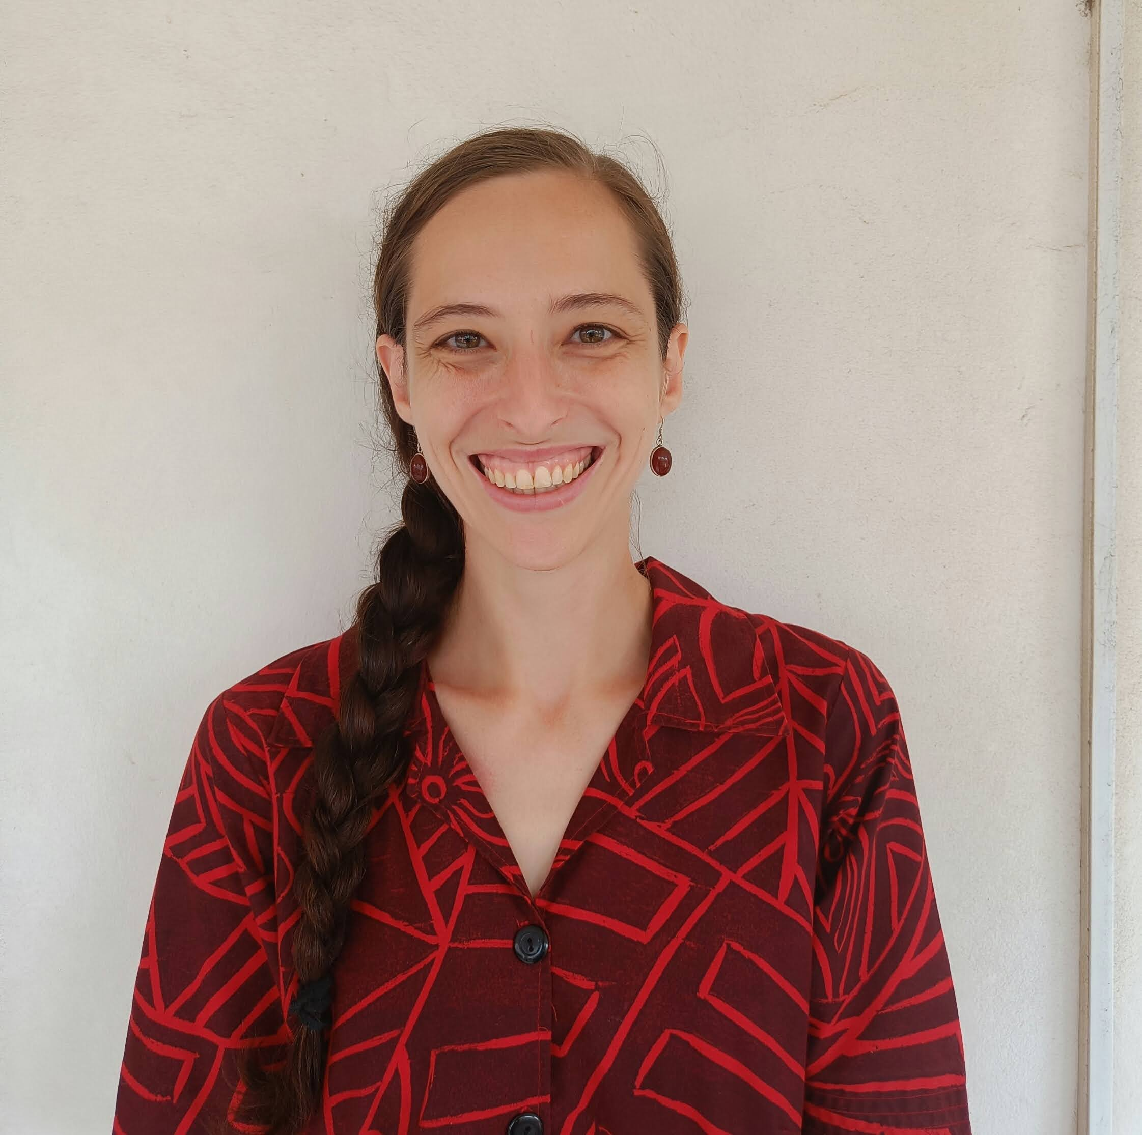
Insider insight
Katy Mackey
Katy started her PhD with LSHTM and St George’s University of London in September 2023, looking at the impact of health policies on migrant children.
Prior to this, she worked as a UNV with WHO Somalia as Programmes and Donor Support Officer and continues to support the office through resource mobilisation, external relations and programmes support.
Katy has seven years’ experience working in international development across public health, peacebuilding and governance and has also worked with UNFPA and the International Planned Parenthood Federation to map sex education programmes in the Pacific and to conduct policy analysis.

Slide 25

We value your feedback
https://forms.office.com/Pages/ResponsePage.aspx?id=oaKtcild7U6xlPh0V3cUnib6FT5JU2lKm1h1jmhk5TFUQ1NBQ1gyMkZNTEdINjBKM0tJQjQ3MlNTSy4u
Please complete the feedback form – the link is in the chat box!​
​
And now let's move to your questions.....

Slide 26
What else is coming up?
Check Moodle Forthcoming workshops and events, including:
LSE Discover International Organisations (11 Nov)
Finding and funding a PhD (14th & 16th Nov)
PhD Applications (21st & 22nd Nov)
Global & Public Health Careers, Alumni Panel (28th Nov)

Slide 27
Opportunity with LSHTM Careers
Become a Careers Project Assistant
Organise a series of student-led careers seminars for Spring term
15 hours’ paid work
Apply by 17:00pm Monday 6 November
Full details here
Notes:
https://lshtm.sharepoint.com/:w:/s/careers_Group/EYU3sTTsfrNOt3qtgQAd568BSZr0OjmvtmOFCypZ89jqwA?e=BQ0wTb link to CPA info

