Slide 1
Student Lead Seminar
Sexual Reproductive Health
Alhaji Mohamed Kamara
MSc. Reproductive and Sexual Health Research
Chevening Scholar

Slide 2
Outline
Overview of my organisation
Roles & Responsibilities
Why LSHTM
Next career step

Slide 3
Overview of my organisation
MSI Reproductive Choices – Sierra Leone (locally known as “de mammy fo welbodi” or “the mother of health”, )
Reputably known as the major actor in the SRH landscape in SL - provider of all modern methods of contraception (STM, LARC, Permanent) post-abortion care. Run a Social Business model approach.
https://www.mariestopes.org.sl
Run outpatient
Laboratory services
Maternal and child health services (ANC,PNC)
Testing and treating for STIs,
Cervical cancer screening and management (Pap smear & Cryotherapy)
Channel of service delivery
Mobile Outreach
Static Clinics
Social Marketing
Public Sector Strengthening & Advocacy

Slide 4
Role & Responsibilities
Deputy Director of Commercial (Clinics & Pharmacies operations) and Marketing – SL & Liberia
My Work focused on four thematic areas:
Proving overall leadership for the CMD
Ensuring the Sustainability of the program
Advocacy & public engagement
Clinics operations (HR, supply chain)
Major Projects
DFID/FCDO grants, LAD, UNFPA
SL2: Saving Lives phase II/Health System Strengthening
WISH: Women Integrated Sexual Health
SAFE: Safe Abortion for Every Woman

Slide 5
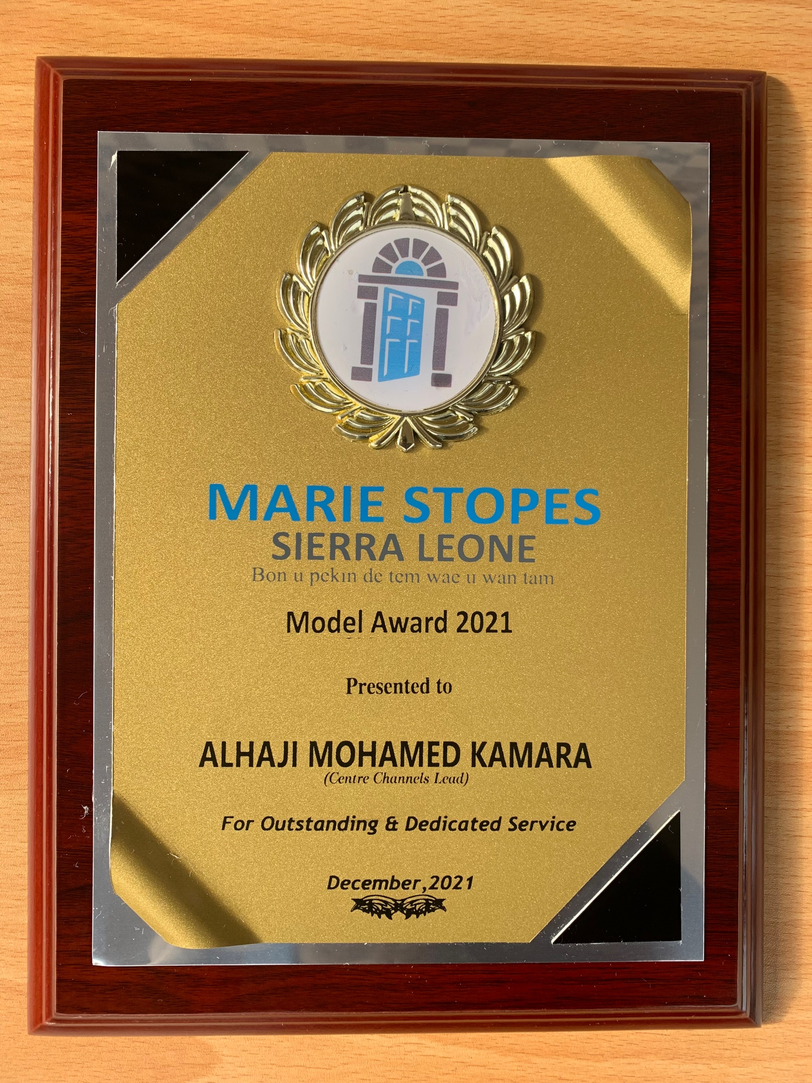
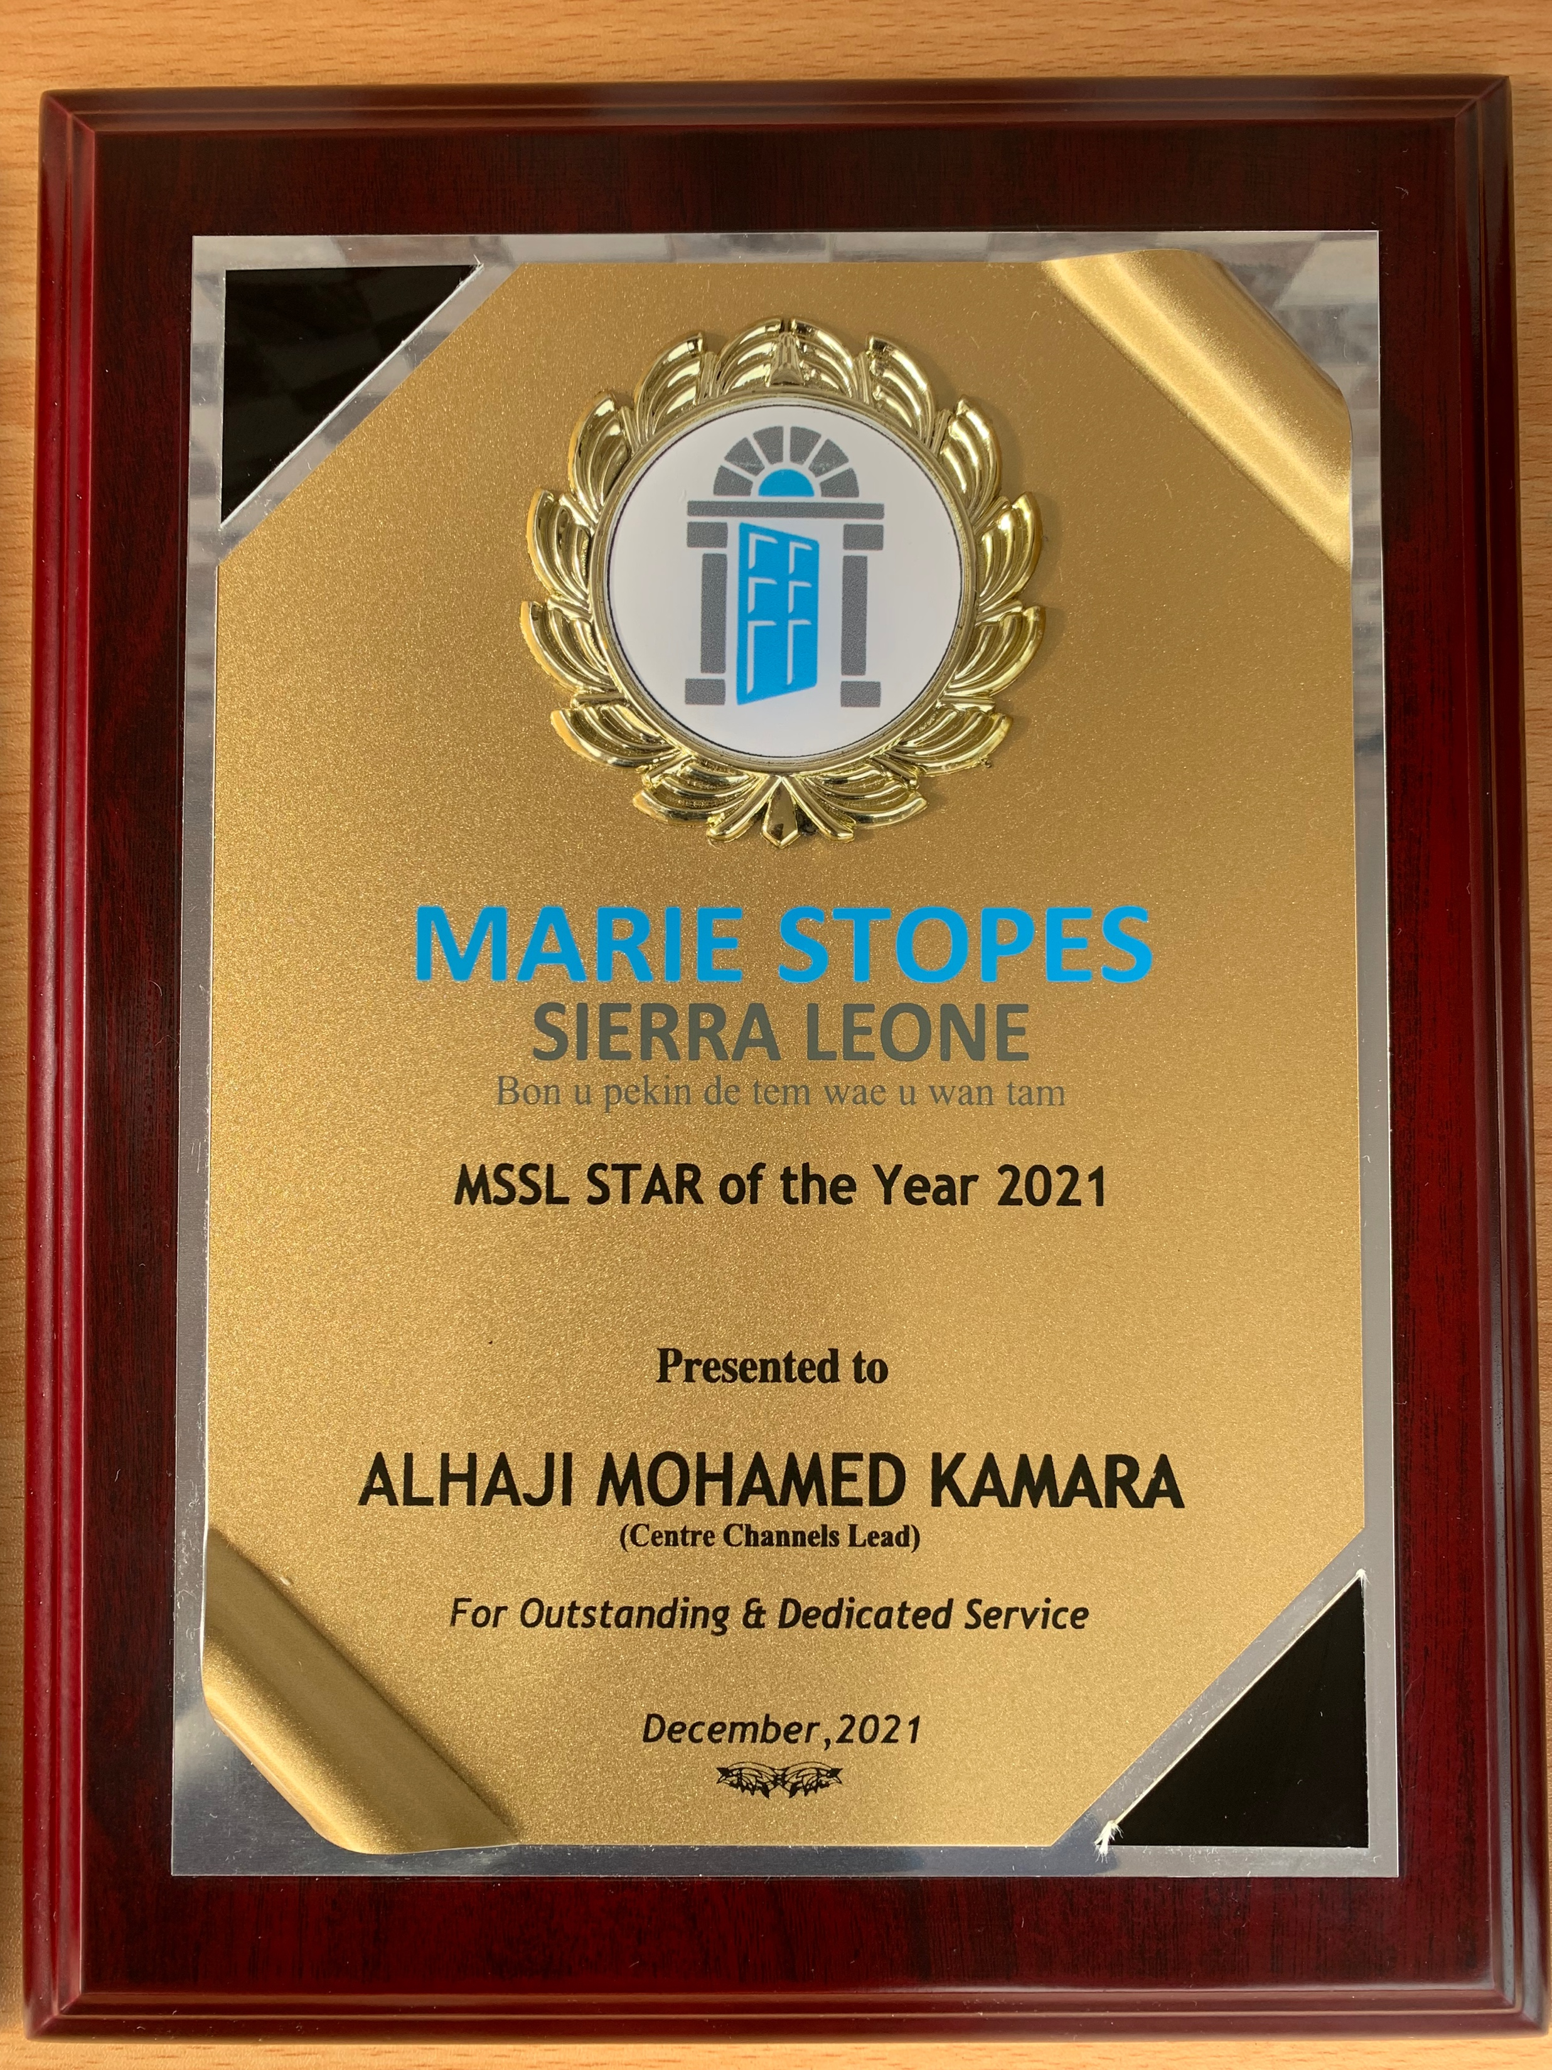
What was it like to work there?
Challenging! KPIs (Targets) driven organisation
Stigmatising – Healed from a Muslim family & District
Restrictive environment for abortion services
Fulfilling serving women and girls
Networking opportunities with both local & international colleagues
Travels & Exploring (ICPD25)
Learning opportunity
Recognition, promotions and Awards!!
Awards for outstanding performance

Slide 6
Personal story
Why a career in public health?
My Country’s poor health indicators – MMR, IMR
Health Workforce Gap in Sierra Leone
Fragile Health system – Post Conflict nation, repeated epidemics
Contribute to national development
Why LSHTM?
Reputation
Opportunity –Networking, collaboration, study opportunity
Brand

Slide 7
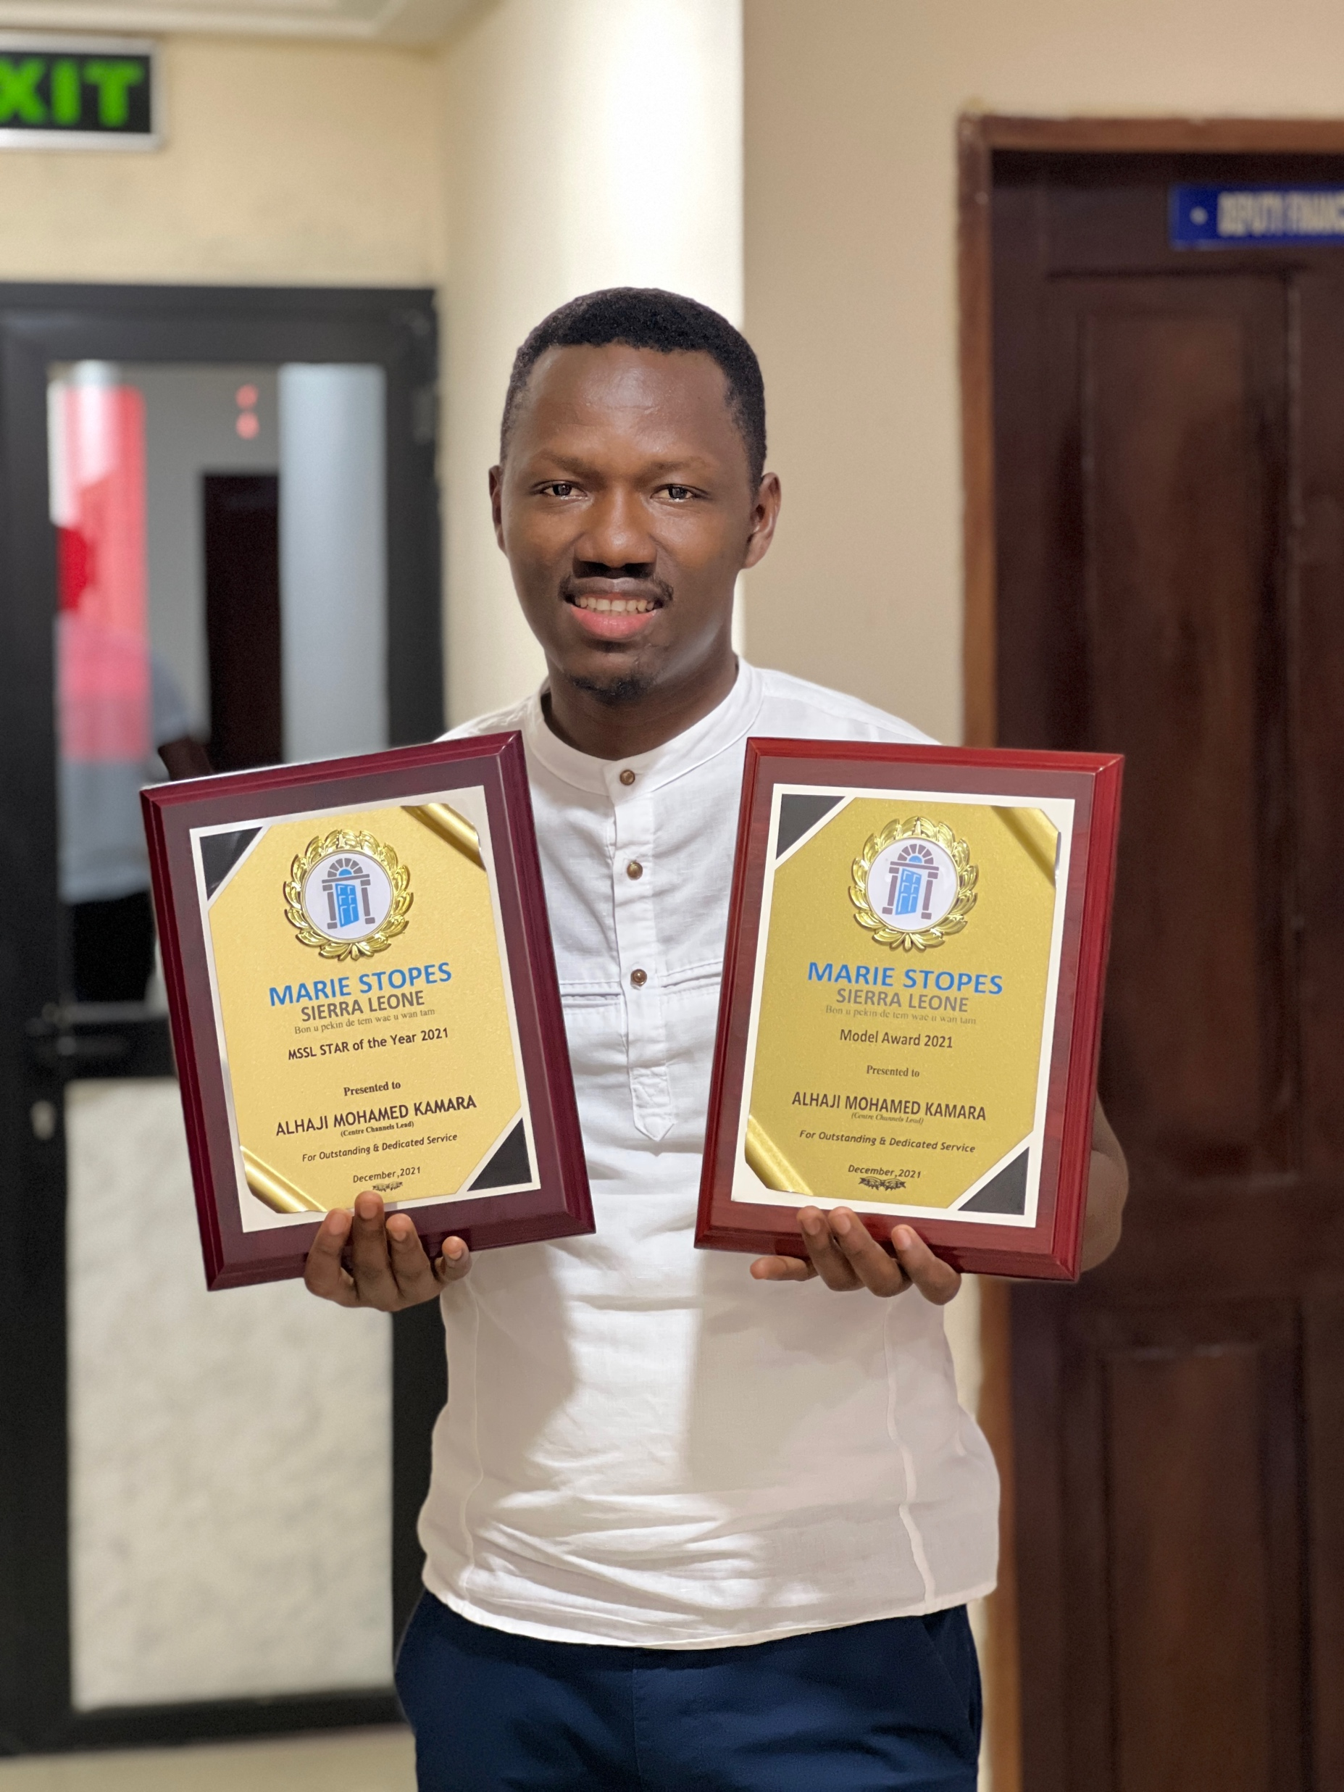
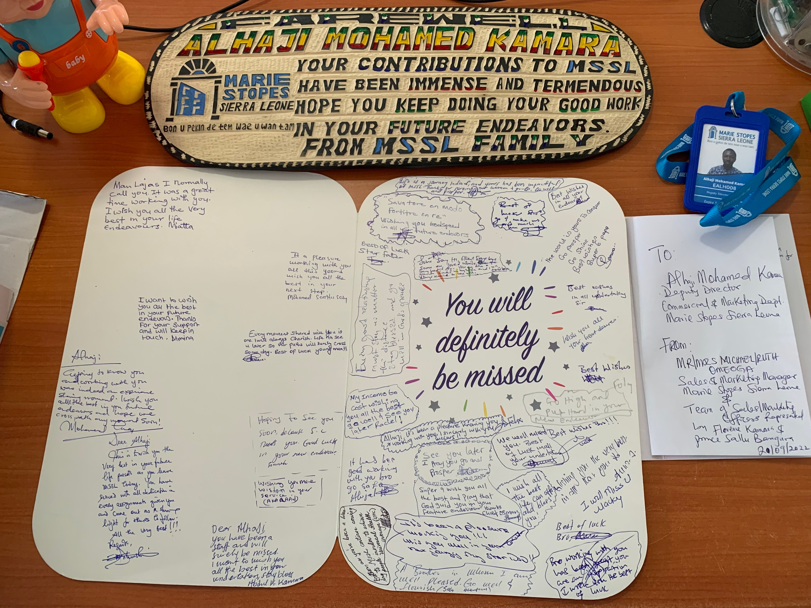
Achievement
The digitalisation of the health system – EHR
Solar Panel introduction – Electricity Challenge
Rebranding and Improving our Laboratories & Clinic infrastructure
Cabinet papers signed by the Minister of Health
Awards and Farewell gift

Slide 8
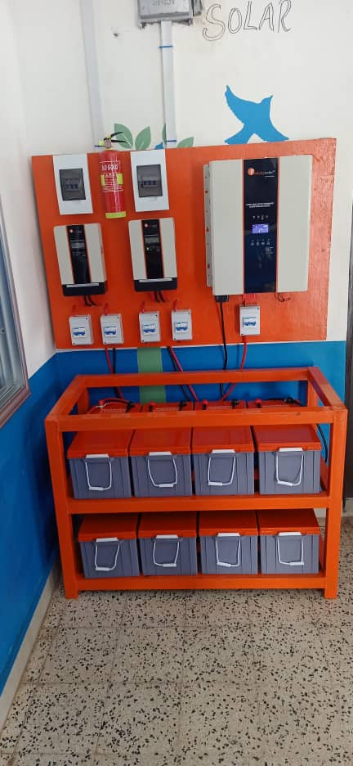
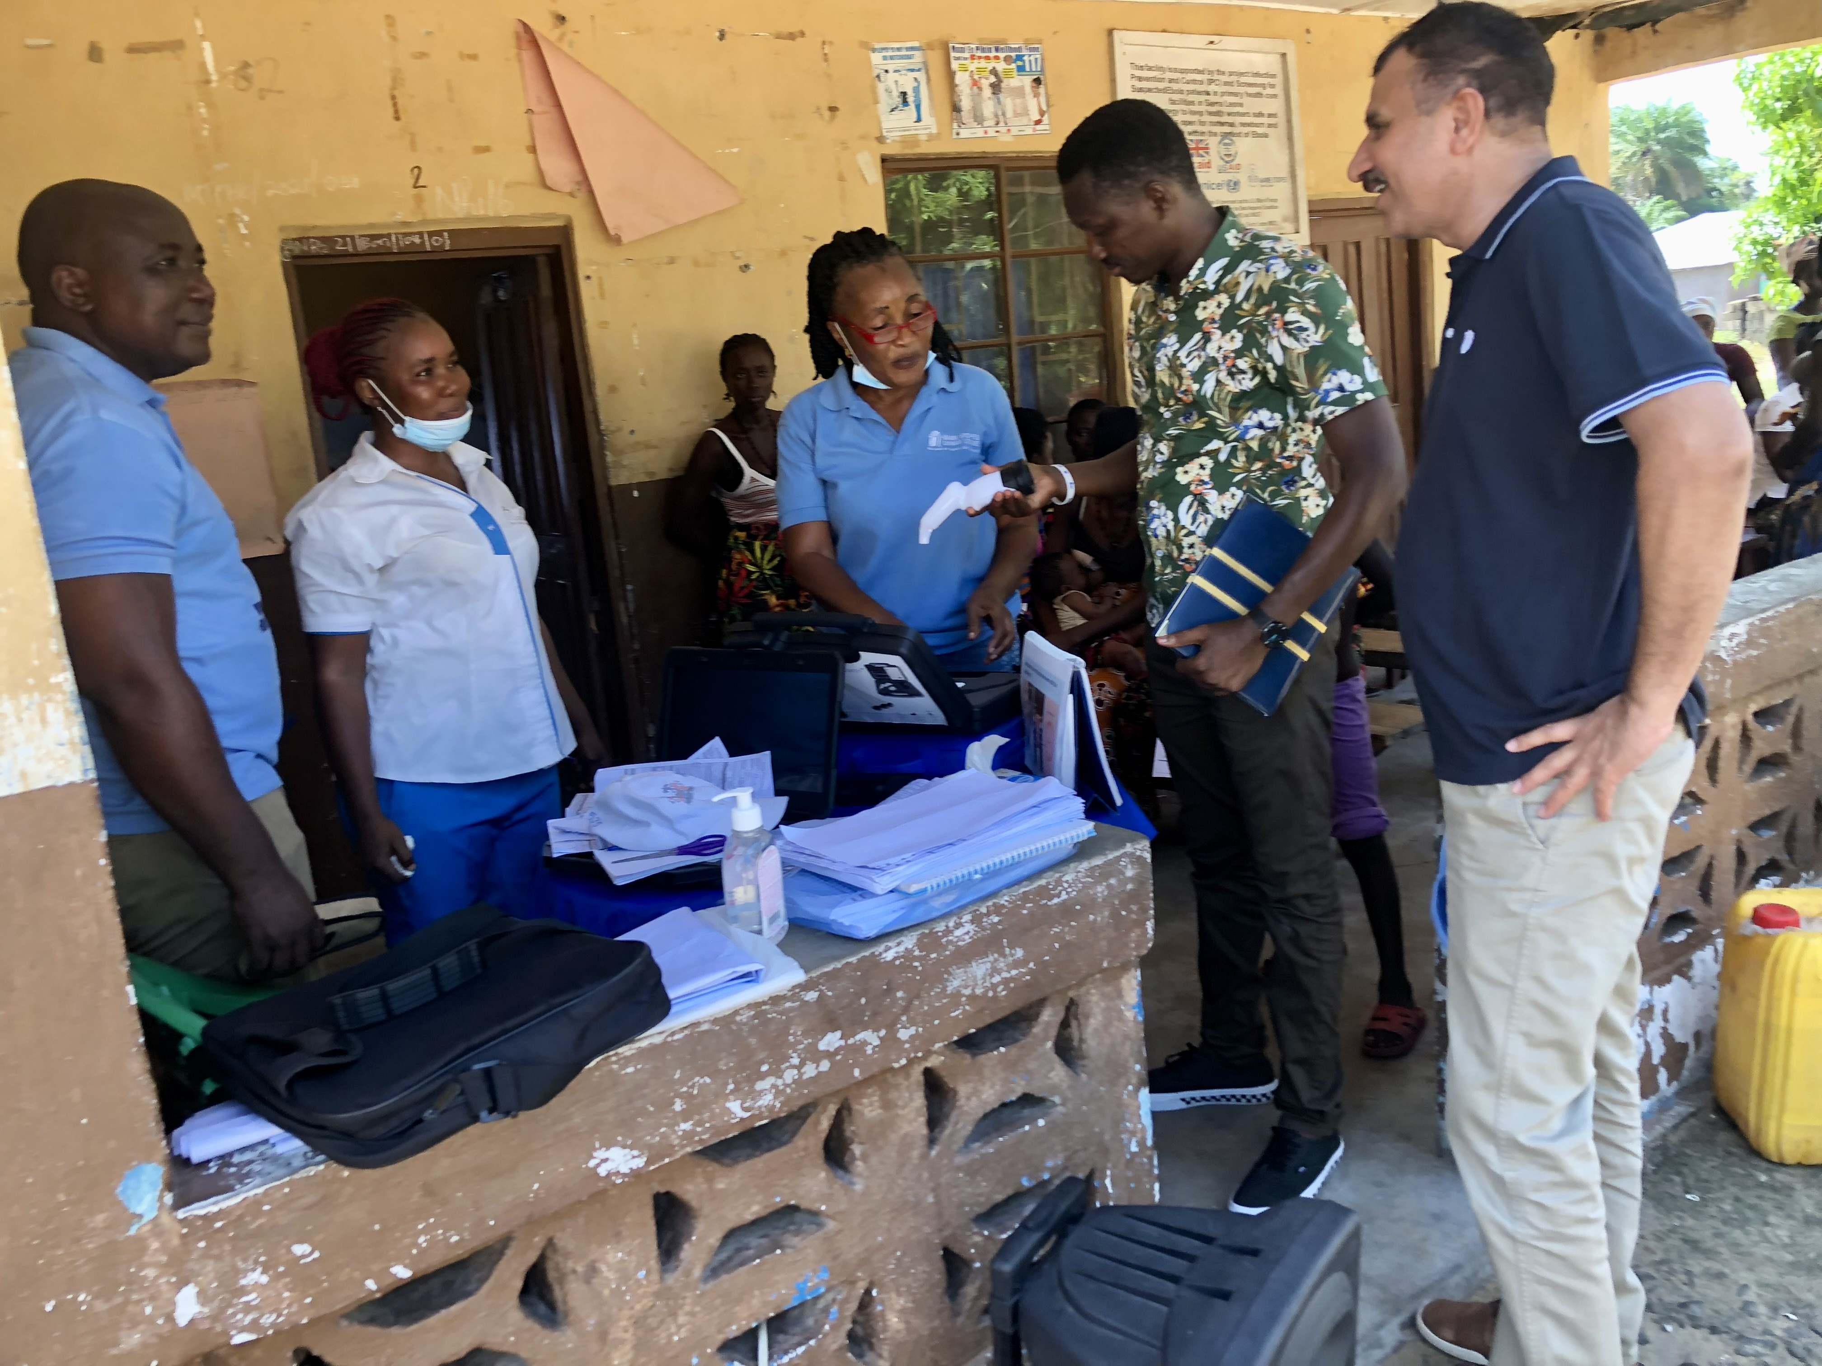
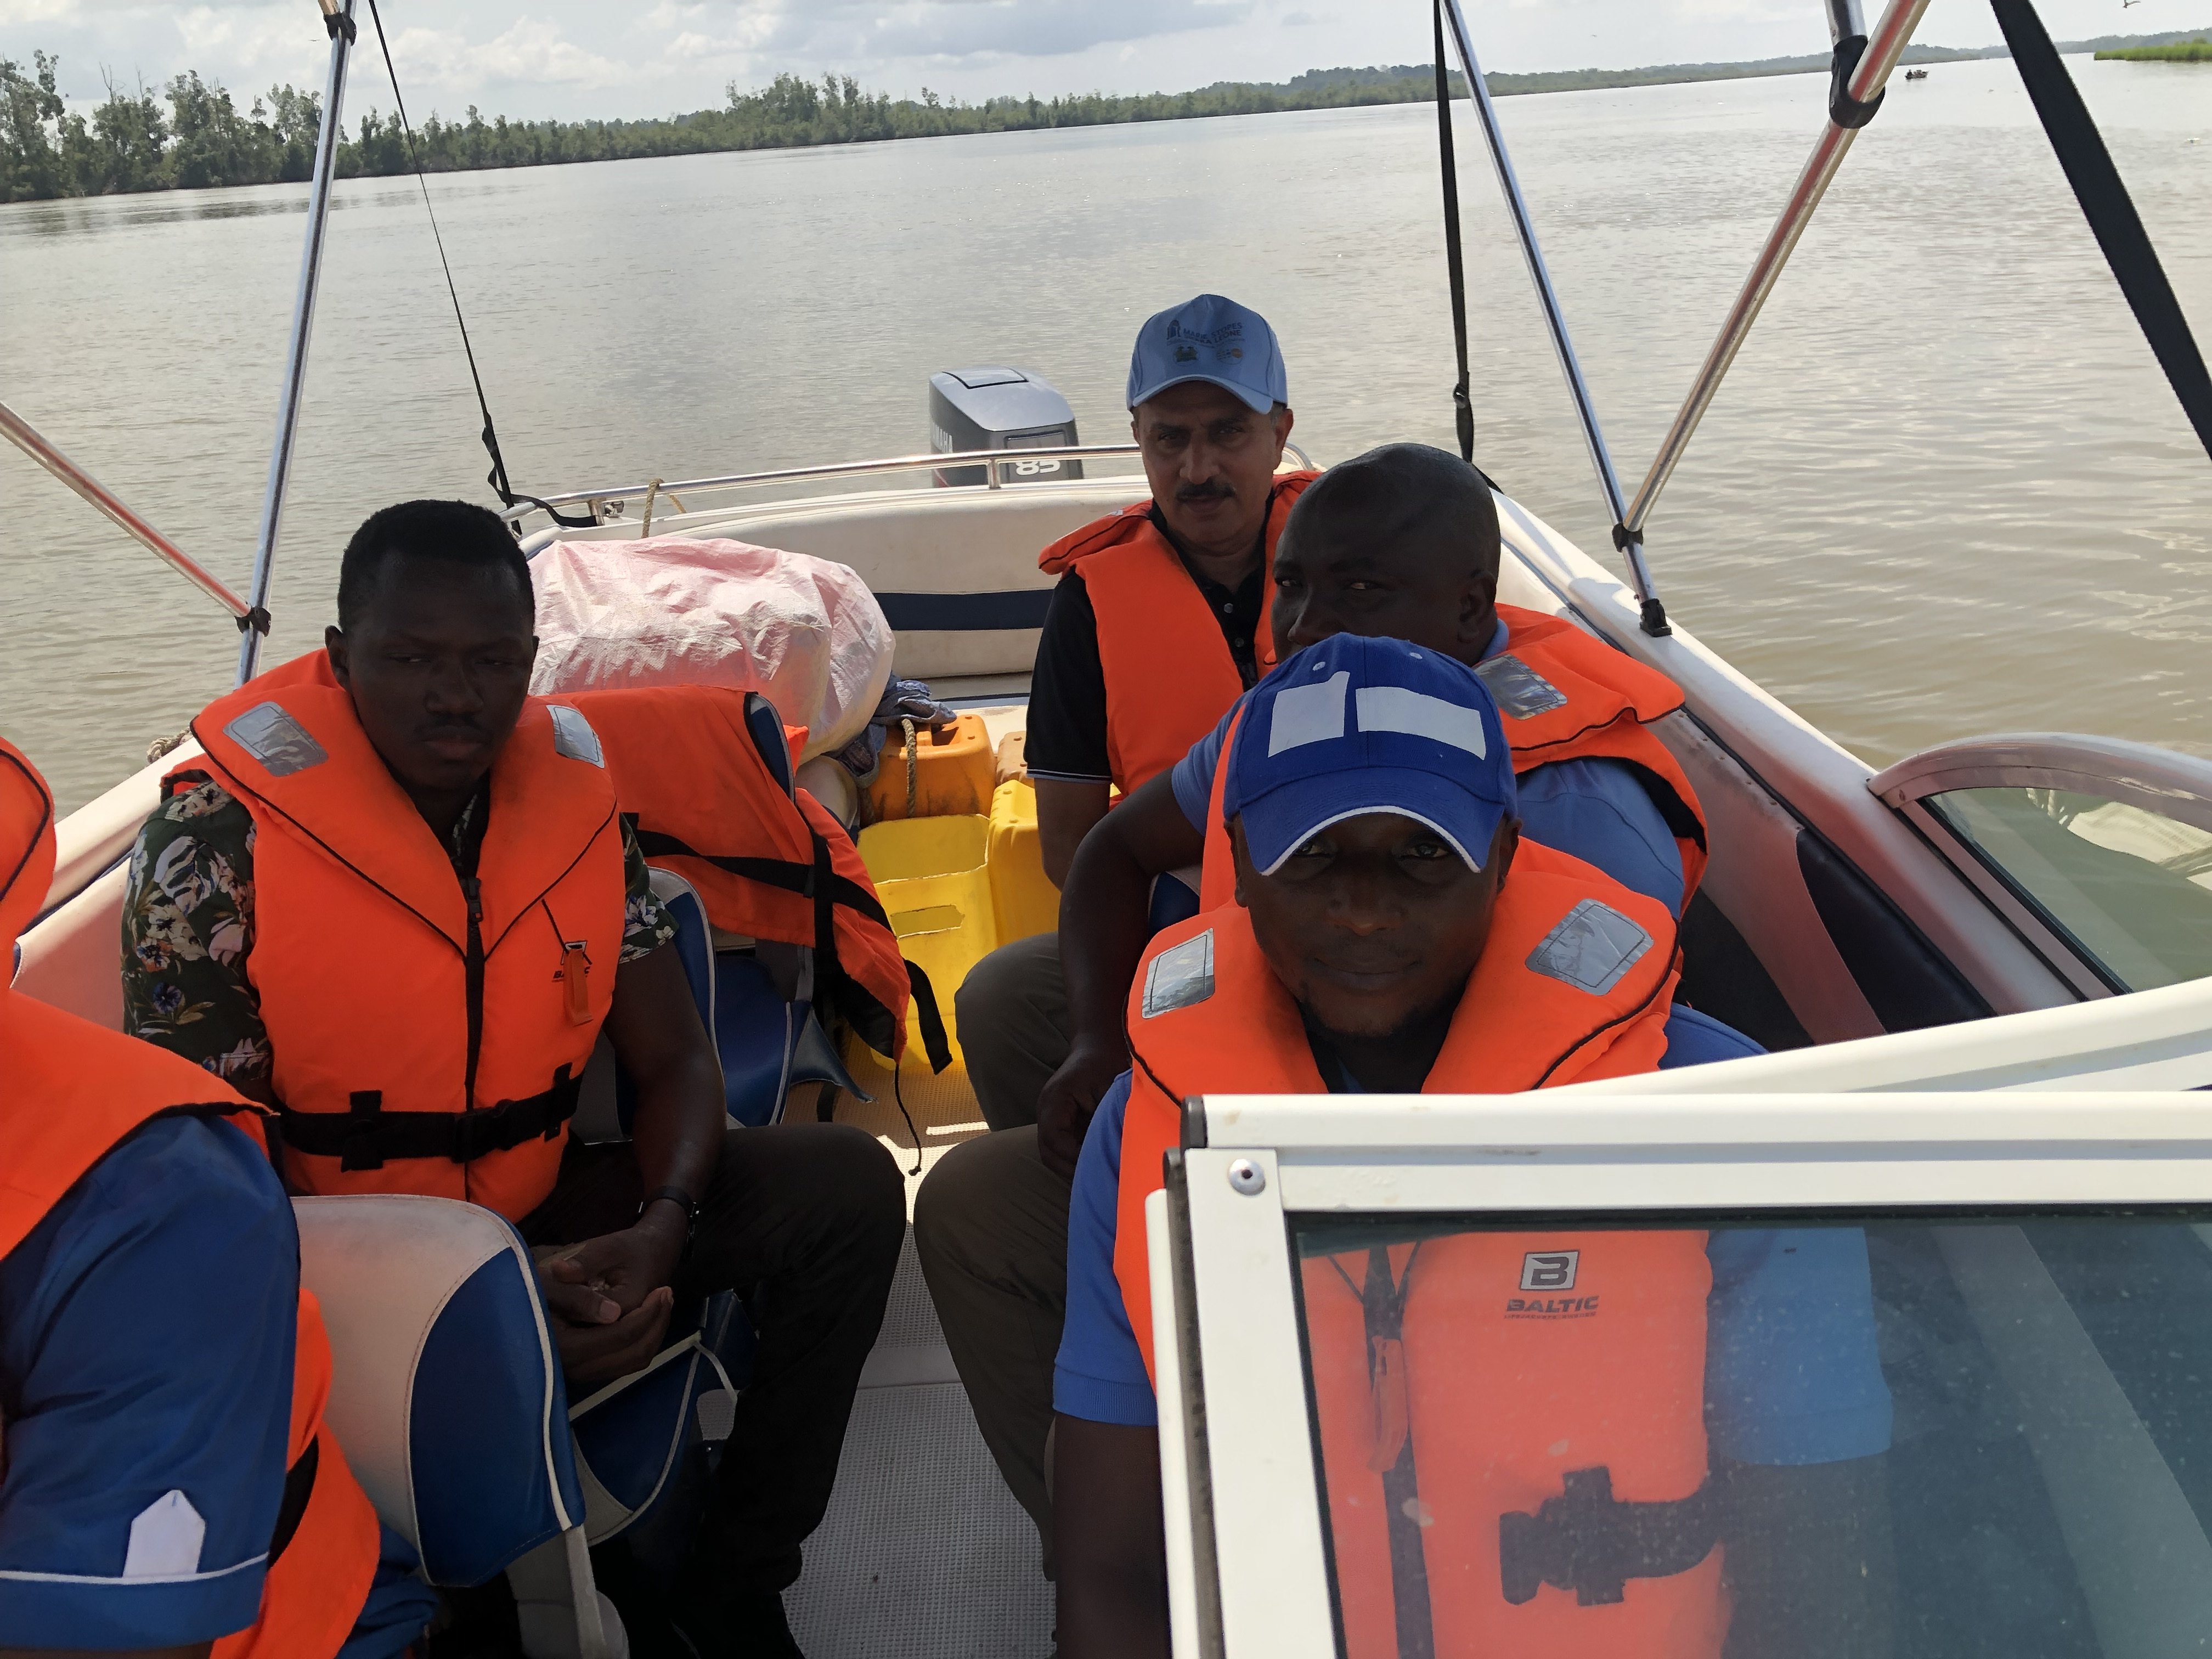
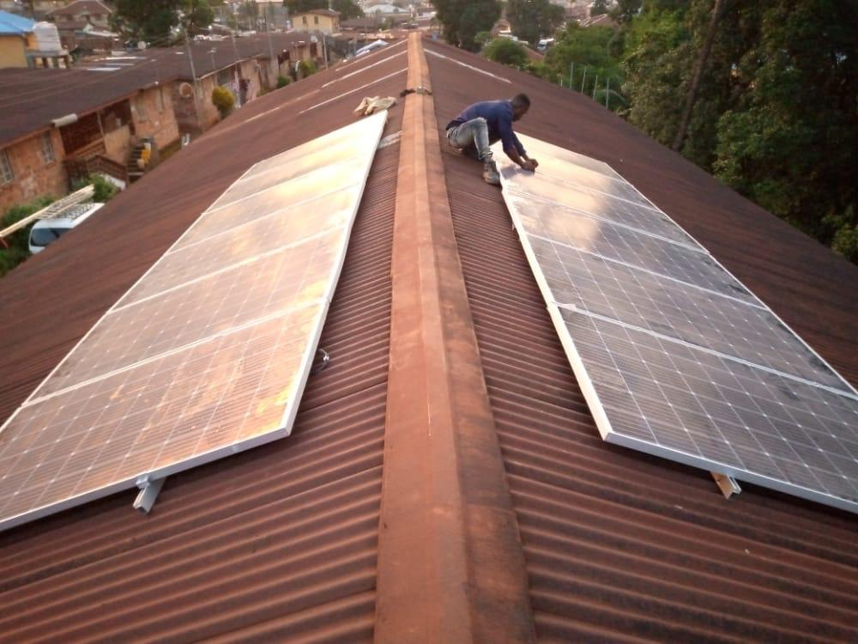
Achievement
Solar Panel Installation
Field Visit to an island

Slide 9
Career Plan
Research – Focusing on Maternal health & SRH
Working with UNFPA, WHO, UNICEF
Support Health System Strengthening – Epidemic Preparedness & Response
Teaching!
Advice
Be passionate about what you do
Be courageous and determined to change society
Learn to do things differently – Engage, ask, learn, take time
Push boundaries!
Play the office politics!

Slide 10
THANK YOU

