Slide 1

Student Lead Seminar
COVID-19 Response in the UN System in South Sudan
Robert Lubajo
MSc. Health Policy Planning and Financing
Chevening Scholar

Slide 2
Outline
Overview of my career
COVID-19 role response
Why Study at LSHTM
Career Plan

Slide 3
Career overview
BSc Medical Laboratory-Makerere University Jan-2016
MSc Public Health-USW (Online)
Health training consultant- International Medical Corps, train nurses, midwives at diploma level-June17
Laboratory Technologist WHO, June 2018
UN Clinic Laboratory Technician, UNDP-Oct 2022
Appointed by UNDP management to lead COVID-19 response

Slide 4
Leading COVID-19 in the UN System
What’s this role all about?

Slide 5
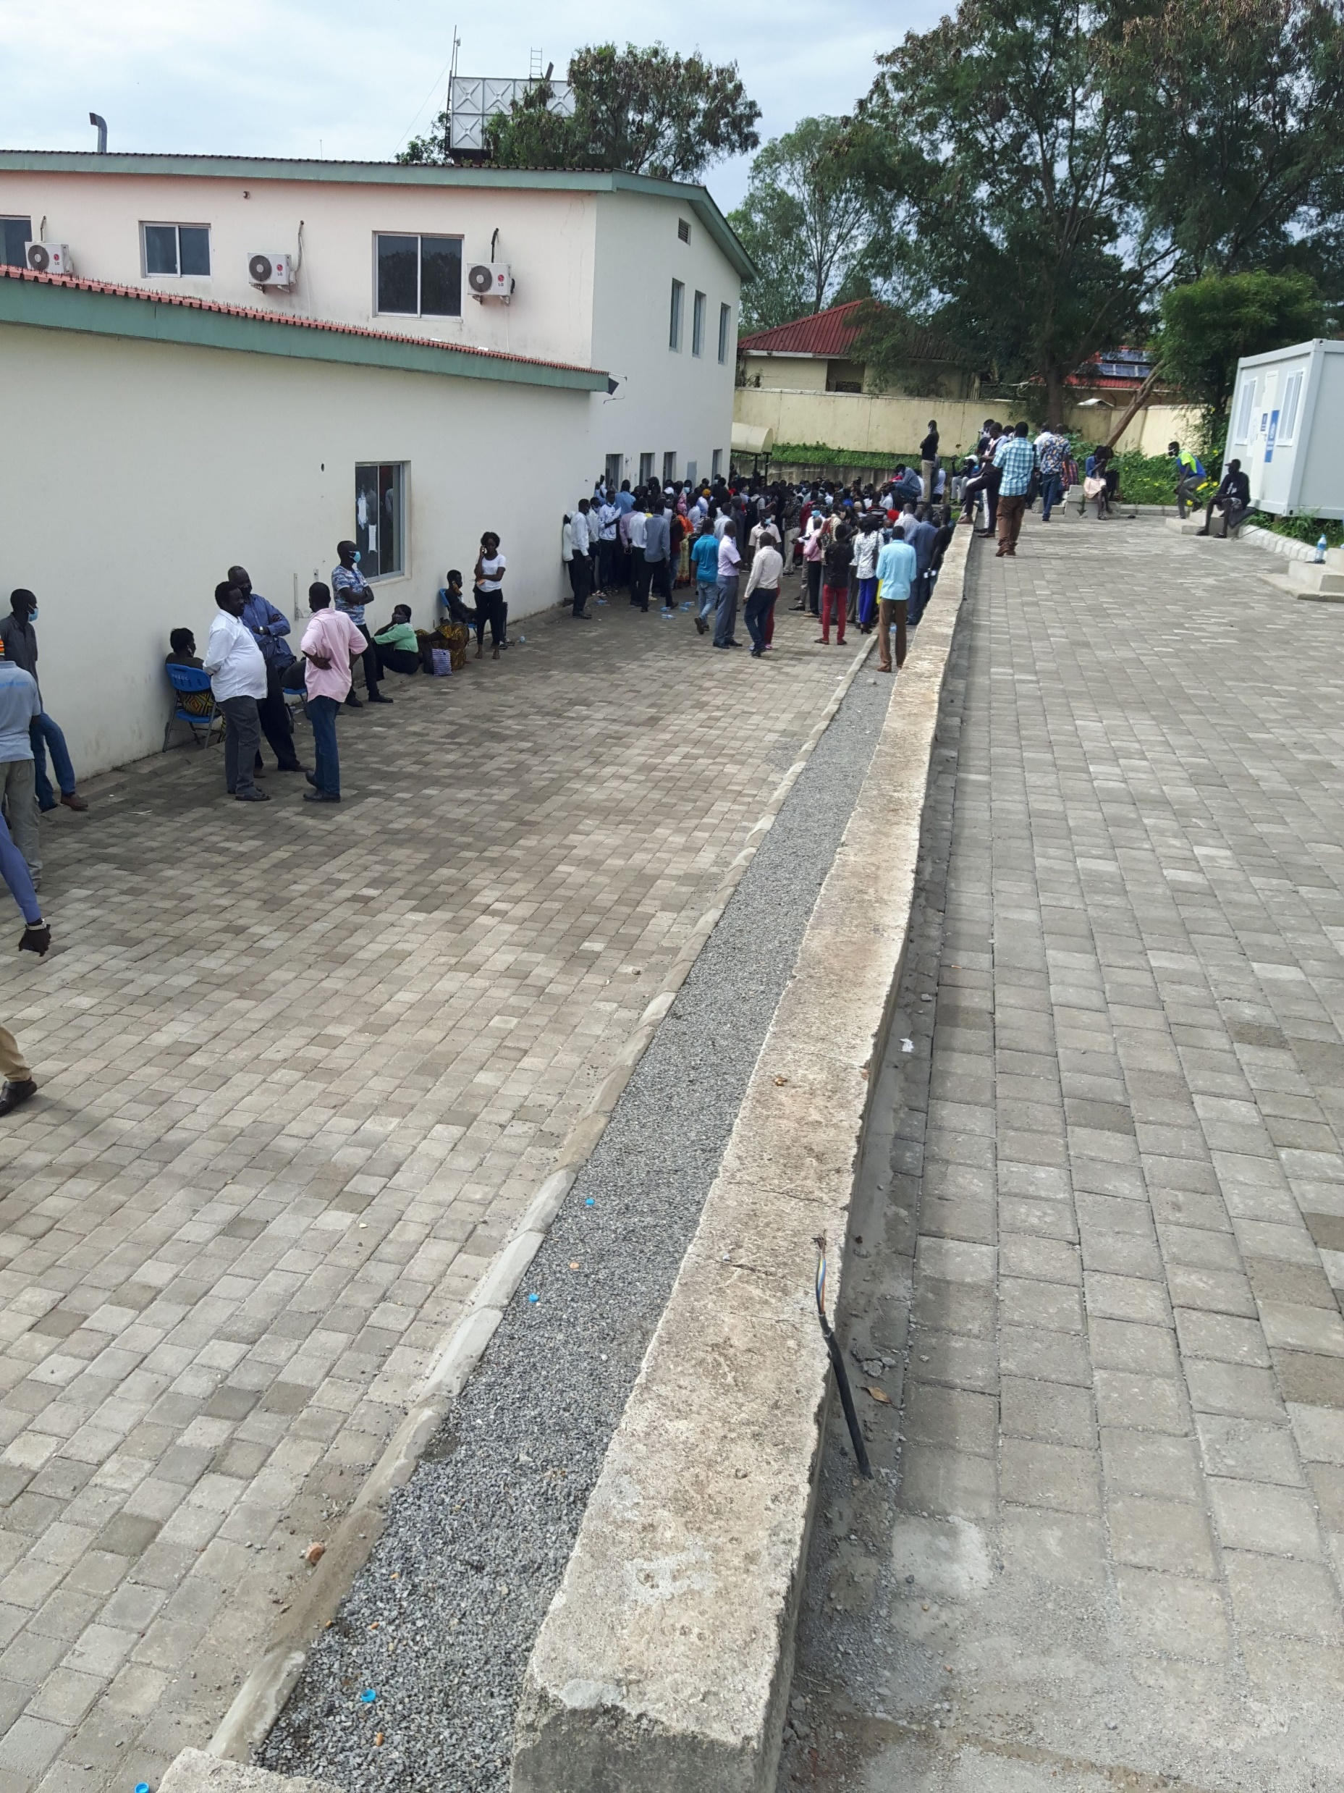
COVID-19 South Sudan, Context

Slide 6
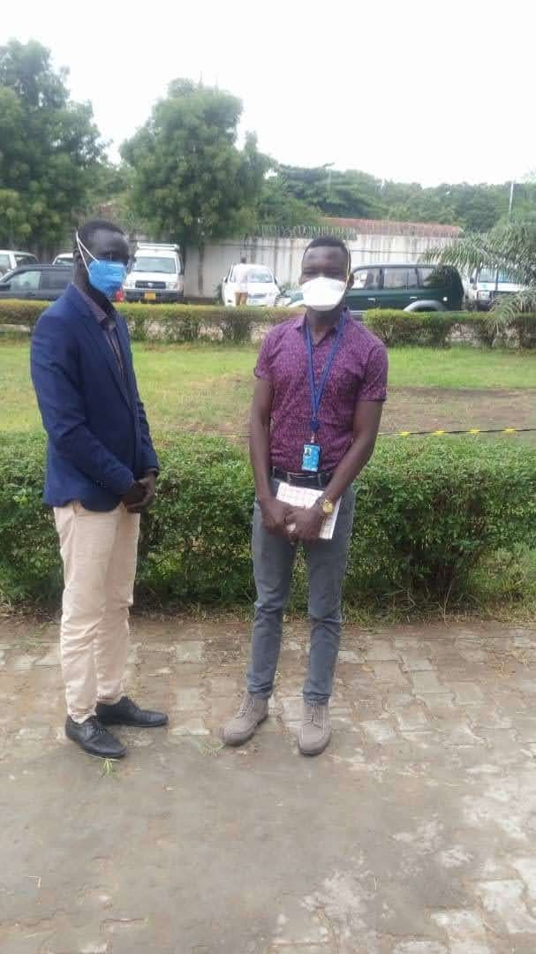
My roles
Negotiate with MOH
Priority for UN staff
Timely PCR test result
Sample collection in a safe place
Successful

Slide 7
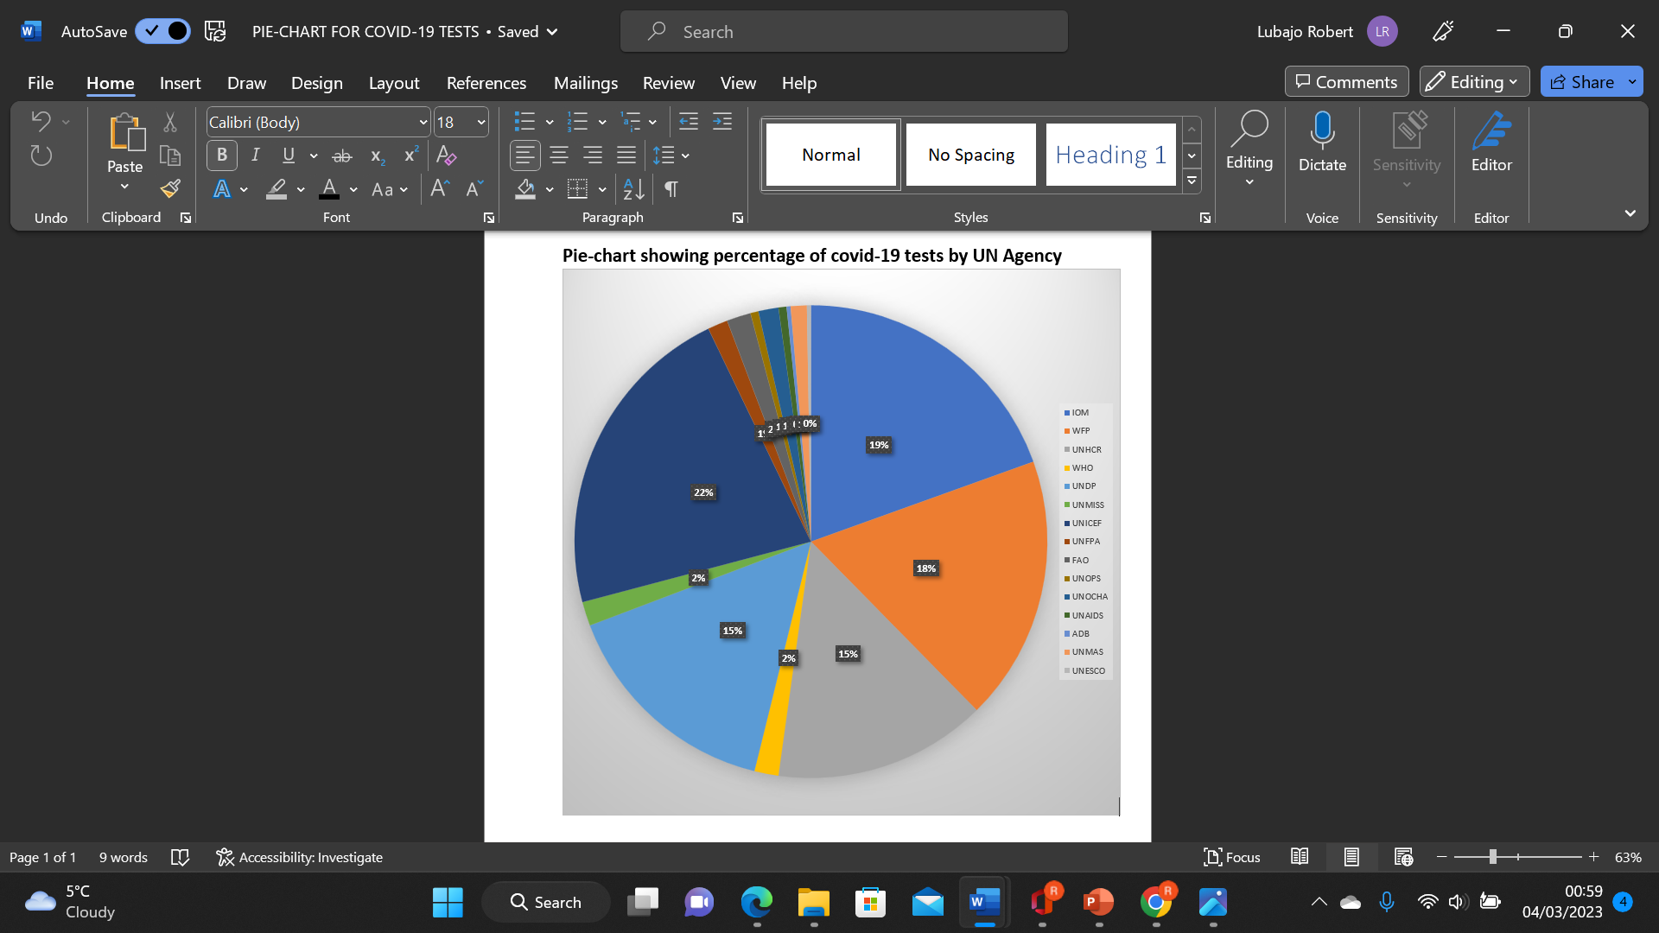
Outcome

Slide 8
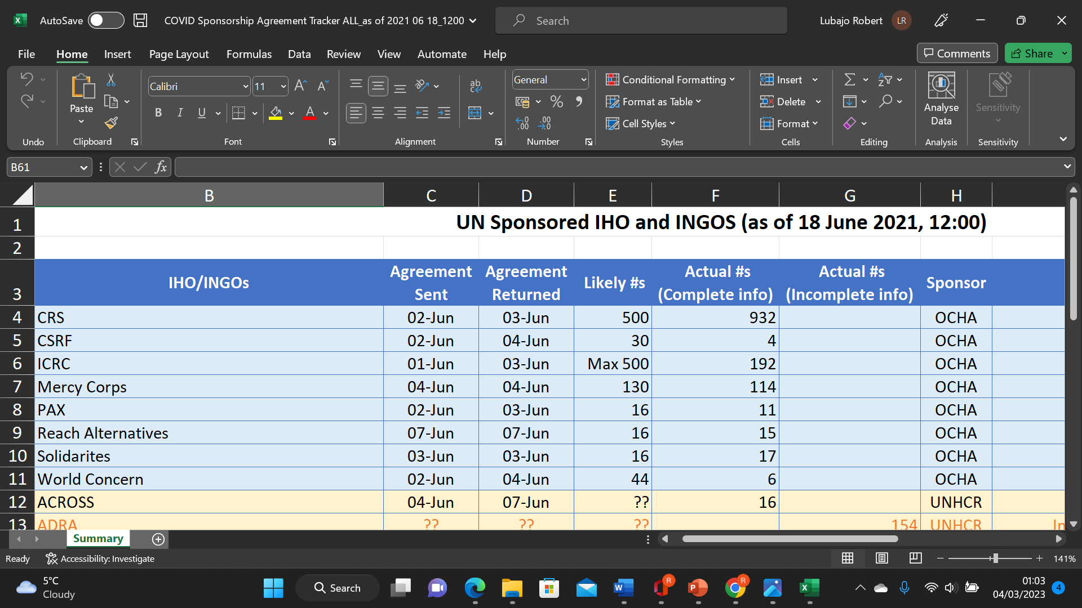
Outcome

Slide 9
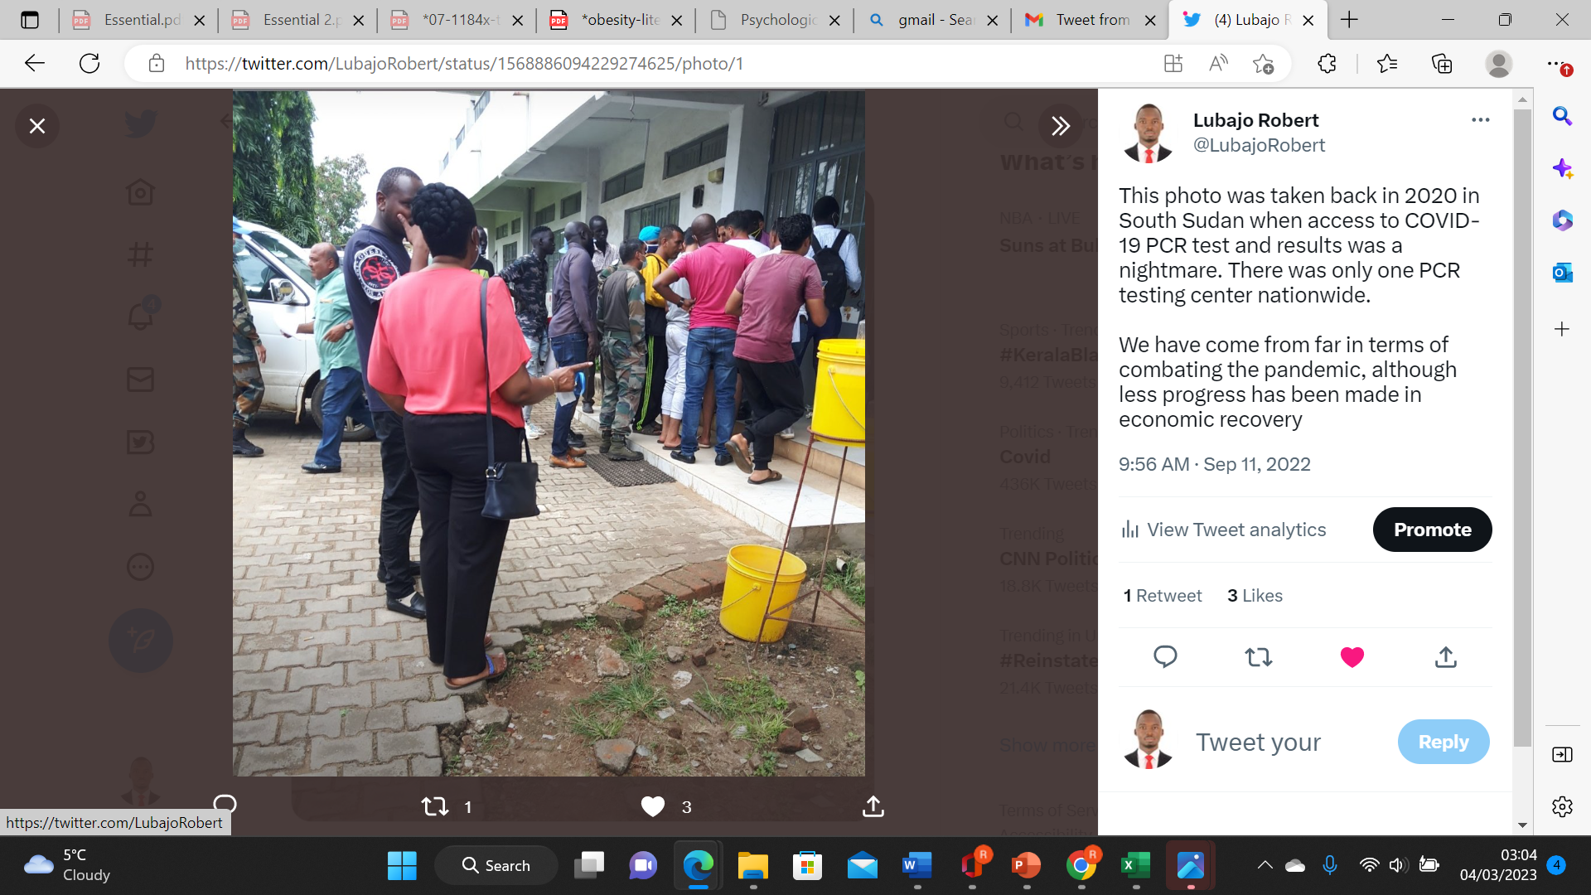
New Challenges
Government suddenly privatised testing in December 2020
Only one lab allowed to do test
Costs $130 for internationals
Mandatory testing at exit or entry
UN not allowed to do its own testing

Slide 10
What next
Negotiation with the private laboratory
Reduce cost to $90 for UN personnel
Sample collection in safe place
Timely results
Successful

Slide 11
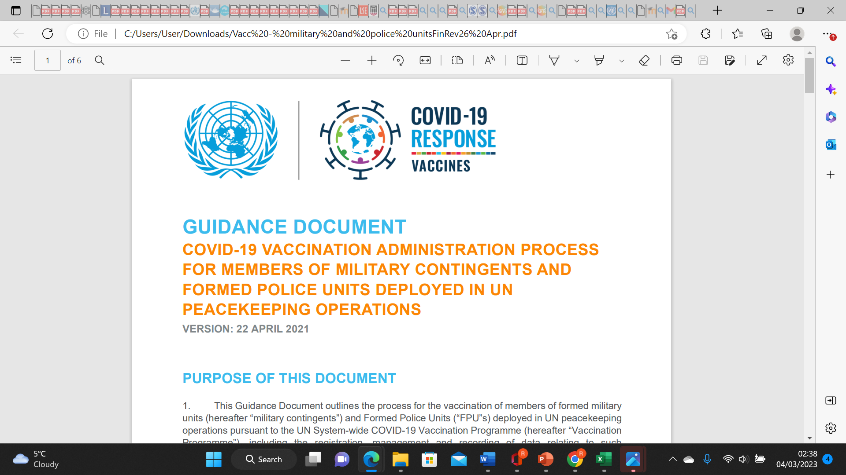
When COVID-19 Vaccine was out

Slide 12
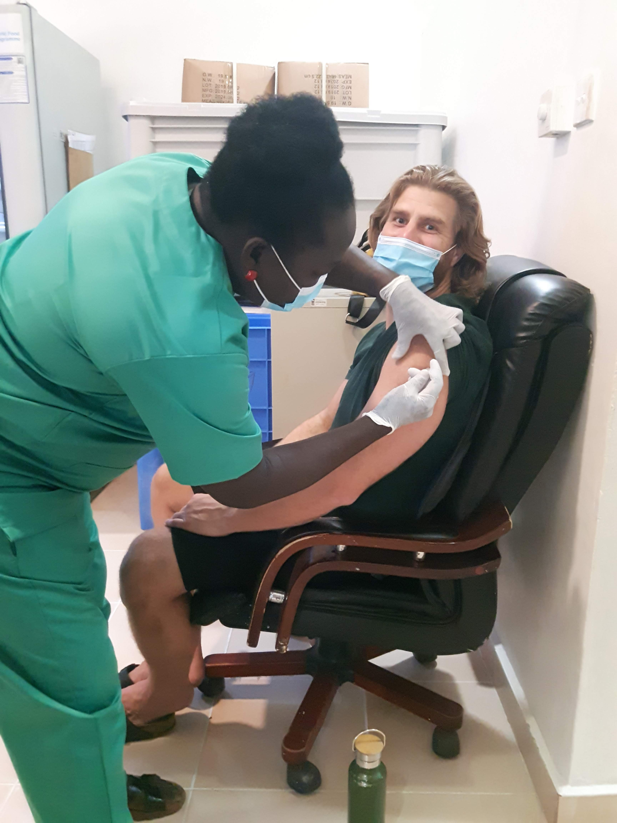
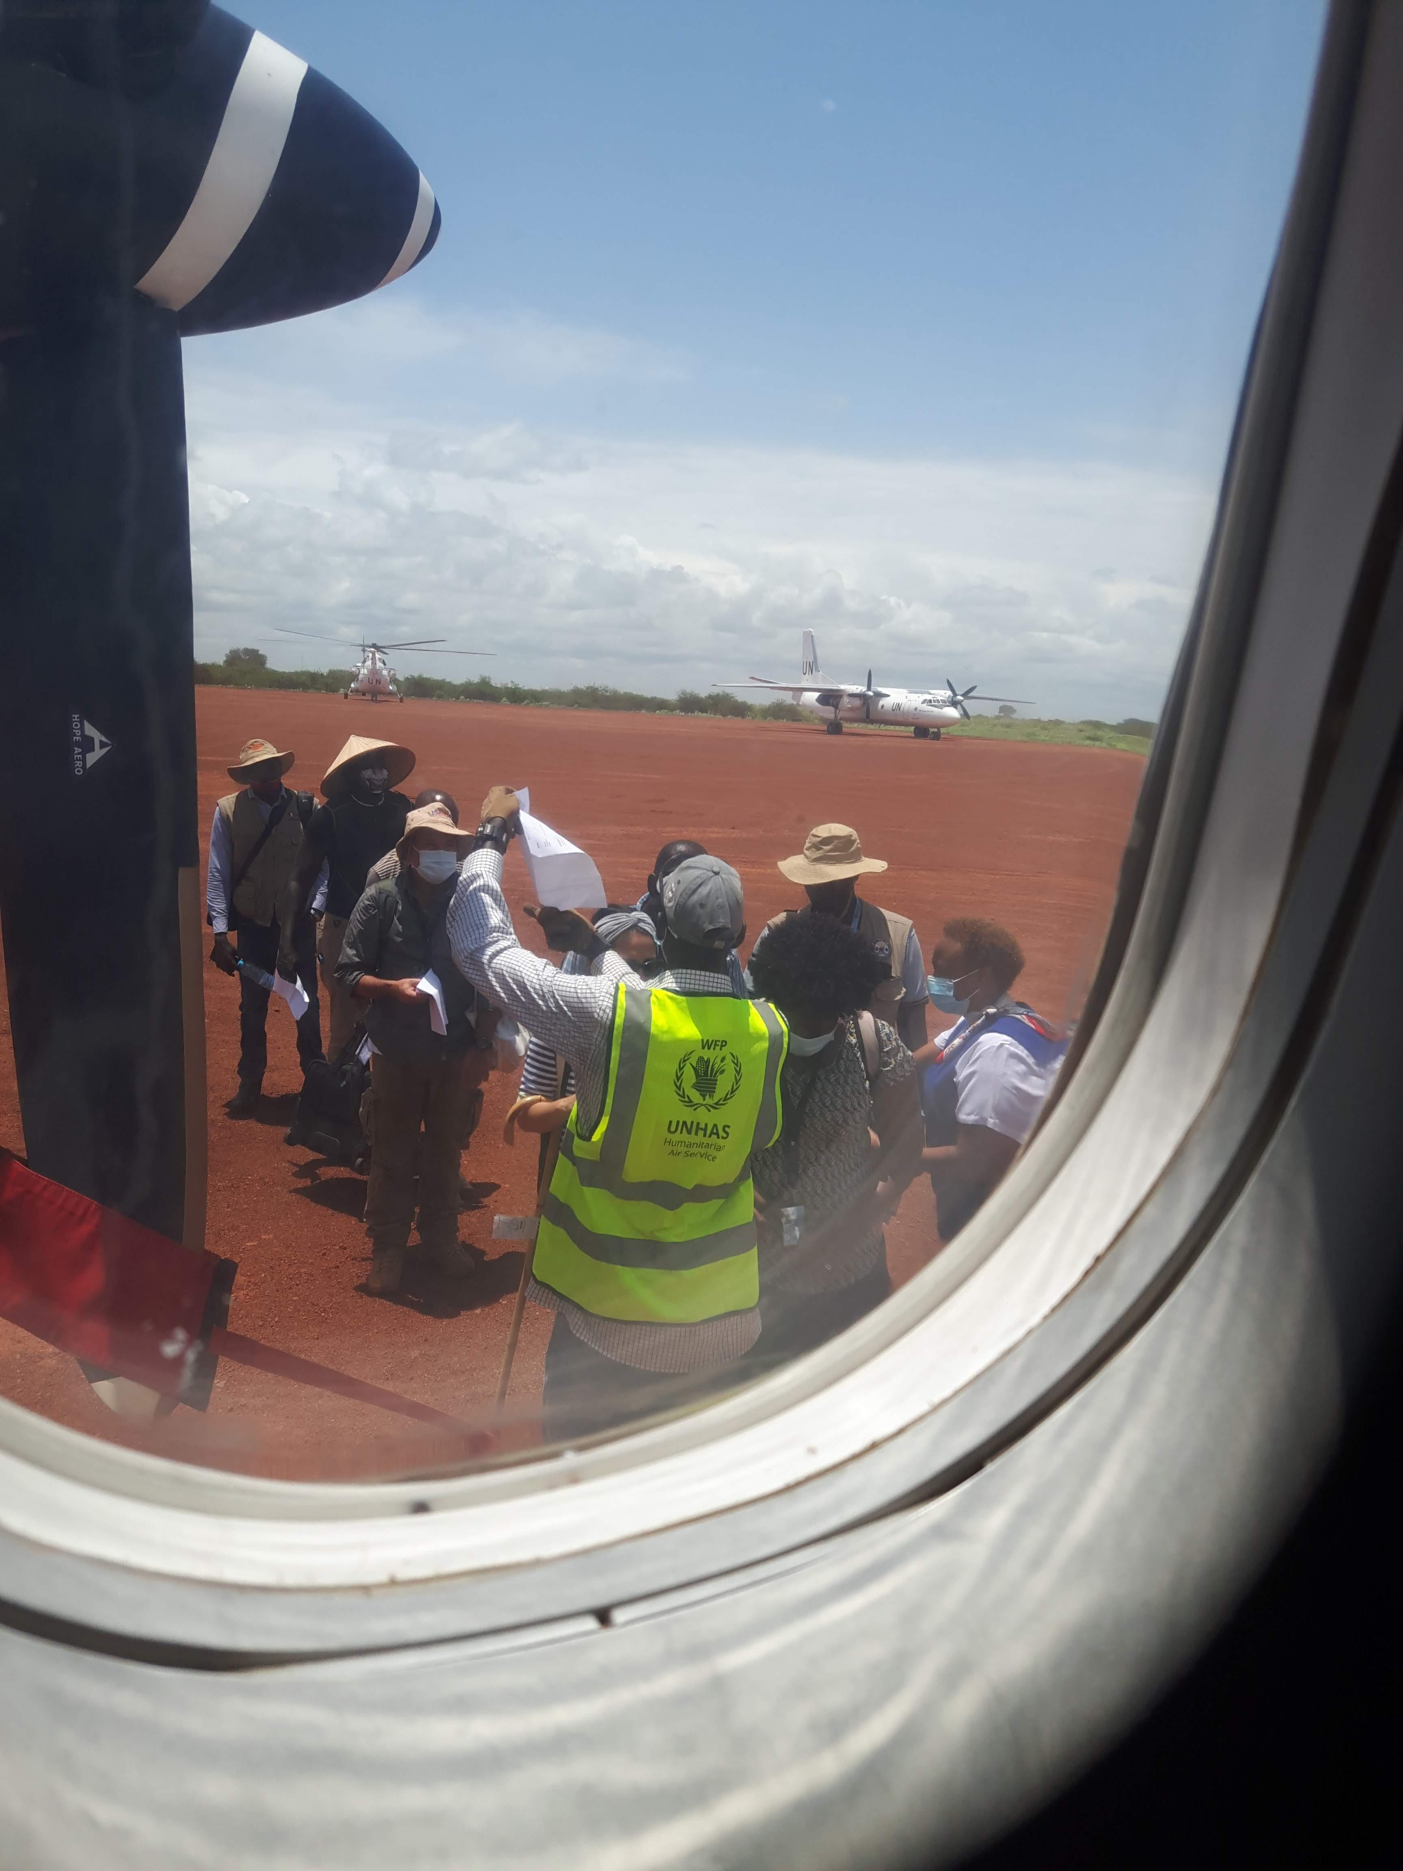
Duty stations with and without UN Clinic

Slide 13
Accomplishments
Improved access to COVID-19 PCR testing
Over 90% COVID-19 vaccination coverage
No adverse reactions
<10 COVID-19 deaths

Slide 14
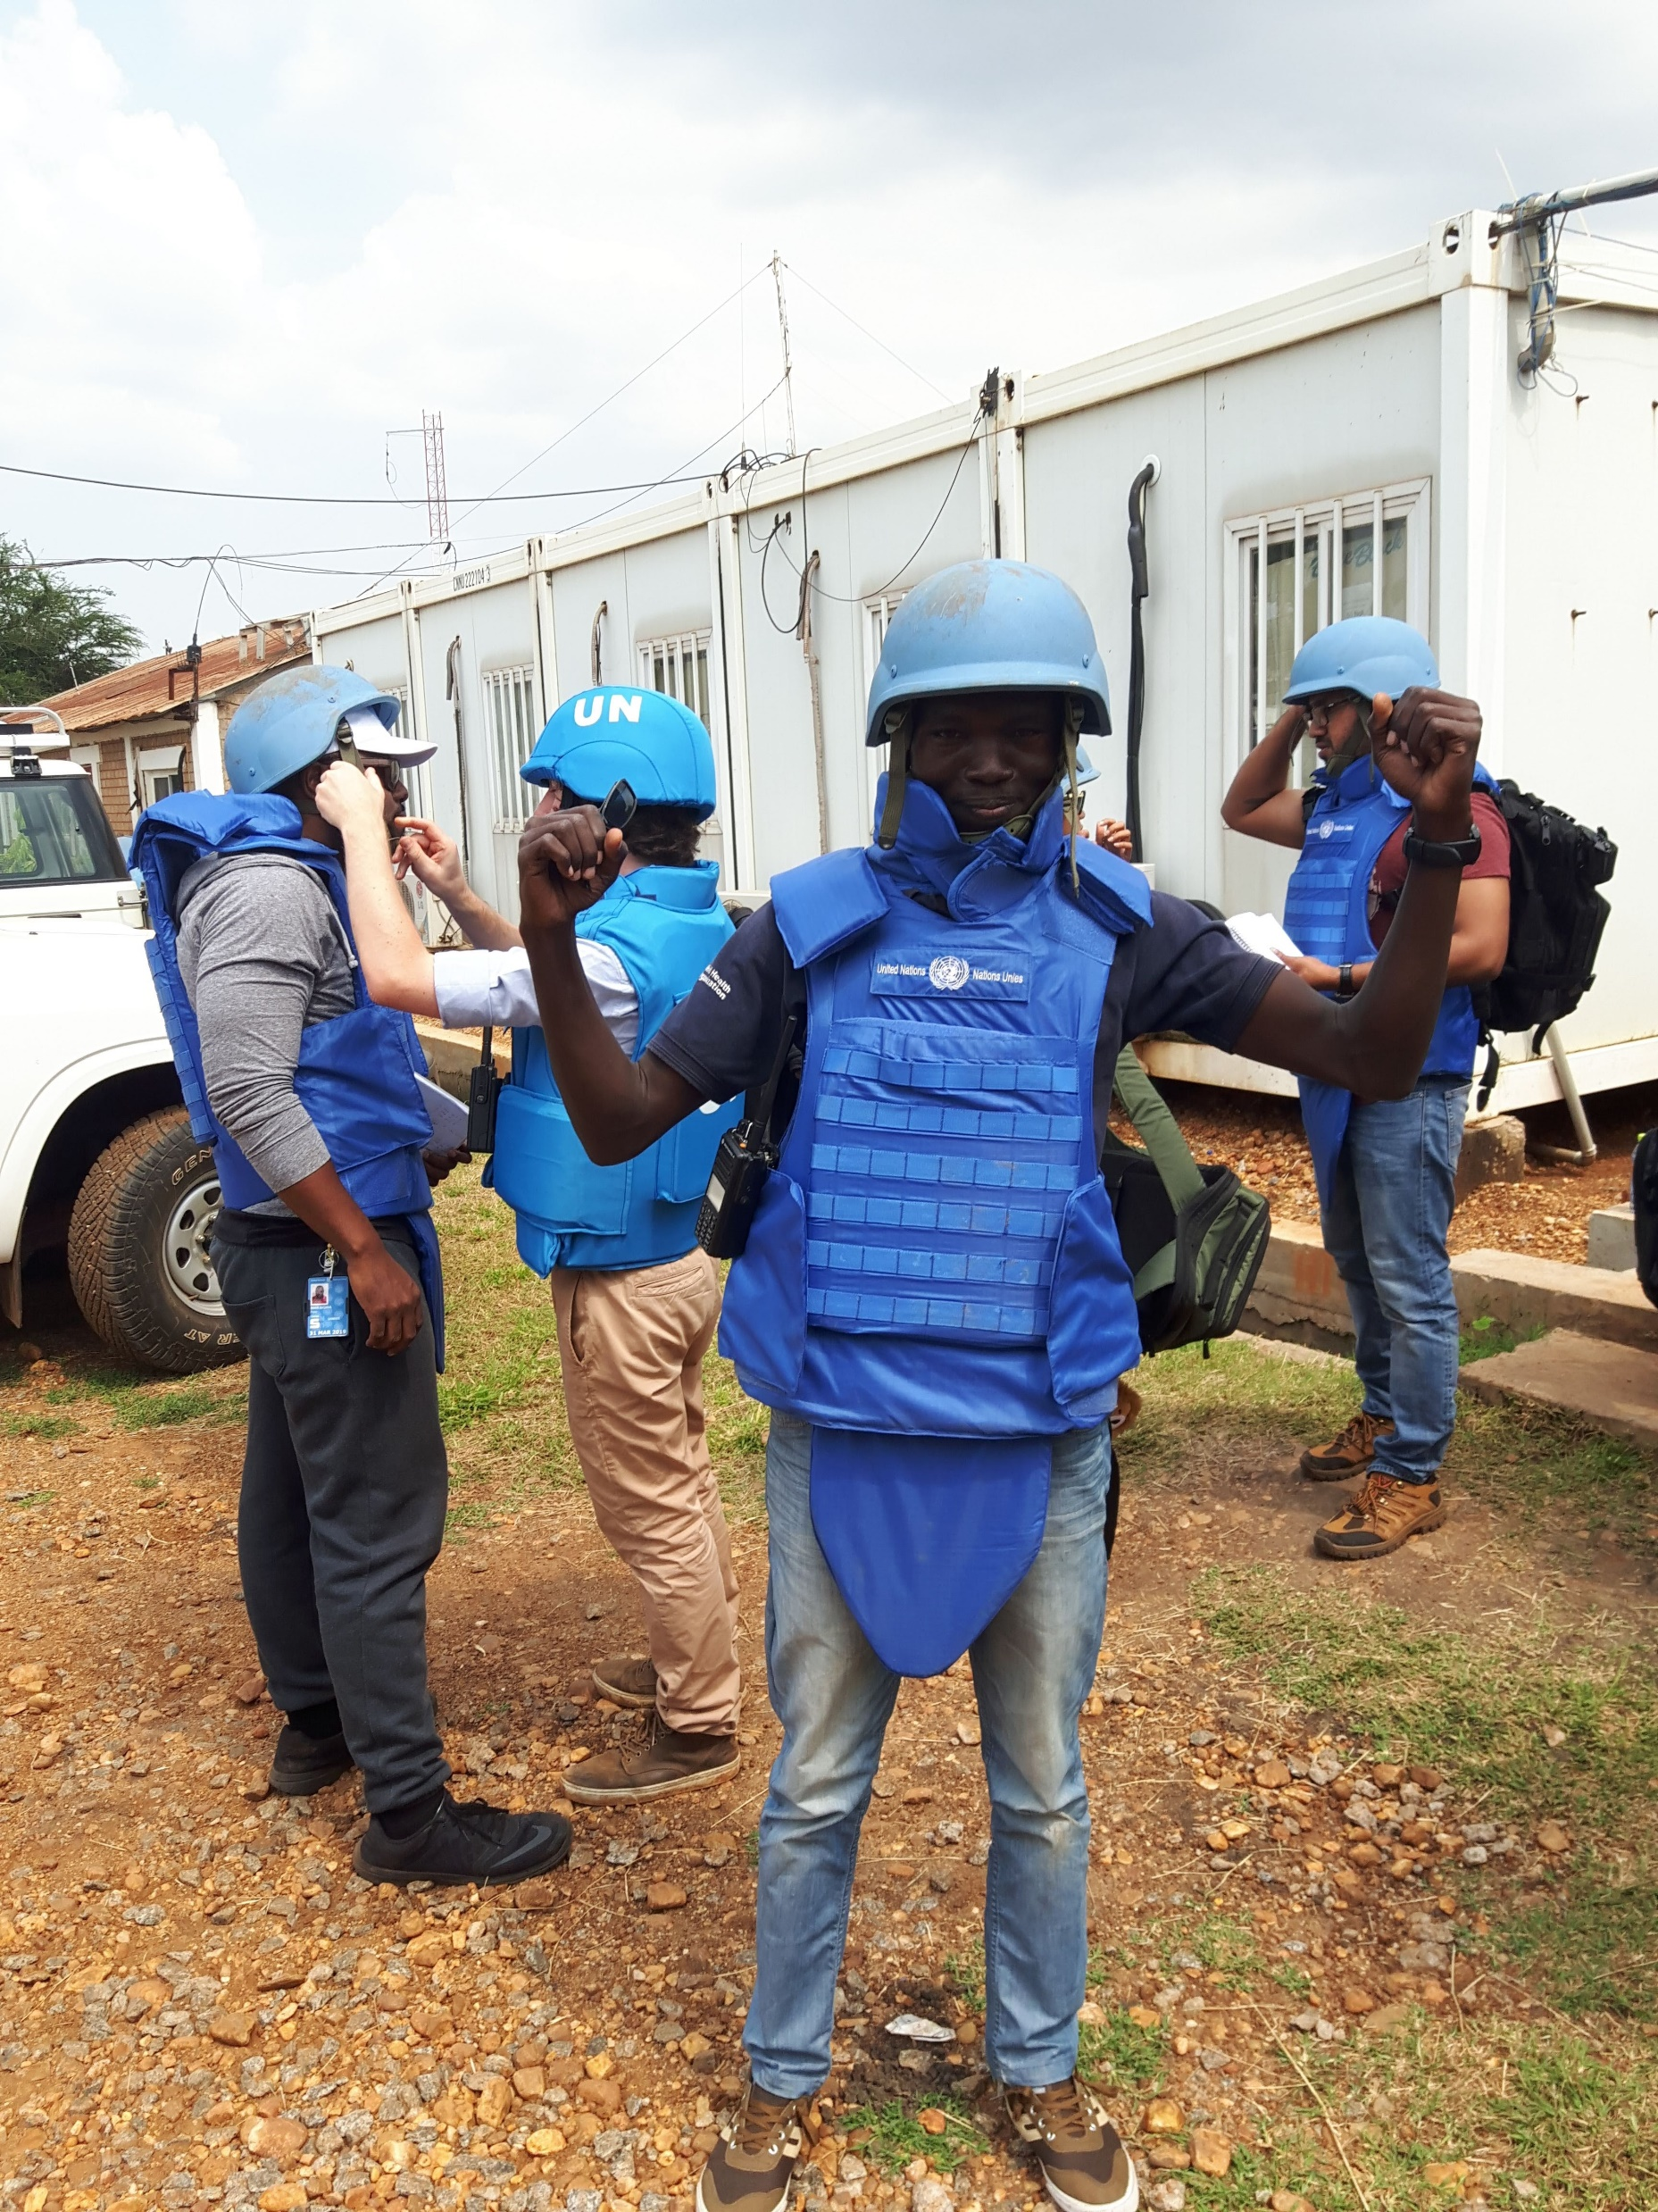
Challenges and opportunities
Opportunities
  Satisfying serving entire UN staff in the country
  Vast networking opportunities
  Briefing UNCT on covid-19 situation
  Professional development
  Good working conditions
Challenges
Job intensity
Dynamic political situation

Slide 15
Personal story
Why a career in public health?
Transition from technical to health policy arena for high impact
Health systems strengthening of ‘post conflict’ South Sudan
Advocate for more national health funding to advance UHC
Why LSHTM?
Prestigious
Networking and collaboration
Increase career prospects

Slide 16
Career Plan
Work with health implementing INGOs/UN at policy level
Work for SSD Ministry of health directorate of health policy
Establish a research and health training institution
Any interesting opportunity that will come my way
Key message
Networking skills will take you places
You need your integrity in those places

Slide 17
Thank You

