Slide 1
Sawyer Patterson
Mpox (monkey pox) Response

Slide 2
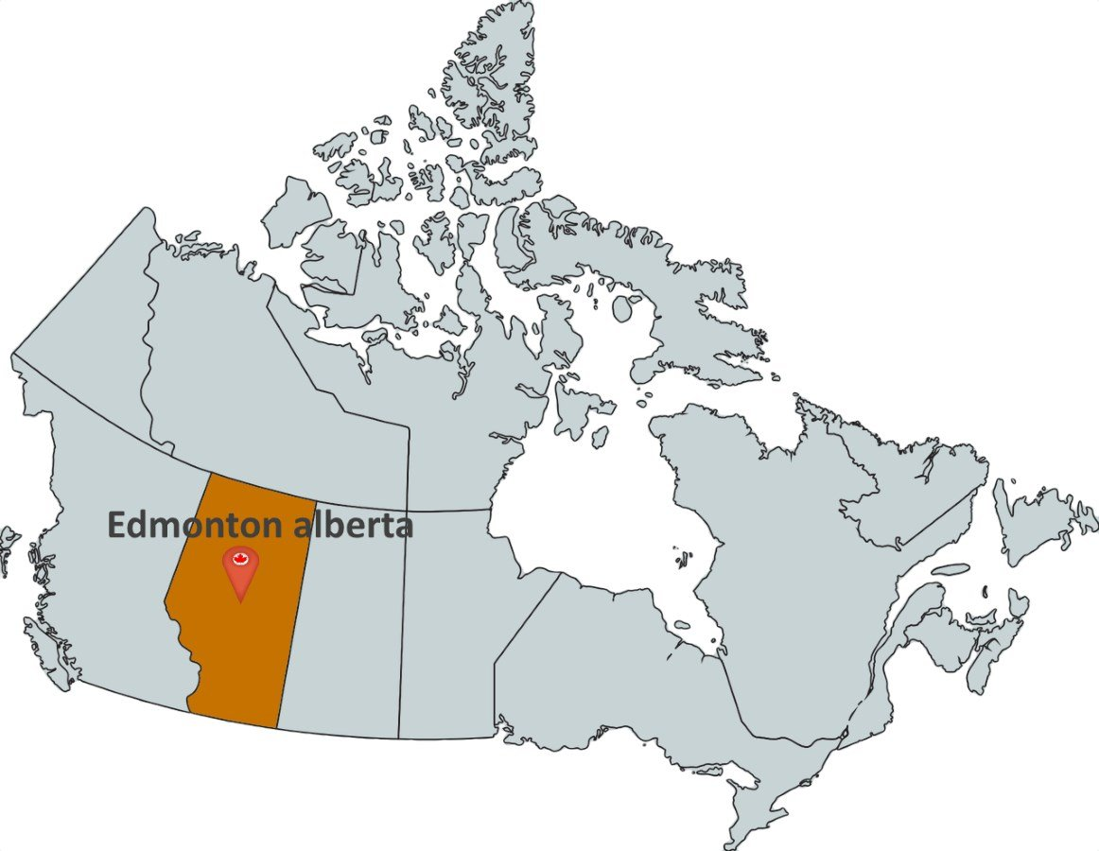

Slide 3
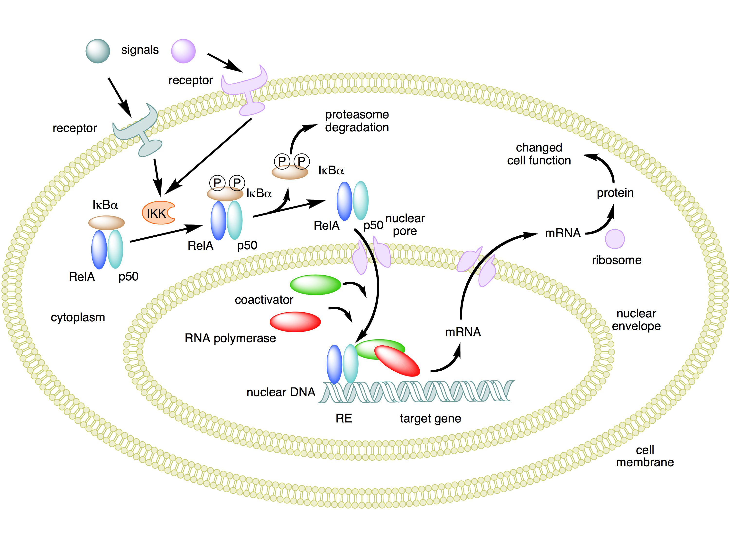
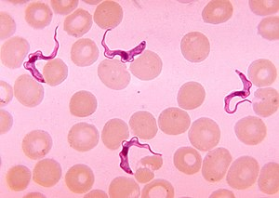
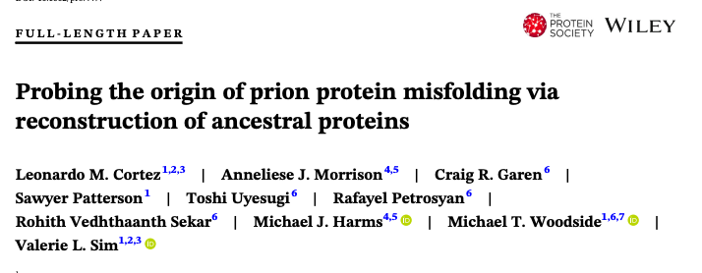

Slide 4
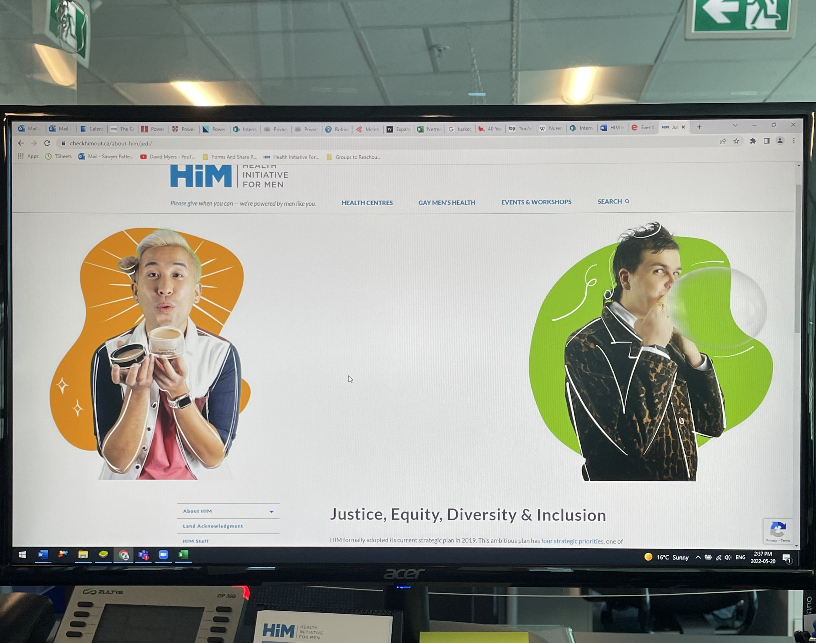

Slide 5
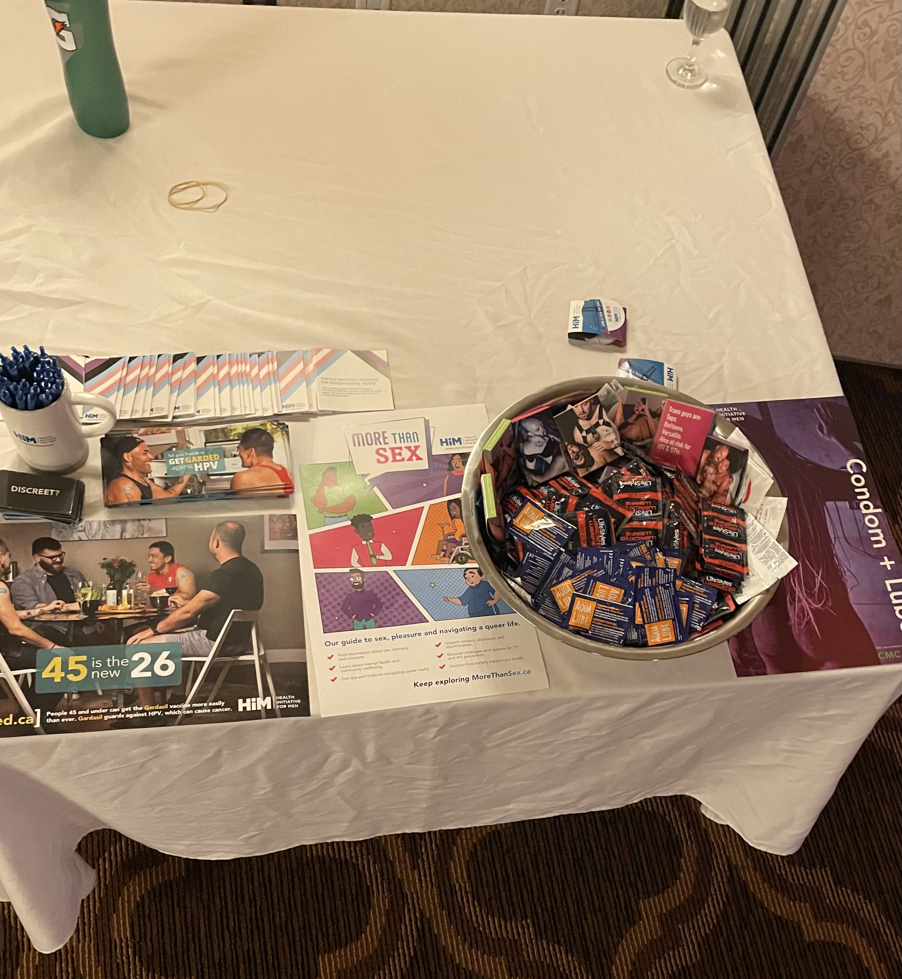
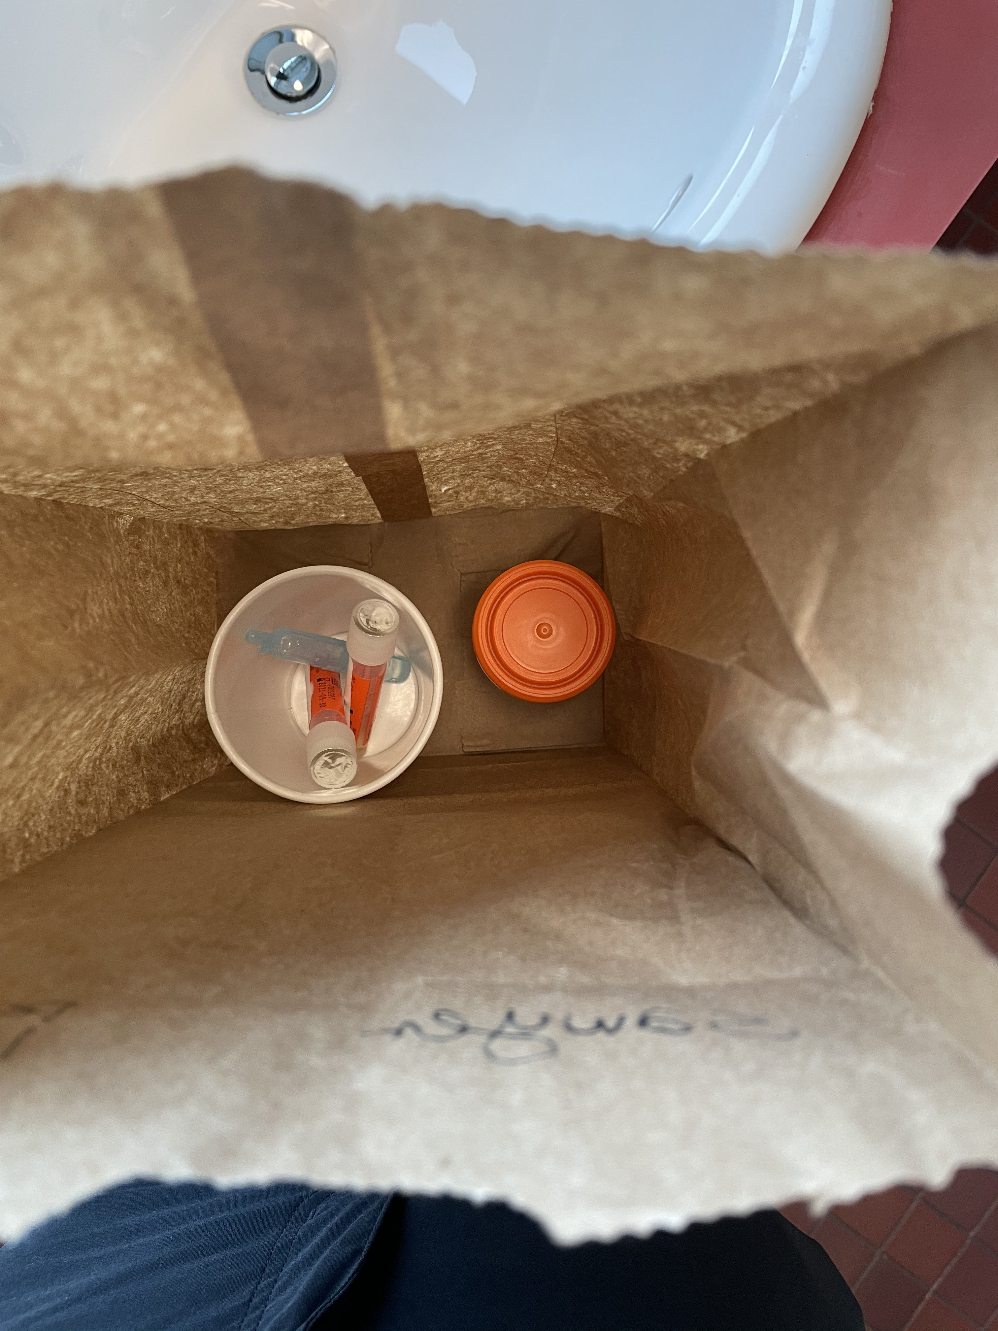

Slide 6
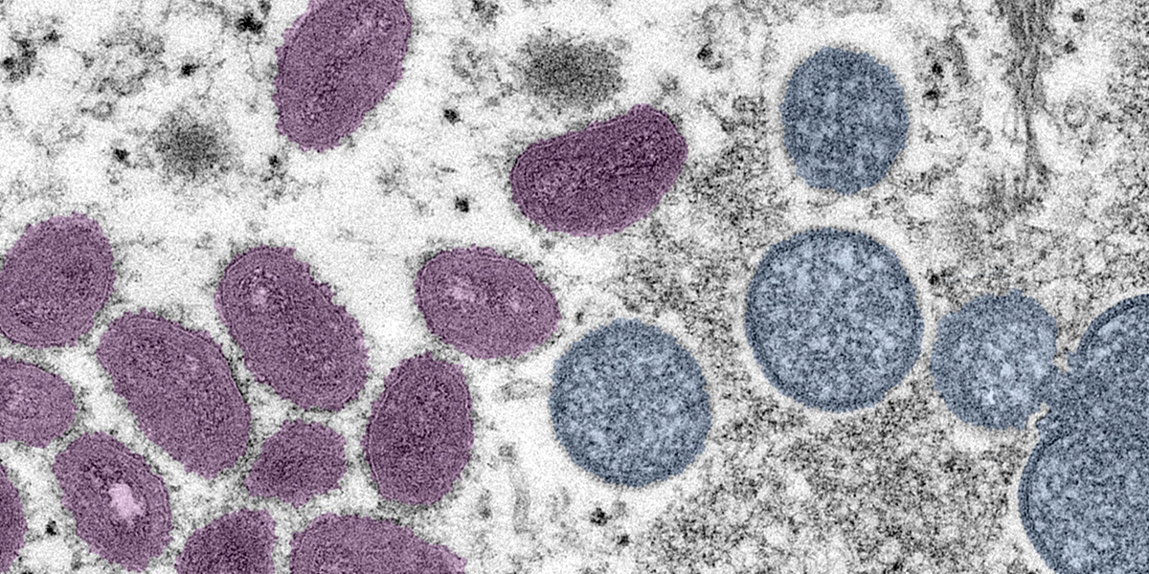

Slide 7
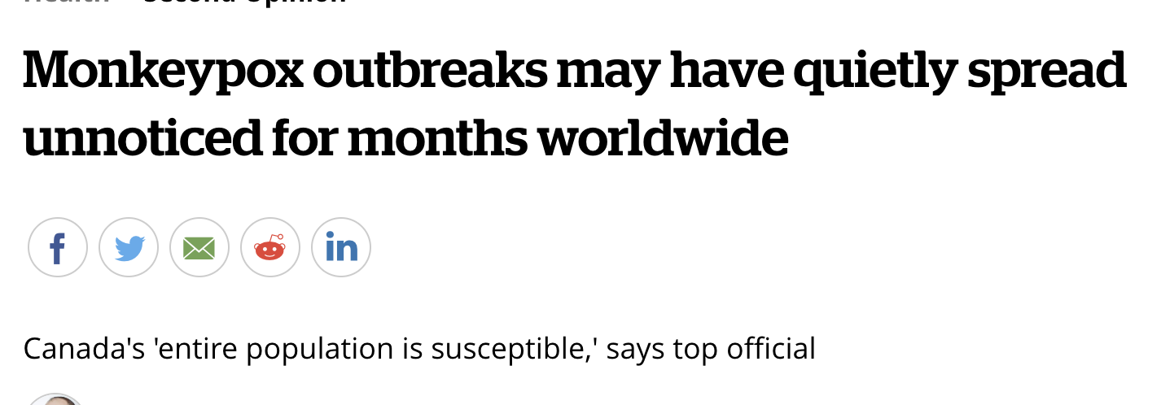
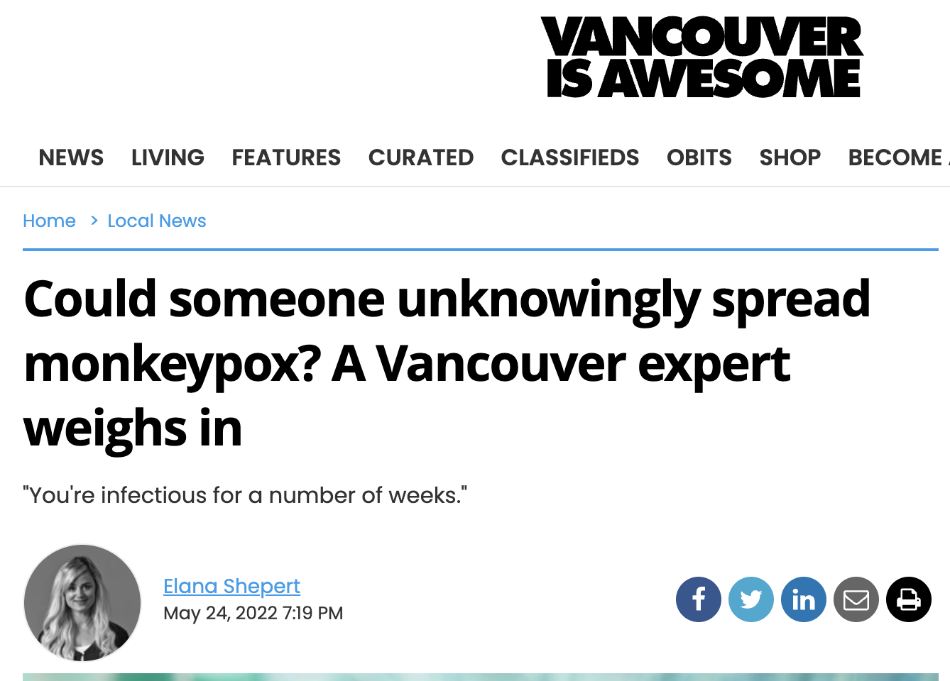

Slide 8
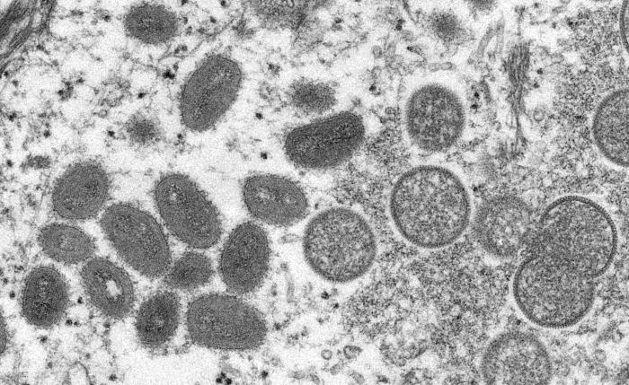
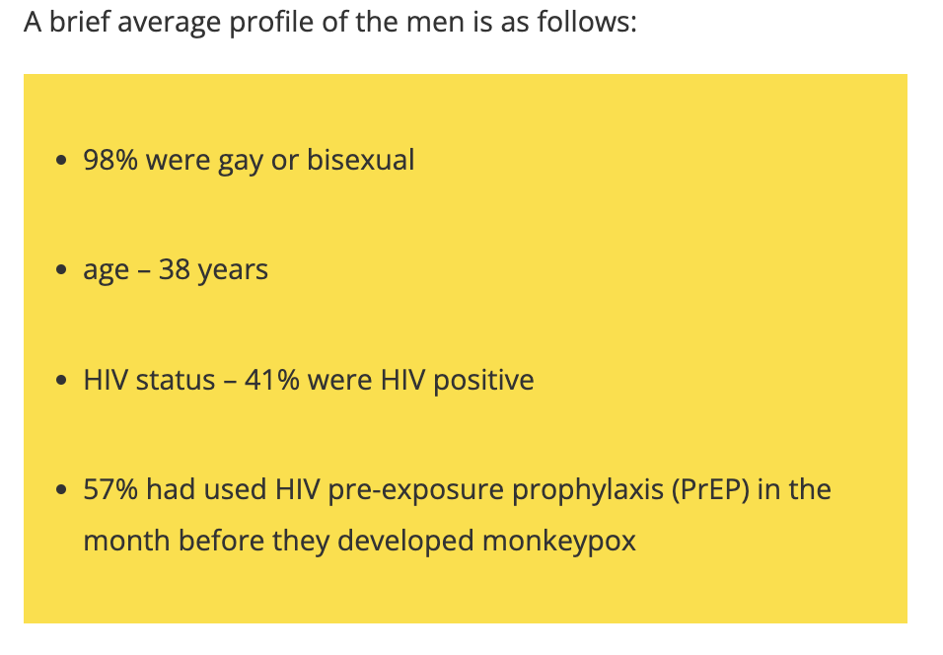

Slide 9
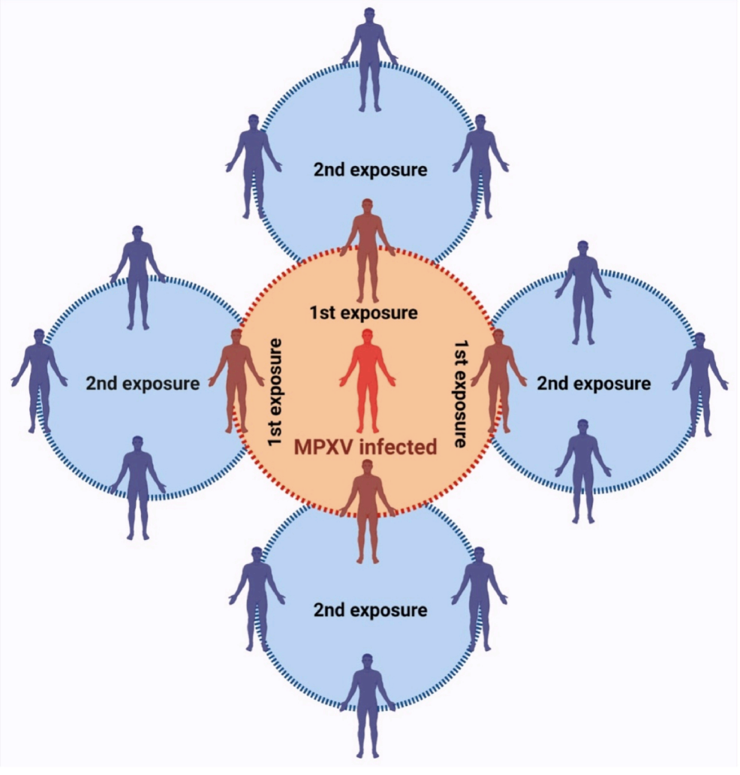
Ring Vaccination Strategy
(Choudhary et al. 2022)

Slide 10
Ring Vaccination Strategy
(Choudhary et al. 2022)

Slide 11
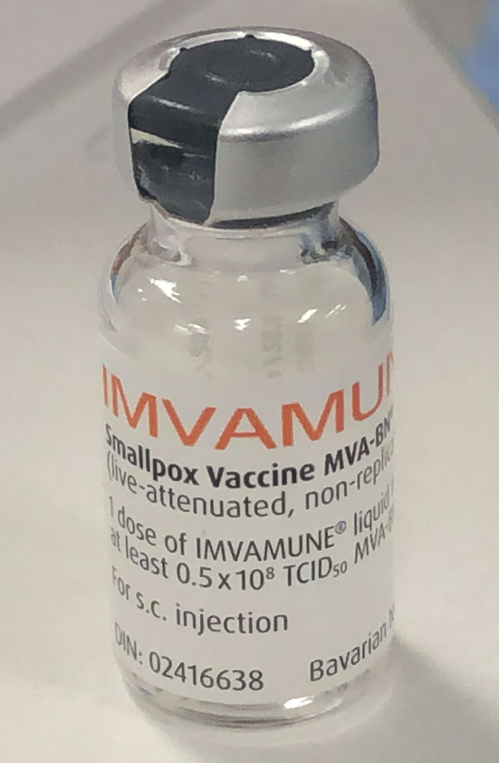
+
Clinicians

Slide 12
+
Clinicians
(Choudhary et al. 2022)

Slide 13
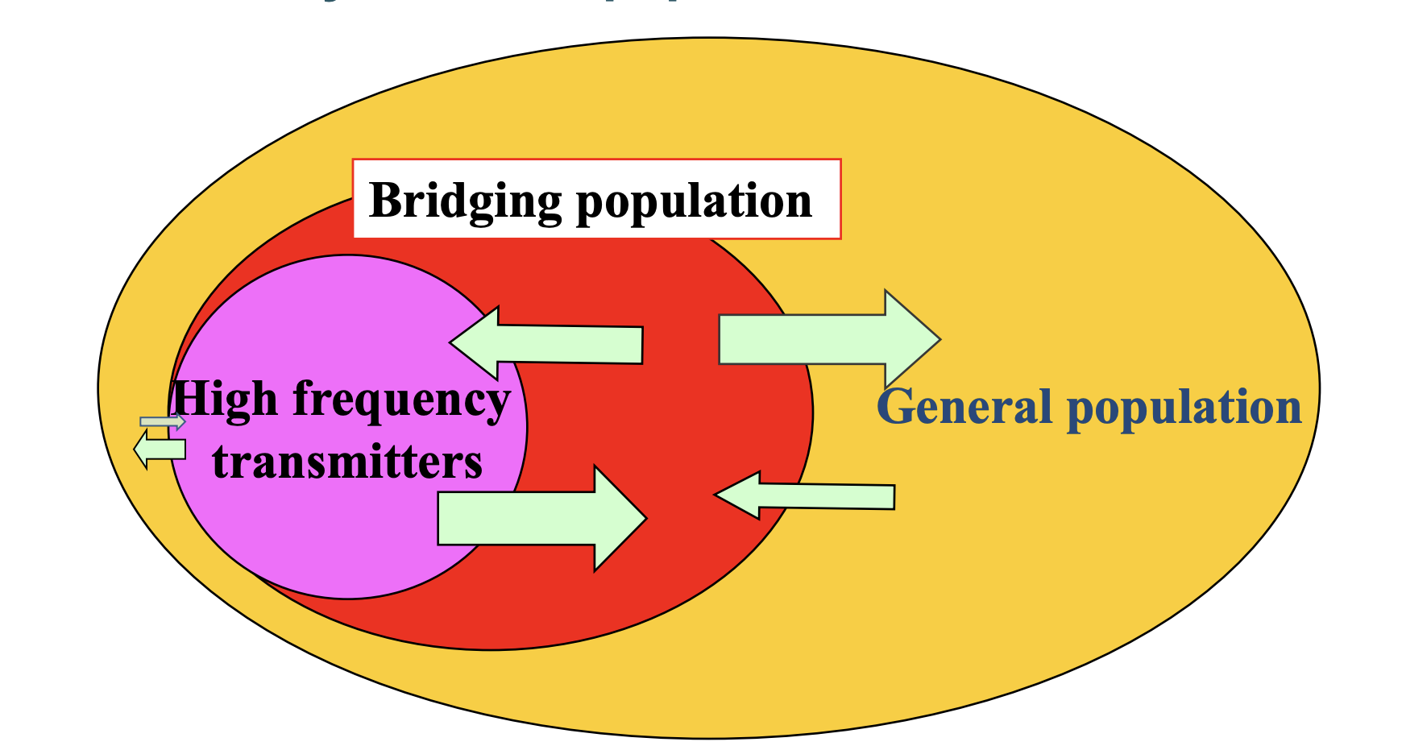
Group Sex Participants
MSM with multiple partners
Cates Jr & Dallabetta, Lancet 2000
Notes:
Core Group Model

Slide 14
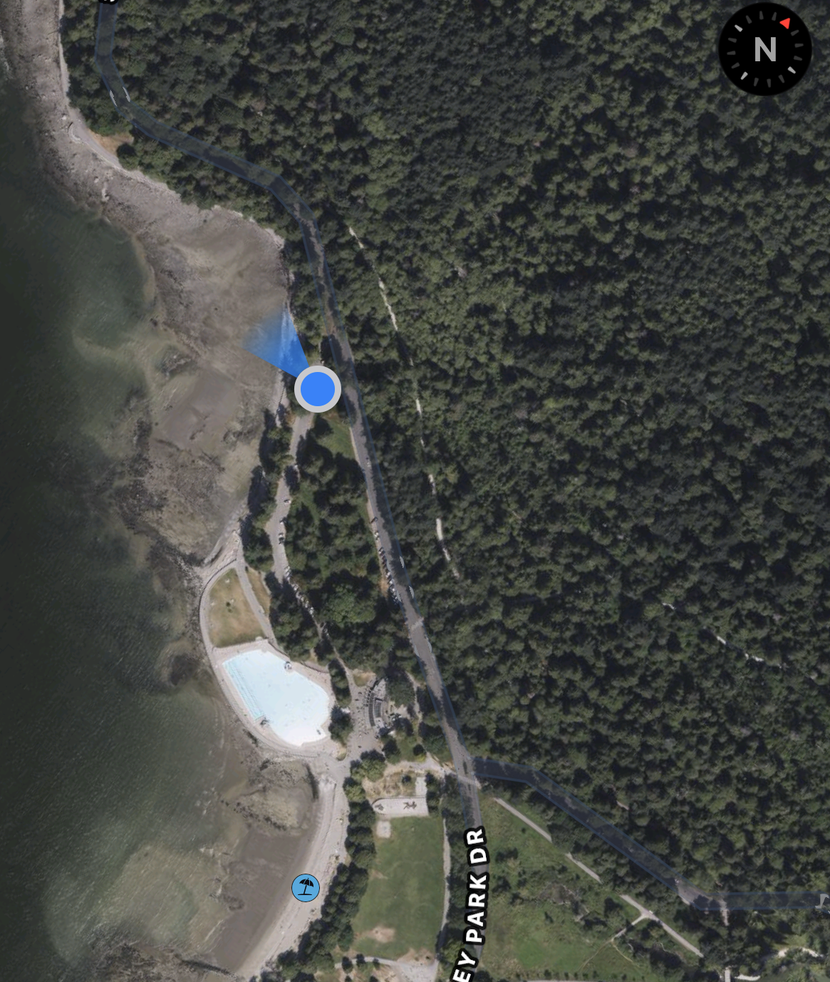

Slide 15
High Transmission Event
Mobile Vaccination Sites

Slide 16
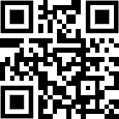
Mpox Vaccines
Scan here for mobile clinic location
Free Mpox vaccines in the park tonight
No questions asked, no ID needed
Exemption from Littering Laws

Slide 17
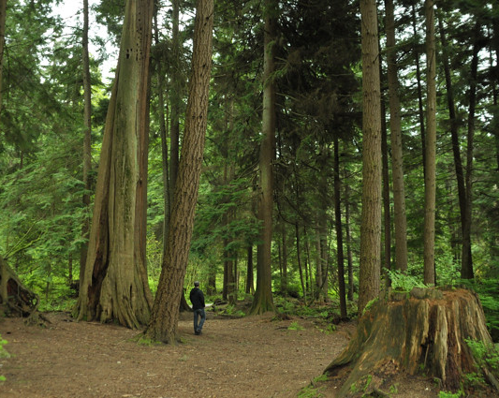
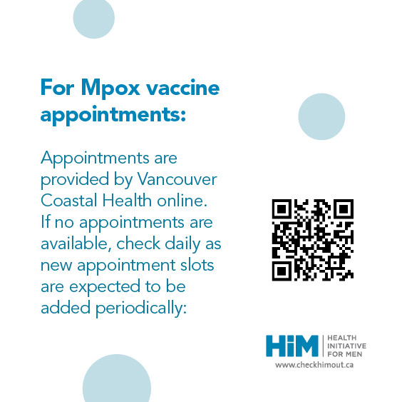
Mpox Vaccines
Scan here for mobile clinic location
Free Mpox vaccines in the park tonight
No questions asked, no ID needed
Exemption from Littering Laws

Slide 18
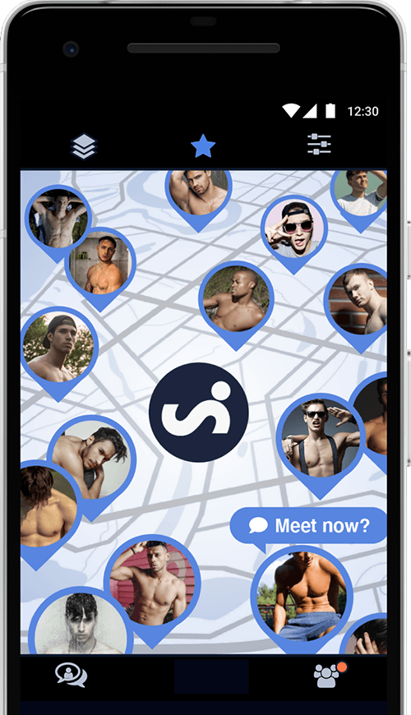
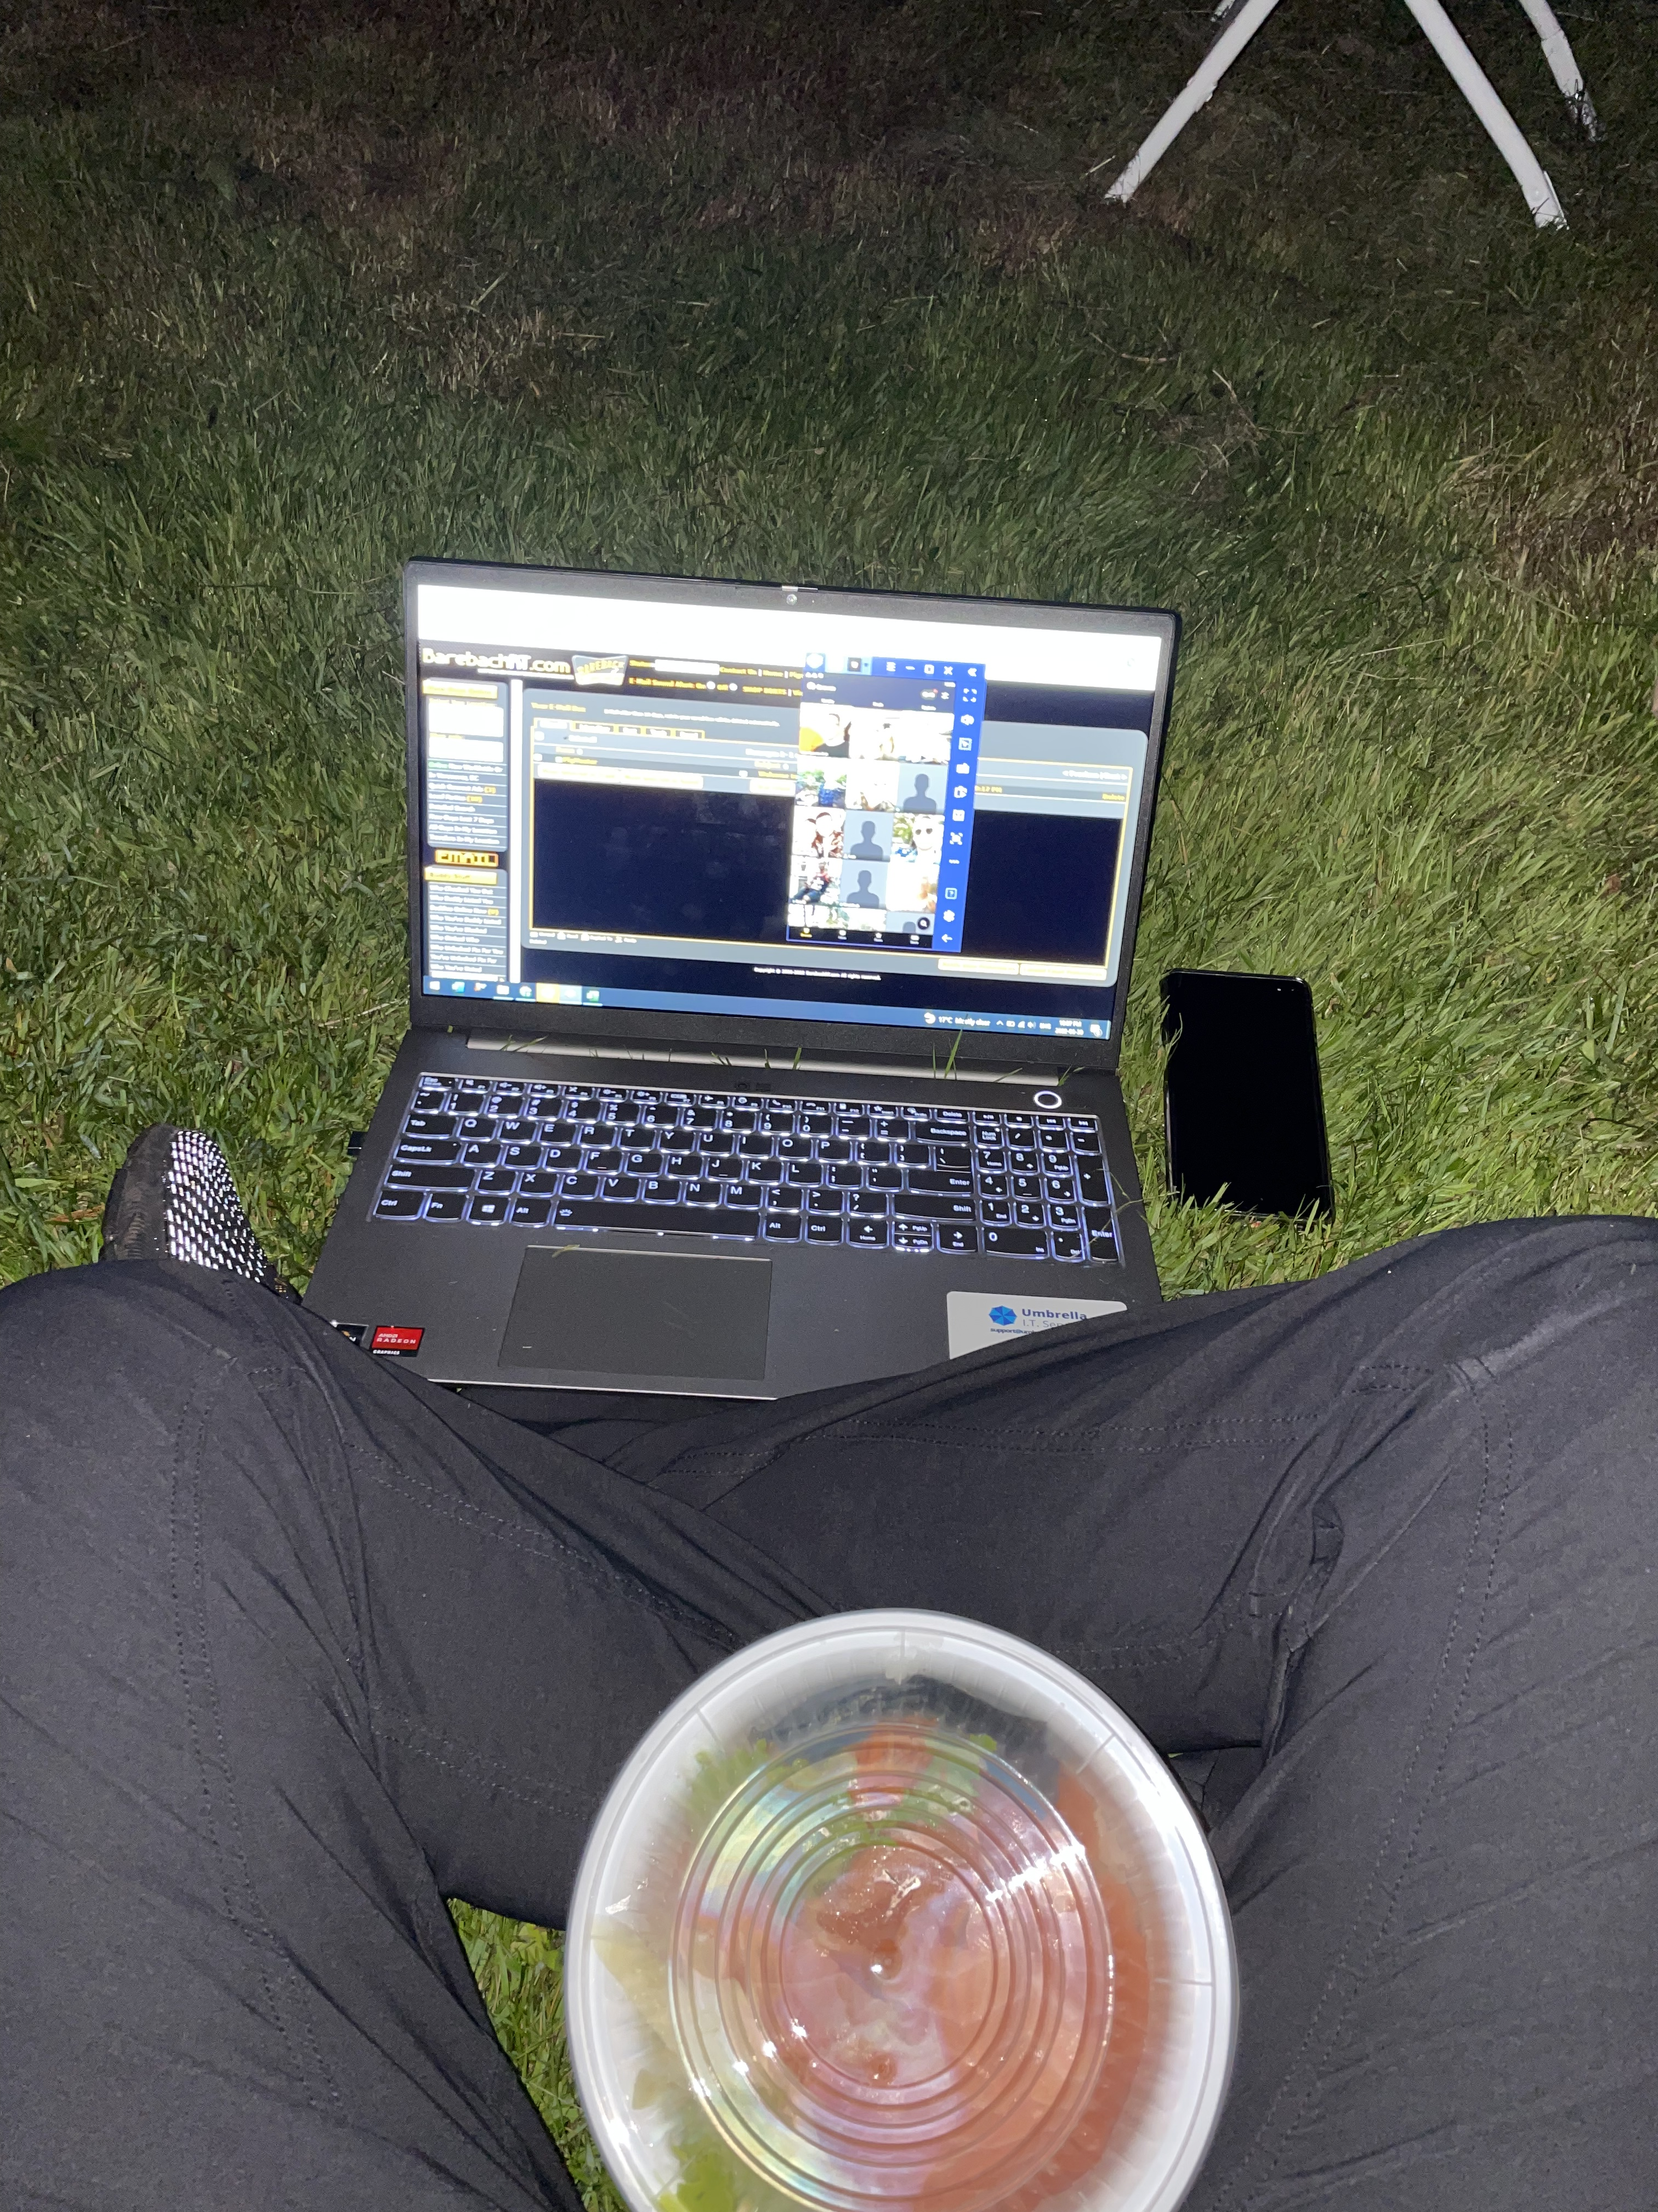
Online “Netreach”

Slide 19
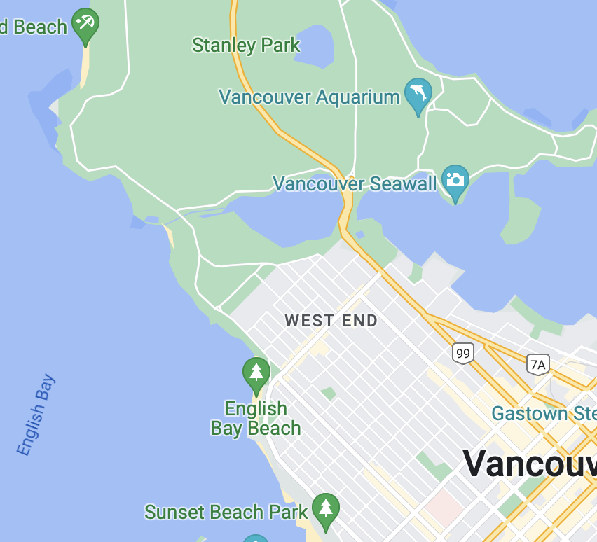
Online “Netreach”

Slide 20
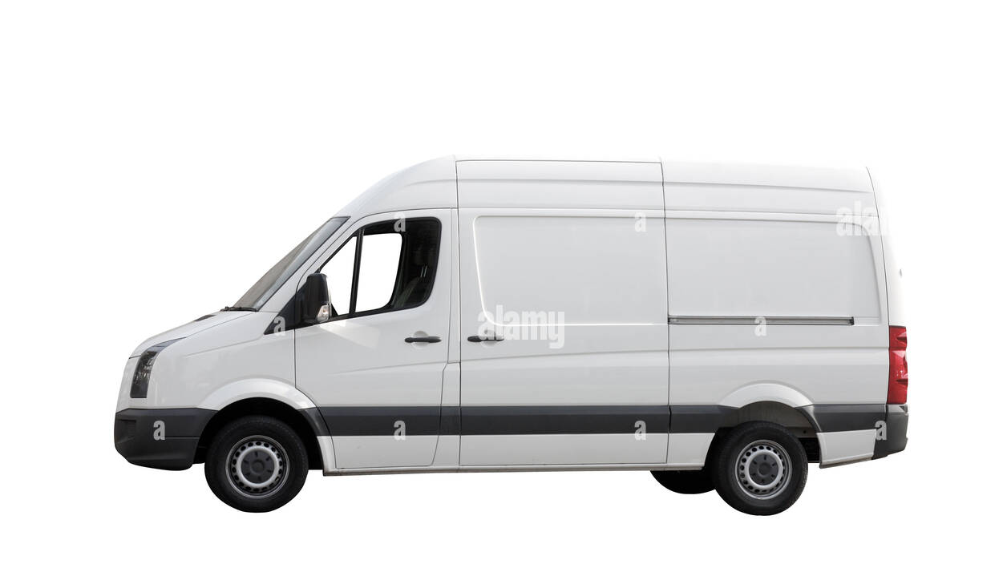

Slide 21
